Slide 1
Extra Curricular at BPS
THE
BADGE CHALLENGE
#DoMoreBeMore

Slide 2
Extra Curricular at BPS
Extra Curricular is important for us to lead a balanced life.
Extra Curricular activities help us develop key skills as well as helping us manage our mental health.
#DoMoreBeMore

Slide 3
Extra Curricular at BPS
We have designed an Extra Curricular programme that you can take part in from home and get rewarded for.
#DoMoreBeMore

Slide 4
Extra Curricular at BPS
Each week, until the end of term, we will set you a challenge based on a Blue Peter Badge.
If you complete the challenge you get the badge!
#DoMoreBeMore

Slide 5
Extra Curricular at BPS
Week 1
The Blue Peter Badge
Week 2
The Green Badge
Week 3
The Music Badge
Week 4
The Sport Badge
#DoMoreBeMore

Slide 6
Extra Curricular at BPS
Where can a Blue Peter Badge take you?
#DoMoreBeMore

Slide 7
Extra Curricular at BPS
WEEK 1: The Blue Peter Badge
Blue badges are awarded for sending in interesting letters, stories, makes, pictures, poems, good ideas for the programme.
#DoMoreBeMore

Slide 8
Extra Curricular at BPS
WEEK 1: The Blue Peter Badge
Things you could do to earn the badge:
Write a poem, story or play
Create a piece of art
Design a new sports kit or stadium
Create your own TV show
Write a review of something you have watched.
#DoMoreBeMore

Slide 9
Extra Curricular at BPS
Things you could do to earn the badge:
Take photos of the accidental alphabet.
#DoMoreBeMore

Slide 10
Extra Curricular at BPS
Things you could do to earn the badge:
Take photos of the accidental alphabet.
#DoMoreBeMore

Slide 11
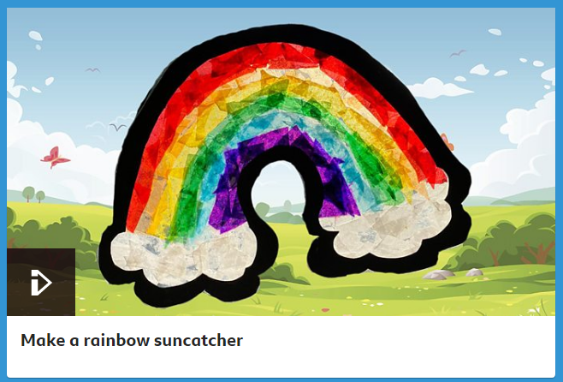
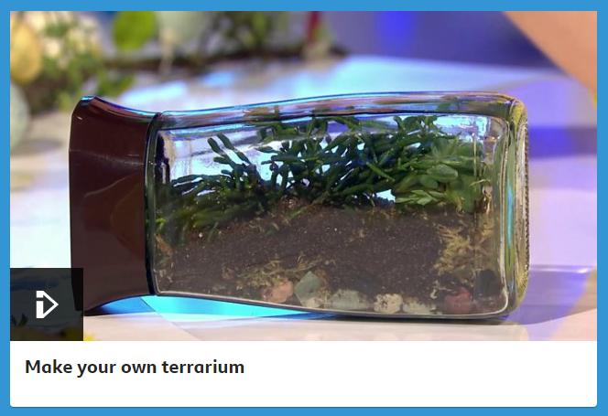
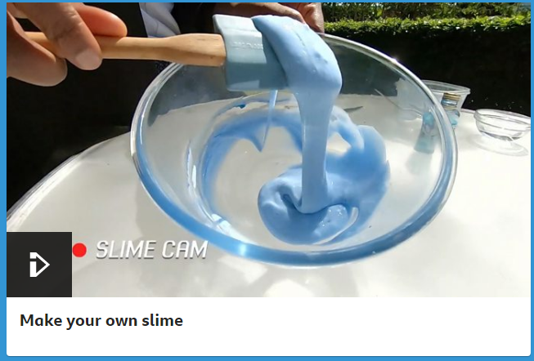
Extra Curricular at BPS
Things you could do to earn the badge:
There is loads of ideas and instructions onL bbc.co.uk/cbbc/curations/bp-arts-and-crafts
#DoMoreBeMore

Slide 12
Extra Curricular at BPS
Once you have completed your challenge email me your entries to:
OSG@birkenheadparkschool.com
I will help you apply for your badge!
#DoMoreBeMore

