Slide 1
Year 9 Remote Learning Programme – Practice for Y10/11 GCSE
AQA Paper 1 and Paper 2 - Question 5
English Language – Narrative and Descriptive Tasks and Viewpoint Writing
All images in this resource have been found on Google and labelled for reuse under the creative commons licence.
Hi Year 9! ☺ Miss King here, hope you are all doing ok! We are all missing you!
In this PowerPoint you will find 2 writing tasks for each week – one from Paper 1 (narrative or description) and the other from Paper 2 (non-fiction)
Don’t forget to use the notes box at the bottom of each slide, they tell you what to include in each piece.
There is also a Tier 2 word for each narrative piece in the notes box for you to include in your writing.
Good luck and rememeber your SPAG!

Slide 2
Week of April 20th Two slides, Two lessons 1. Narrative/description 2. Non-fiction

Slide 3
Paper 1 - Question 5
English Language – Narrative and Descriptive Task
EITHER:
Write a narrative, as suggested by the picture
OR:
Write a description of a time when you enjoyed yourself in a new environment.
Do these!
A range of sentence openers (adverbs, prepositions)
Tier 2 Vocabulary – your best words!
Paragraphs – for new ideas
Keep your tenses consistent
Use a dictionary (or your phone!) to check spellings
DON’T do these!
Start all your sentences with The They He She It
Use the expression – she ‘started to laugh’ – she just ‘laughed’ – you don’t need started.
Use the word ‘got’ too much – try and re-think your sentence so its not needed
Notes:
Use a simile and a ly opener. Use Tier 2 word ecstatic

Slide 4
Paper 2 – Question 5
English Language – Viewpoint writing
“Funding for sports facilities is too low and we don’t have enough leisure centres. It’s no wonder some of them turn to crime and anti-social behaviour.”
Write an article for a local newspaper in which you respond to this statement.
Notes:
Use a headline and emotive words

Slide 5
Week of April 27th Two slides, Two lessons 1. Narrative/description 2. Non-fiction

Slide 6
EITHER:
Write a description of somewhere isolated, as suggested by this picture.
OR:
Write the opening of a story set in an empty or deserted place.
Paper 1 - Question 5
English Language – Narrative and Descriptive Task
Do these!
A range of sentence openers (adverbs, prepositions)
Tier 2 Vocabulary – your best words!
Paragraphs – for new ideas
Keep your tenses consistent
Use a dictionary (or your phone!) to check spellings
DON’T do these!
Start all your sentences with The They He She It
Use the expression – she ‘started to laugh’ – she just ‘laughed’ – you don’t need started.
Use the word ‘got’ too much – try and re-think your sentence so its not needed
Notes:
Try and use a metaphor or two, use adjectives 2ad (adjective adjective noun) use the Tier 2 word - desolate

Slide 7
Paper 2 – Question 5
English Language – Viewpoint writing
“School uniforms are oppressive. They take away freedom of expression”
Write an article for a school magazine, expressing your views on this.
Notes:
use a rhetorical question and repetition and a survey or statistic

Slide 8
Week of May 4th Two slides, Two lessons 1. Narrative/description 2. Non-fiction

Slide 9
Paper 1 - Question 5 English Language – Narrative and Descriptive Task
Do these!
A range of sentence openers (adverbs, prepositions)
Tier 2 Vocabulary – your best words!
Paragraphs – for new ideas
Keep your tenses consistent
Use a dictionary (or your phone!) to check spellings
DON’T do these!
Start all your sentences with The They He She It
Use the expression – she ‘started to laugh’ – she just ‘laughed’ – you don’t need started.
Use the word ‘got’ too much – try and re-think your sentence so its not needed
EITHER:
Write a description of a place in summer, as suggested by the picture
OR:
Write a story about an unusual purchase.
Notes:
Use colour words and similes. Use the Tier 2 word myriad

Slide 10
Paper 2 – Question 5
English Language – Viewpoint writing
“16 year olds are thoughtful, politically aware, and intelligent. They should be given the right to vote.”
Write a persuasive letter to the government, explaining your point of view on this statement.
Notes:
Use opinions and emotive words

Slide 11
Week of May 11th Two slides, Two lessons 1. Narrative/description 2. Non-fiction

Slide 12
Paper 1 - Question 5
English Language – Narrative and Descriptive Task
EITHER:
Write the opening of a story, as suggested by this picture
OR:
Write a story about being separated from someone
Do these!
A range of sentence openers (adverbs, prepositions)
Tier 2 Vocabulary – your best words!
Paragraphs – for new ideas
Keep your tenses consistent
Use a dictionary (or your phone!) to check spellings
DON’T do these!
Start all your sentences with The They He She It
Use the expression – she ‘started to laugh’ – she just ‘laughed’ – you don’t need started.
Use the word ‘got’ too much – try and re-think your sentence so its not needed
Notes:
Use personification (if you can) use interesting adjectives – use the Tier 2 word isolated

Slide 13
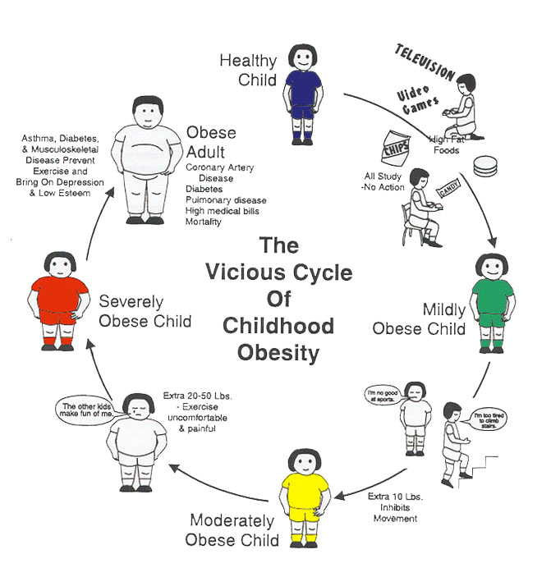
Paper 2 – Question 5
English Language – Viewpoint writing
“We have an obesity crisis in the UK. Daily sport should be compulsory for all children between the ages of 4 and 16”
Write a letter to your headteacher to argue the case for or against this statement.
Notes:
Use two addresses and paragraphs. Use the emotive Tier 2 word drastic

Slide 14
Week of May 18th Two slides, Two lessons 1. Narrative/description 2. Non-fiction

Slide 15
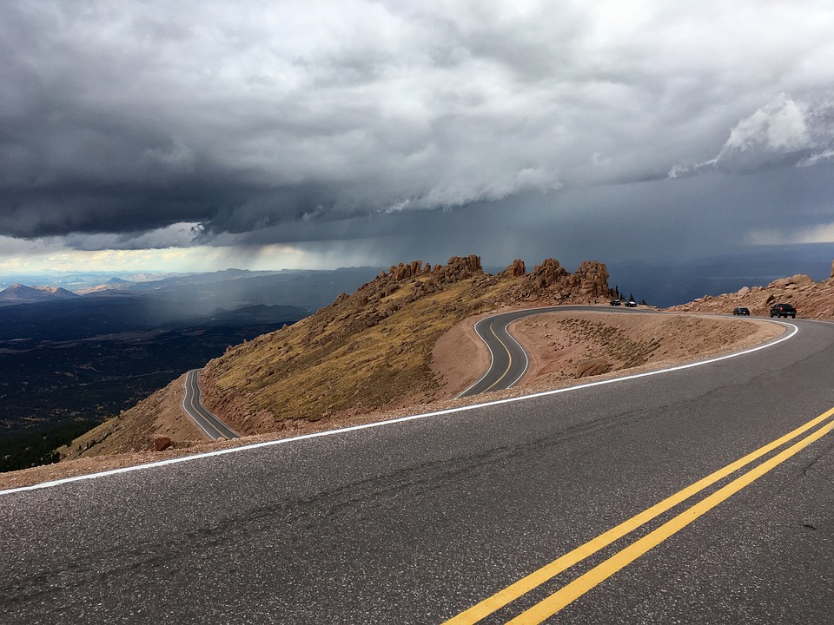
Do these!
A range of sentence openers (adverbs, prepositions)
Tier 2 Vocabulary – your best words!
Paragraphs – for new ideas
Keep your tenses consistent
Use a dictionary (or your phone!) to check spellings
DON’T do these!
Start all your sentences with The They He She It
Use the expression – she ‘started to laugh’ – she just ‘laughed’ – you don’t need started.
Use the word ‘got’ too much – try and re-think your sentence so its not needed
Paper 1 - Question 5
English Language – Narrative and Descriptive Task
EITHER:
Write a narrative set on the road, as suggested by this picture
OR:
Write a narrative about a personal journey
Notes:
Use alliteration and a sentence with commas Use the Tier 2 word never-ending

Slide 16
Paper 2 – Question 5
English Language – Viewpoint writing
“Smokers should not be given treatment on the NHS. It’s a choice to smoke so we should not pay for their treatment”
Write an article for a newspaper in which you explain your point of view on this statement.
Notes:
Write an article – use a headline, emotive words and a quote from a doctor about smoking

Slide 17
Half-term

Slide 18
Week of June 1st Two slides, Two lessons 1. Narrative/description 2. Non-fiction

Slide 19
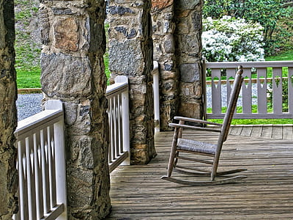
Paper 1 - Question 5
English Language – Narrative Descriptive Task
EITHER:
Write a description of a home, as suggested by this picture.
OR:
Write a narrative about missing somebody
Do these!
A range of sentence openers (adverbs, prepositions)
Tier 2 Vocabulary – your best words!
Paragraphs – for new ideas
Keep your tenses consistent
Use a dictionary (or your phone!) to check spellings
DON’T do these!
Start all your sentences with The They He She It
Use the expression – she ‘started to laugh’ – she just ‘laughed’ – you don’t need started.
Use the word ‘got’ too much – try and re-think your sentence so its not needed
Notes:
Use emotive adjectives, add details, use a short sentence Use the Tier 2 word eerie

Slide 20
Paper 2 – Question 5
English Language – Viewpoint writing
“Social media is causing cyber-bullying and triggering screen-addiction in young people. It needs to be limited by the government”
Write a newspaper article for an online news site in which you explain your opinion on this statement.
Notes:
Use emotive words, use a quote from a teenager, use a rhetorical question

Slide 21
Week of June 8th Two slides, Two lessons 1. Narrative/description 2. Non-fiction

Slide 22
Paper 1 - Question 5 English Language – Narrative and Descriptive Task
EITHER:
Write a description of fans at a sporting event, as suggested by the picture
OR:
Write the opening of a story about a competition
Do these!
A range of sentence openers (adverbs, prepositions)
Tier 2 Vocabulary – your best words!
Paragraphs – for new ideas
Keep your tenses consistent
Use a dictionary (or your phone!) to check spellings
DON’T do these!
Start all your sentences with The They He She It
Use the expression – she ‘started to laugh’ – she just ‘laughed’ – you don’t need started.
Use the word ‘got’ too much – try and re-think your sentence so its not needed
Notes:
Use three verbs together – e.g.. cheering, clapping, singing, use a simile Use the Tier 2 word cacophony

Slide 23
Paper 2 – Question 5
English Language – Viewpoint writing
“Mental health is the biggest barrier to educational success. Teenagers who are stressed and anxious cannot learn as well as those who are not”
Write a letter to students in the year group below you, giving advice on how to cope with the pressures of examinations.
Notes:
You don’t need an address – think of it like an email, Use Words associated with Mental Health (use the background picture) Use paragraphs, Use emotive language

Slide 24
Week of June 15th Two slides, Two lessons 1. Narrative/description 2. Non-fiction

Slide 25
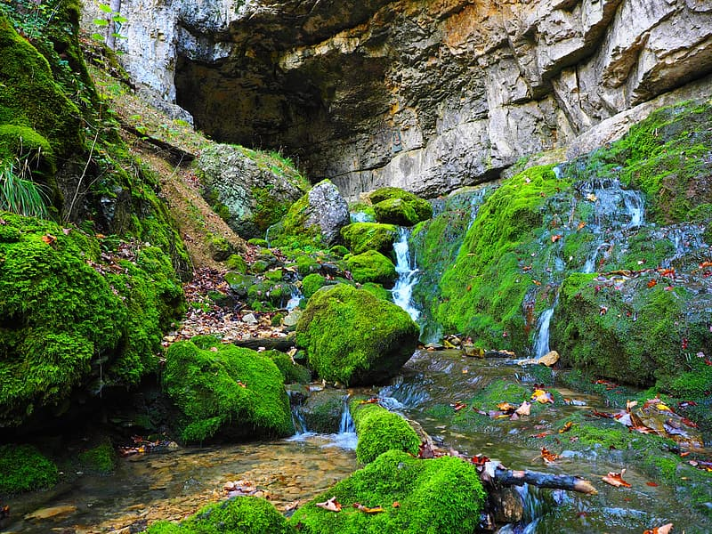
Do these!
A range of sentence openers (adverbs, prepositions)
Tier 2 Vocabulary – your best words!
Paragraphs – for new ideas
Keep your tenses consistent
Use a dictionary (or your phone!) to check spellings
DON’T do these!
Start all your sentences with The They He She It
Use the expression – she ‘started to laugh’ – she just ‘laughed’ – you don’t need started.
Use the word ‘got’ too much – try and re-think your sentence so its not needed
Paper 1 - Question 5
English Language – Narrative and Descriptive Task
EITHER:
Write a description of a stream, as suggested by the picture
OR:
Write the opening of a story about discovering somewhere new
Notes:
– Use sounds to describe the water, use a simile, use personification(if you can) use interesting adjectives Use the Tier 2 word meander

Slide 26
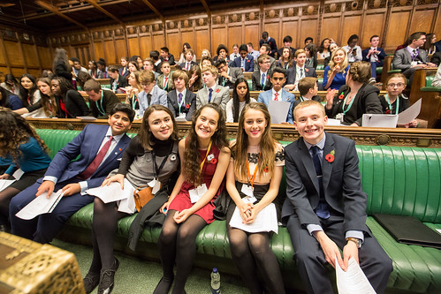
Paper 2 – Question 5
English Language – Viewpoint writing
“Politicians don’t listen to teenagers. We should have teenage MPs represented in the Houses of Parliament”
Write an article for a magazine where you explain your views on this statement.
Notes:
Use clear opinions and reasons, use repetition, alliteration, emotive words

Slide 27
Week of June 22nd Two slides, Two lessons 1. Narrative/description 2. Non-fiction

Slide 28
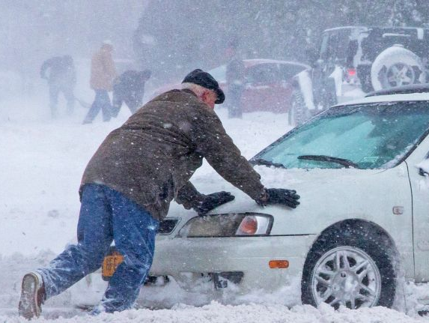
Paper 1 - Question 5 - English Language – Narrative and Descriptive Task
EITHER:
Write a story about a terrible storm
OR:
Write a description of a place experiencing extreme weather conditions.
Do these!
A range of sentence openers (adverbs, prepositions)
Tier 2 Vocabulary – your best words!
Paragraphs – for new ideas
Keep your tenses consistent
Use a dictionary (or your phone!) to check spellings
DON’T do these!
Start all your sentences with The They He She It
Use the expression – she ‘started to laugh’ – she just ‘laughed’ – you don’t need started.
Use the word ‘got’ too much – try and re-think your sentence so its not needed
Notes:
Use alliteration, use a one word paragraph, use a list of verbs – Use the Tier 2 word - catastrophic

Slide 29
Paper 2 – Question 5
English Language – Viewpoint writing
“Writing things by hand is old-fashioned. We should have computers for all our lessons and not be judged on our handwriting”
Write a letter to your Headteacher in which you argue for or against this statement.
Notes:
Use the school address, use paragraphs with a clear point, use opinions

Slide 30
Week of June 29th Two slides, Two lessons 1. Narrative/description 2. Non-fiction

Slide 31
Paper 1 - Question 5 English Language – Narrative and Descriptive Task
EITHER:
Write a description of a city in the rain, as suggested by the picture
OR:
Write the opening of a story entitled ‘Moving Forward’
Do these!
A range of sentence openers (adverbs, prepositions)
Tier 2 Vocabulary – your best words!
Paragraphs – for new ideas
Keep your tenses consistent
Use a dictionary (or your phone!) to check spellings
DON’T do these!
Start all your sentences with The They He She It
Use the expression – she ‘started to laugh’ – she just ‘laughed’ – you don’t need started.
Use the word ‘got’ too much – try and re-think your sentence so its not needed
Notes:
Use prepositions, use a metaphor, Use the Tier 2 word - murky

Slide 32
Paper 2 – Question 5
English Language – Viewpoint writing
“Greta Thunburg is just one person – we all need to speak out about climate change. This should be more important than any other curriculum subject if we want to save the planet”
Write an article for your school magazine in which you argue for or against this statement.
Notes:
Use rule of three, use rheterical questions, use pronouns

Slide 33
Week of July 6th Two slides, Two lessons 1. Narrative/description 2. Non-fiction

Slide 34
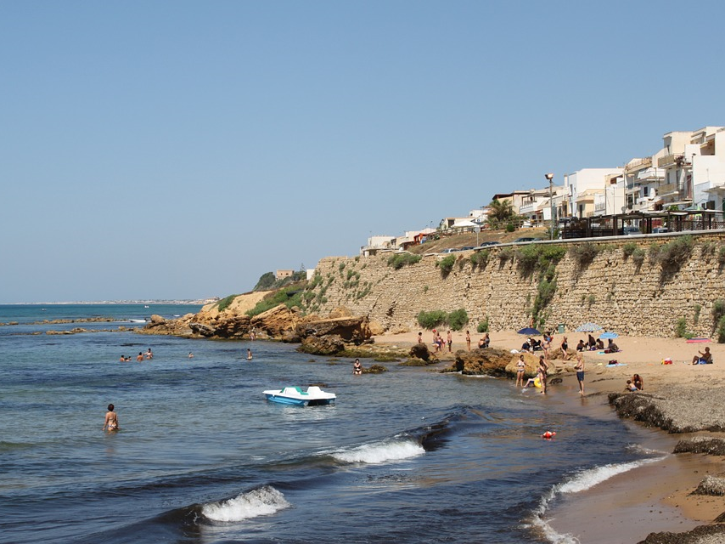
Paper 1 - Question 5
English Language – Narrative and Descriptive Task
EITHER:
Write the opening of a story based near the sea, as suggested by the picture
OR:
Write a description of the seaside
Notes:
Use lots of colour adjectives, use a simile, use the Tier 2 word - exquisite

Slide 35
Paper 2 – Question 5
English Language – Viewpoint writing
“The most important things in life are not things. The most important things are people”
Write an essay in which you discuss this idea.
“I don’t have in the way of possessions, I am not beautiful, intelligent or clever, but I am happy and I intend to stay that way! I was born happy, I love people, I have a trusting nature, and I’d like everyone else to be happy too.” Anne Frank
Notes:
Use emotive words, use repetition, use Anne Frank’s words

Slide 36
Week of July 13th Two slides, Two lessons 1. Narrative/description 2. Non-fiction

Slide 37
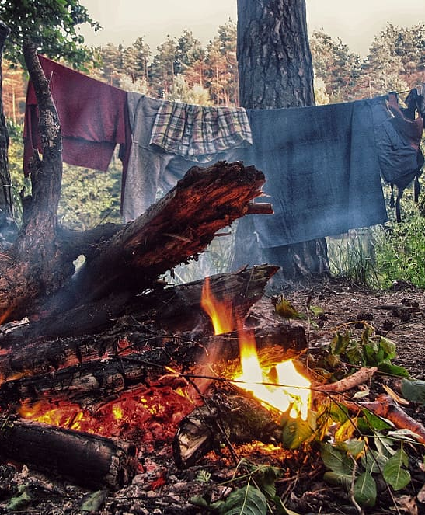
Paper 1 - Question 5
English Language – Narrative and Descriptive Task
EITHER:
Write a description of the outdoors, as suggested by the picture
OR:
Write the opening of a narrative about a camping trip.
Notes:
Use personification, use a preposition, use sound words – like crackle. Use the Tier 2 word foliage

Slide 38
Paper 2 – Question 5
English Language – Viewpoint writing
“Animals should be treated with equal respect to humans and should not be used for any cosmetic or medical testing.”
Write an article for the school newspaper where you explain your opinion about this statement.
Notes:
Use a catchy headline, use emotive words, use repetition, use rhetorical questions, use facts and opinions

