Slide 1
Year 8 Help Sheets!

Slide 2
Task 1!
“Young people are too often and too easily blamed for everything that is wrong with society today” Write an article for a newspaper to explain your point of view.
In today’s society young people are left to take the blame for many things that may be beyond their control. In this task, challenge yourself to include the following:
A balanced argument! (Think of both sides of the coin)
A colon
Personification
Make sure it is set in an article format

Slide 3
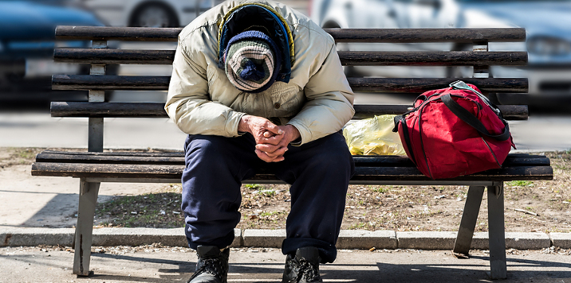
Task 2
‘It was cold. The man shivered. He was worried about what had happened. He didn’t know what to do.’
Write the opening of a story about this man. What has happened to him?
In this task, be adventurous! Make the opening of the story as interesting as possible by creating an element of suspense.
Include a cliffhanger
3 different types of punctuation
Introduce a second character
Use the word ‘Ominous’

Slide 4
Task 3
‘School Uniform stifles individuality and should be scrapped.’ Write the text of a speech for an assembly to your peers in which you explain your point of view.
This is a speech to convince your peers to join your way of thinking! Don’t forget to keep your language appropriate for your audience, your friends!
Include a simile
Use Alliteration
Use Repetition
Discuss the Positives and Negatives of both sides of the argument.

Slide 5
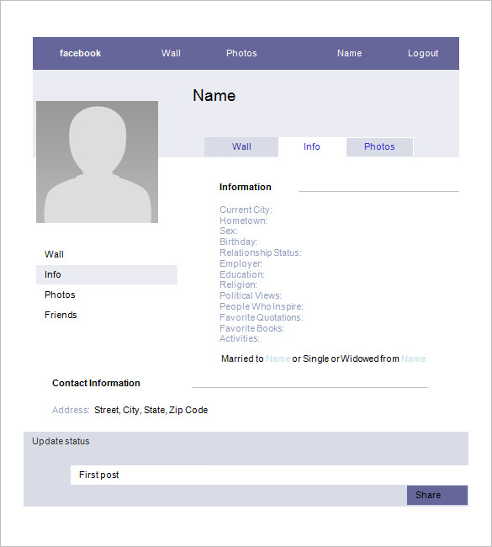
Task 4
Create a Facebook profile (On paper) for your favourite fictional character from a book. Remember to include factual information (D.O.B, education, hometown) and also status updates of what they're thinking.

Slide 6
Task 5 – My Perfect Day
Write a detailed diary entry on what you would consider being ‘Your Perfect Day’ but you cannot spend any money. You must link this to a historical event and use a simile.
Think about the day that stands out in your mind. The greatest day you have ever had. Whether that be with family or friends, recall what about that day made it so special.
Include 3 characters
Base your diary entry around a historical event (research if you need to)
Don’t forget to set it out in a diary format.

Slide 7
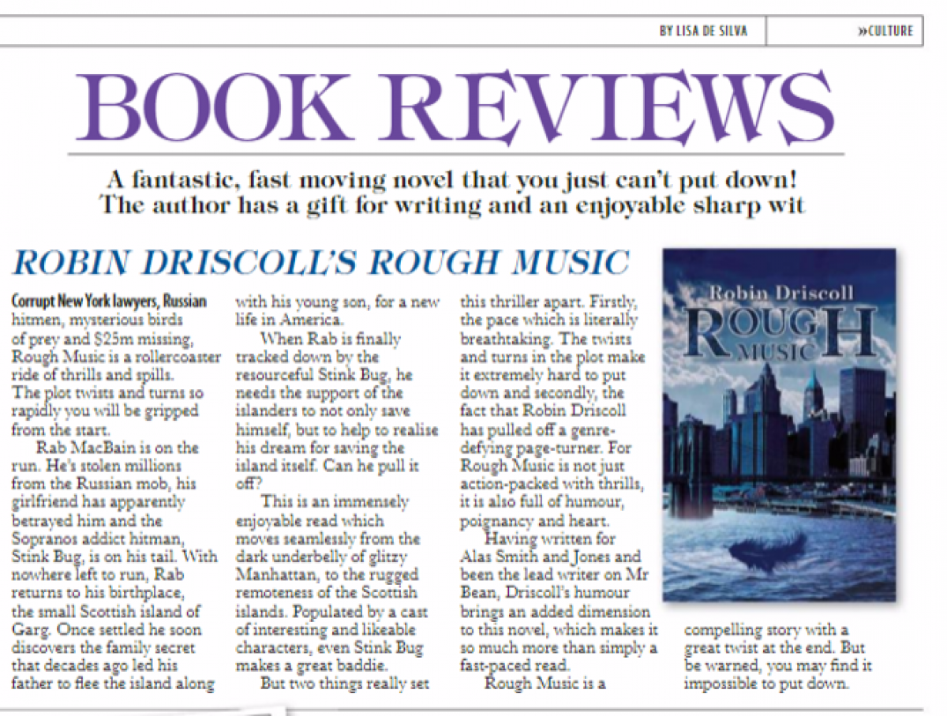
Task 6
Write a newspaper article relevant to a novel you’ve studied this year.
Include specific, accurate information, with correct English. You could include images and/or quotes. Have a look at a newspaper for some inspiration!
Think of the last novel you read, either in school or at home and write a review of it in a newspaper article! Include:
A Catchy headline
Alliteration
A simile

Slide 8
Task 7 – Getting Creative!
‘Slowly opening my eyes I saw something…”
Write a short story that starts with the above sentence.
This is an ideal opening for a story to take in any direction. Take a few minutes to plan some ideas down on a piece of paper before you start. This could go in so many directions so use your imagination to create something incredible!

Slide 9
Task 8
Create your own superhero and write a story with them in it.
Finished? Draw a comic strip of what happened in your story.
Don’t forget, the key to creating an interesting character is to give them a flaw. For example, if you are creating a superhero, you can give them an attribute that is negative, for example something that could annoy them.
The same goes for a villain. They could be the most evil person on the planet, however giving them a good quality could make them more accessible. A villain that gives to the needy for example.

Slide 10
Task 9
‘The Arrival’
Write a film script using this title.
Don’t forget to use:
• Include stage directions
• Speech
Set the location and what you expect the characters to look like at the start.

Slide 11
Task 10
Write your own story about anything you want.
It must:
Have a clear structure
Have interesting characters
Use a range of language techniques.
Use a range of punctuation.

Slide 12
Task 11
Write the opening chapter of a sequel to a story or film you have recently seen.
Make sure you include the characters from the previous story.
Make sure it links to the first story.
Use similes and Metaphors.

Slide 13
Task 12
Write a plot summary for your very own Netflix series!
Make sure you use:
Repetition
Similes
The word ‘Antithesis’

