Slide 1
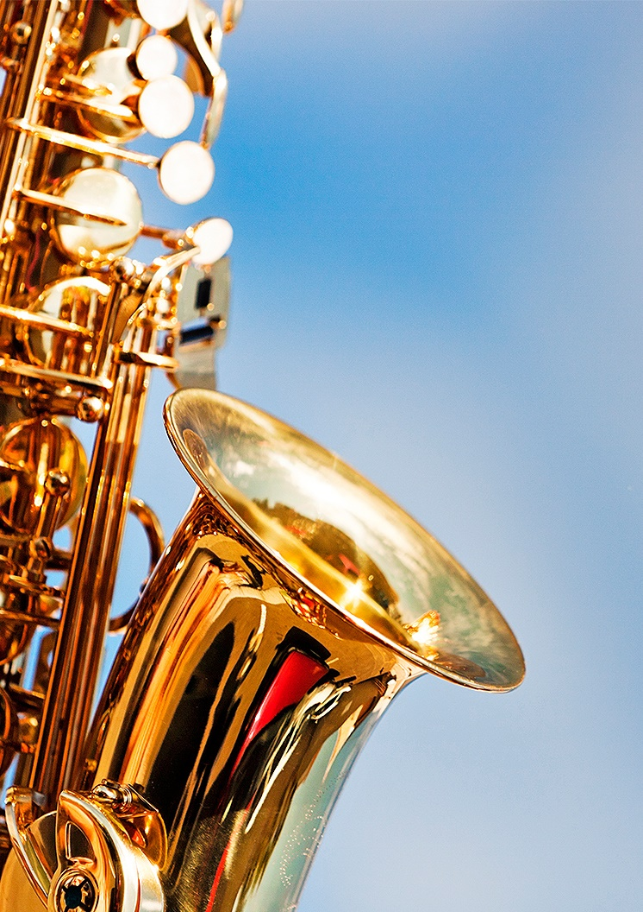
MUSIC AND
ME
1
ISSUE
Enter Date Here
MY MUSIC
My favourite style of music, my first song, my most memorable song.
“I would like to spend 10 minutes with….”
The last concert I went to….
[Enter school name here]
[Enter your name and class/form here]
© WWW.MUSICALCONTEXTS.CO.UK

Slide 2
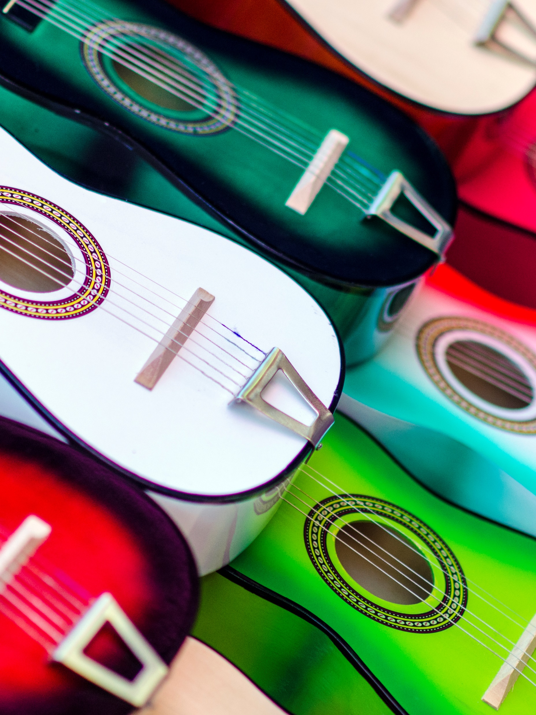
MY MUSIC
1
ISSUE
[Enter your name and form/class here]
My favourite style of music is…
Describe your favourite type/style/genre of music – include images/photos/illustrations.
My first song was…
Describe your first song – the song title, name of artist/band/group and the year that it was released. How did you buy/purchase/listen to your first song? Include images/photos/illustrations.
MY FAVOURITE STYLE/FIRST SONG
© WWW.MUSICALCONTEXTS.CO.UK

Slide 3

MY MUSIC
1
ISSUE
[Enter your name and form/class here]
My most memorable song…
Describe your most memorable song giving the song title and artist/band/group – use photos, images and illustrations and say why this song is memorable to you and what makes it memorable.
MY MOST MEMORABLE SONG
© WWW.MUSICALCONTEXTS.CO.UK

Slide 4

MY MUSIC
1
ISSUE
[Enter your name and form/class here]
I would like to spend 10 minutes with…
Describe who you would like to spend 10 minutes with and what question or questions you would like to ask them.
The last concert I went to…
Describe the last concert or live music performance you went to, who or what you saw and what you liked or disliked about it.
QUESTIONS AND CONCERTS
© WWW.MUSICALCONTEXTS.CO.UK

