Slide 1
Do now task
How much can you remember?
1. Who was the first black student to graduate from the University of Mississippi?
2. Campaign C and the Children’s Crusade took place in which city in Alabama?
3. What was set up by Stalin to control all of the communist parties of Europe?
4. What were NATO and the Warsaw Pact?
Notes:
1. James Meredith. 2. Birmingham, Alabama. 3. Cominform. 4. Military Alliances.

Slide 2
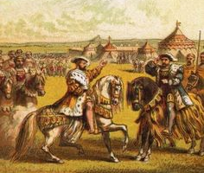
Wolsey: Relations with France
To be able to:
* Describe (4) key developments of foreign policy with France
** Explain (5/6) some of the successes and failings of foreign policy with France
*** Evaluate (7/8) the extent of success Wolsey’s policies were towards France

Slide 3
Read it:
Consequence
Define it:
A result or effect, typically one that is unwelcome or unpleasant.
Deconstruct it:
Late Middle English: via Old French from Latin consequentia, from consequent- ‘following closely’, from the verb consequi .
Example:
Explain two consequences of the bus boycott.
Link it:
Aftermath, aftereffect, fallout, reaction.

Slide 4
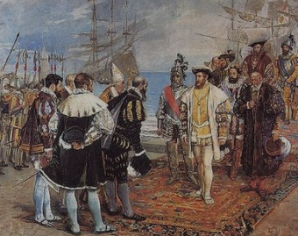
What can you remember?
What can you remember about England’s relations with France?
Aim: To be able to *describe (4), **explain (5/6) and ***evaluate (7/8) the implications of policies towards France

Slide 5
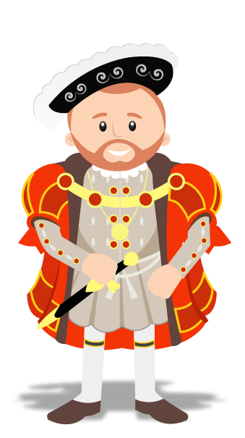
Foreign policy: France
Draw a two column table. One for successes and one for failings. On the next slide you will have many cards in relation to my foreign policy. Cut them out and stick them onto your table onto the right column.
Successes: Policy towards France | Failings: Policy towards France
Aim: To be able to *describe (4), **explain (5/6) and ***evaluate (7/8) the implications of policies towards France

Slide 6
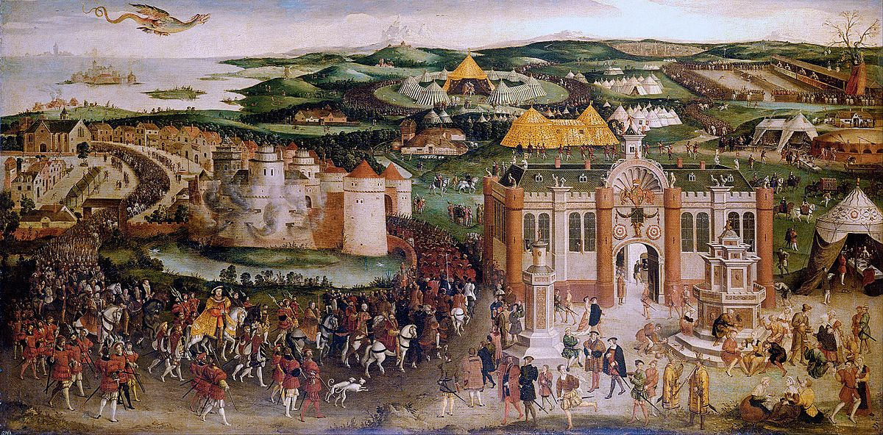
Henry had already invaded France in 1513.This had been a very expensive expedition which achieved nothing other than a small victory at the Battle of the Spurs. His desire for war increased further.
In June 1520, a spectacular diplomatic meeting took place between Henry VIII and Francis I of France. Both men wanted to show off their prestige and so no expense was spared on a fortnight’s activities of feasting and jousting. The high point was a wrestling match between the two King.
Francis I declared war on Charles V in 1521. Wolsey attempted to broker a peace deal between the two but ultimately failed. With England’s political and trade links more closely linked with the Hapsburg Empire, Henry declared war on France in May 1522.
Henry completely exaggerated his own power. He did not have the military strength. Wolsey worked hard to find England allies against France but was largely unsuccessful. By 1515, Francis had successfully invaded Italy and taken land.
Initially, England launched minor raids on French soil. Henry and Charles were joined by the French nobleman the Duke of Bourbon who had taken up arms against his King. In August, the Duke of Suffolk began an advance on Paris with 11,000 troops. However, Charles failed to deliver any troops and the Duke of Bourbon had not managed to raise any support. English enthusiasm for war faded.
By 1518, a Turkish army attacked Italy. The Pope appealed to the rulers of Europe for help. Wolsey pounced on this idea. He organised a large meeting in London, inviting all of Europe to send ambassadors. They signed a Treaty of London which guaranteed European peace and help for the Pope. If anyone declared war, the other signatories would unite against the Treaty breaker.
Although the Field of Cloth of Gold was a grand occasion, nothing was really achieved. No decision was made about European events. Spain became suspicious that England was allying with France. England’s relationship with France did not improve and the two countries were at war with one another again within 2 years.
The Treaty of London meant that:
Henry could have international prestige.
Henry was seen as a peacemaker.
England was at the centre of European politics.
Wolsey done the work, Henry got the glory.
Notes:
Consider printing this out for students

Slide 7
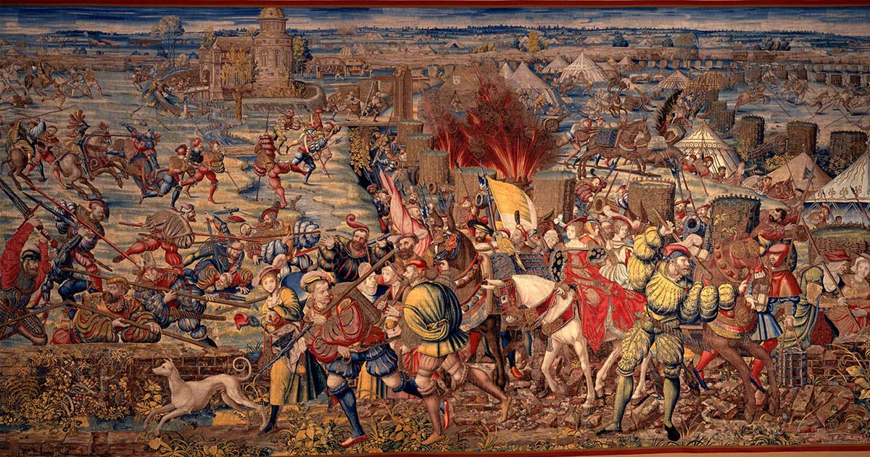
In 1525 a great battle was fought between Charles V and Francis I in Northern Italy. At the Battle of Pavia, the French army was destroyed and Francis was taken prisoner. It was clear that Charles V had used Henry’s troops to distract the French as he launched a direct attack on Francis.
Henry and Wolsey immediately pressed on Charles V to take advantage of France after the Battle of Pavia. Henry and Charles could launch a joint invasion of the leaderless France. They would then divide France between them and Henry would take the French crown.
Charles did not wish to see Henry’s power increased. He also released Francis I of France after securing a promised that the humiliated French King would not seek revenge. Having been let down by the Spanish and Charles V, Wolsey opened peace negotiations with France signing a peace treaty in 1525.
The Battle of Pavia in 1525 in which Francis was captured and the French army destroyed. Henry was not able to achieve military glory in this battle, nor could Henry take advantage of Francis’ capture and imprisonment.
Henry’s second war with France had not gone well. It was clear that Charles did not view or treat England as an ally. Charles V had abandoned Henry on his attack on Paris. Charles had not been prepared to let England take some of the glory from the Battle of Pavia. The financial costs of the war totalled £430,000. Taxes were increased and forced loans damaged Henry’s popularity.
Henry’s attack on Paris was almost a success. His troops got within 50 miles of the city but there was disease and disharmony among his armies. Henry decided to abandon his attack on the French city.
Notes:
Consider printing this out for students

Slide 8
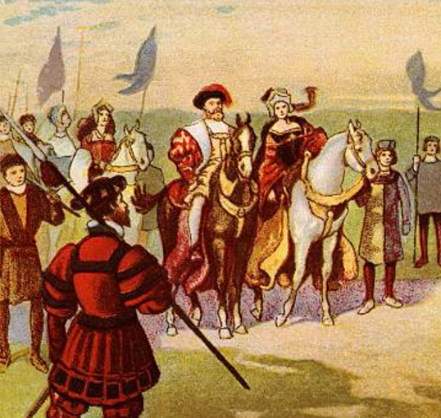
Successes and failures of Henry’s policy with France
Successes
Failures
Aim: To be able to *describe (4), **explain (5/6) and ***evaluate (7/8) the implications of policies towards France
Notes:
Justification line where are you on this? Decide and support your answer.

Slide 9
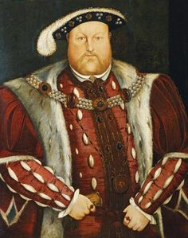
To what extent was Henry’s policies towards France a success?
Weighing up the successes and failings of Henry’s policies towards France, do you think that there was more successes or failings and why?
Aim to consider the following in your answer:
Income/Size of population. - Field of Cloth of Gold.
Tournai/Theouranne. - Battle of Pavia.
Rivalry with Francis I. - Cost of the wars.
Battle of the Spur - Alliance with Scotland.
Aim: To be able to *describe (4), **explain (5/6) and ***evaluate (7/8) the implications of policies towards France

Slide 10
Exam question
Sentence starters to help you:
One key feature of…
This meant that…
This was important at that time…
This was important because…
Another key feature of…
This was significant as…
This led to…
This meant that…
Describe and explain 2 features of England’s war with France between 1522-1525. (6)
Feature 1:
____________________________________________________________________________________________________________________________________________________
Feature 2:
____________________________________________________________________________________________________________________________________________________
Top tip:
Describe 1 feature and explain it.
Describe a 2nd feature and explain it.
Aim: To be able to *describe (4), **explain (5/6) and ***evaluate (7/8) the implications of policies towards France
Notes:
Hint – think of military successes/failures, costs of these war, and consider all of the successes and failures you have looked at in this lesson.

Slide 11
Peer assess your partner’s work
Use the mark scheme to help you decide what mark your partner’s answer should be.
Using the mark scheme, give it a What Went Well and an Even Better If.
Breakdown of the mark scheme
Award one mark for one valid feature.
Award a second mark for a second valid feature.
The third mark should be awarded for supporting information for feature 1.
The fourth mark should be awarded for supporting information for feature 2.
Aim: To be able to *describe (4), **explain (5/6) and ***evaluate (7/8) the implications of policies towards France

Slide 12
Plenary Progress Check
I think I can evaluate the extent of success Wolsey’s policies were towards France. I can look for links within my arguments to come to an informed judgement. (7/8)
I think I can explain some of the successes and failings of foreign policy with France. I can use connectives to support my ideas and develop my arguments. (5/6)
I think I can describe key developments of foreign policy with France. (4)
Aim: To be able to *describe (4), **explain (5/6) and ***evaluate (7/8) the implications of policies towards France

Slide 13
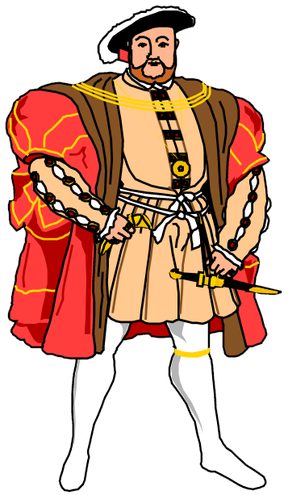
Homework
How was Charles V related to Catherine of Aragon?
When were the Eltham Ordinances?
What year did Henry VIII come to the throne?
Name the two French towns seized by Henry VIII.
When was the Battle of the Spurs?
Name Henry VIII’s mother.
When were Empson and Dudley beheaded?
Describe x2 features of the Henry’s foreign aims.
Describe x2 features of the Amicable Grant.
Describe x2 features of the Subsidy.

