Slide 1
AQA GCSE Drama Component 2: Devised Drama
Written Log Book

Slide 2
Section 1: Response to Stimulus
In this section students are expected to explain your initial ideas, research and intentions for the devised piece.

Slide 3
You, the student, must explain:
your initial response to the stimuli presented by the teacher and the stimulus you chose
the ideas, themes and settings you have considered for the devised piece in response to the stimulus you chose
your research findings
your own dramatic aims and intentions
the dramatic aims and intentions of the piece as a whole.

Slide 4
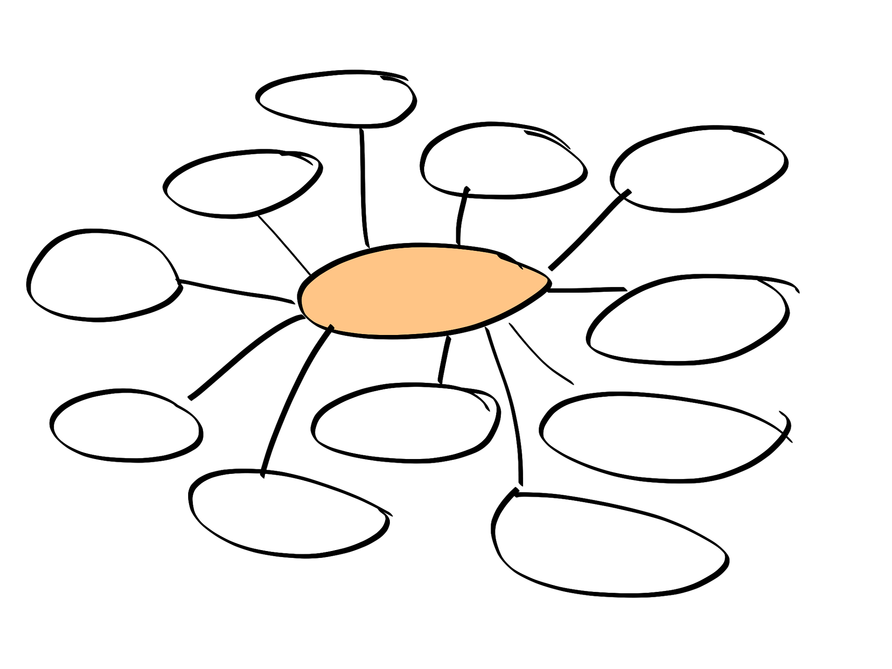
Activity
In your performance groups review the mind maps you were set for homework.
Create 4 new combined mind-maps that bring together all your thoughts and opinions based on these headings:
your initial response to the stimuli
the ideas, themes and settings you have considered for the devised piece
your research findings
the dramatic aims and intentions of the piece as a whole.

Slide 5
Your initial response to the stimuli presented by the teacher and the stimulus you chose
Consider writing about the following statements;
How the stimulus makes you feel on an emotional and intellectual level.
The feelings did it gave you.
What it made you think of or connect to a real-life event you have experienced or know of.
Whether you found it challenging.
Whether you liked it.
Whether you were drawn to it.
Whether you didn’t like it.
Any further details of the stimulus can you talk about further.
It’s a good idea to include an annotated copy of the stimulus.

Slide 6
The ideas, themes and settings you have considered for the devised piece in response to the stimulus you chose
Consider writing about the following statements;
The themes you can identify in the stimulus.
The best ideas (including the final idea) you came up with at the start of the devising process and was good and bad about them.
What the ideas would have been about and what would they have communicated to the audience.
Whether you felt an audience would have liked them.
The themes would it have had.
Where would they have been set.
How would they have related to the stimulus.
How the audience would have related to the ideas.

Slide 7
Your research findings
Consider writing about the following statements;
The idea did you stick with.
The research you need or needed to do to make sure that the piece of theatre would work.
The factual information you have learnt.
The character driven emotional information have you learnt.
How the research is going to help you communicate to the audience.

Slide 8
Your own dramatic aims and intentions
Consider writing about the following statements;
What you personally want to get from this performance to communicate to the audience.
This could relate to your character(s) or to something about the message of your performance that is personal to you.

Slide 9
The dramatic aims and intentions of the piece as a whole
Consider writing about the following statements;
What you, as a group, want to communicate to the audience through your piece of theatre.
What the message of the piece.

Slide 10
