Slide 1
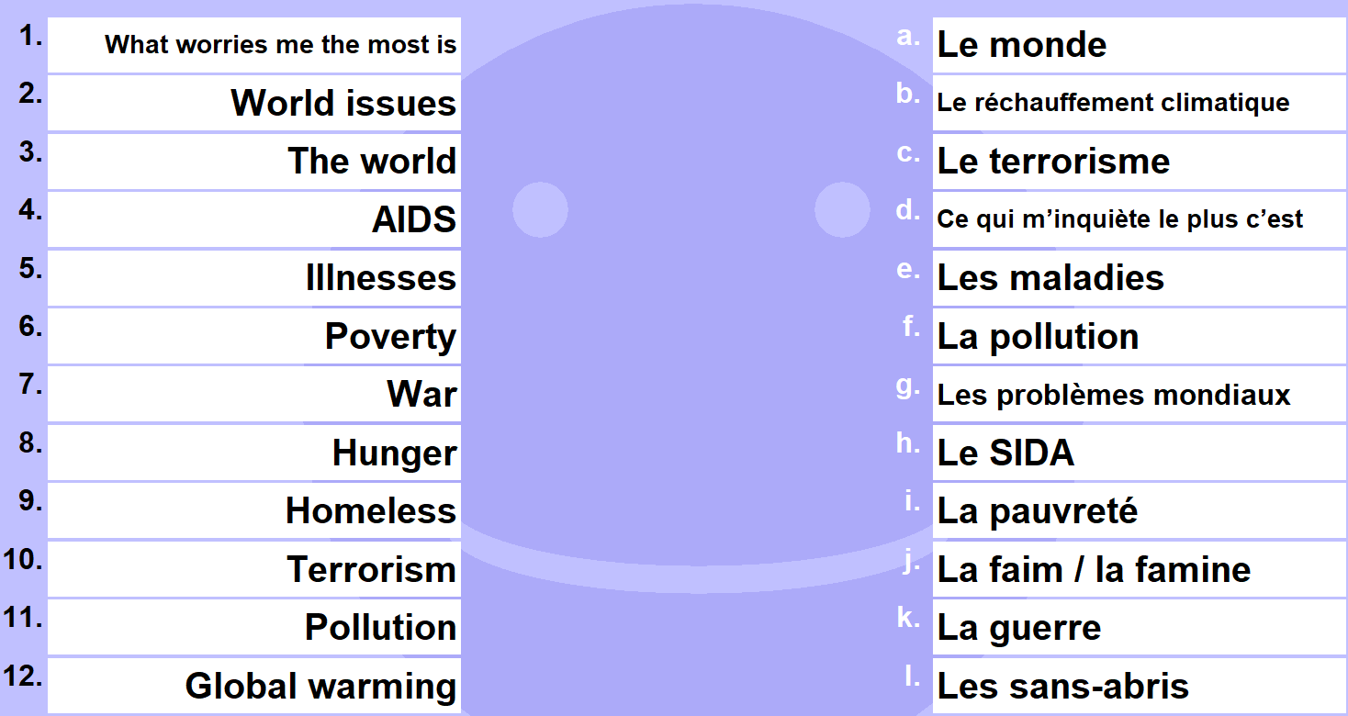
DO NOW
2)
TENSES
1)
Redoubler
PRESENT
PAST
FUTURE 1
FUTURE 2
CONDITIONAL
IMPERFECT
PAST CONDITIONAL

Slide 2
1)
1 | D
2 | G
3 | A
4 | H
5 | E
6 | I
7 | K
8 | J
9 | L
10 | C
11 | F
12 | B
2)
TENSES
Redoubler
PRESENT | Je redouble
PAST | J’ai redouble
FUTURE 1 | Je vais redouble
FUTURE 2 | Je redoublerai
CONDITIONAL | Je redoublerais
IMPERFECT | Je redoublais
PAST CONDITIONAL | J’aurais redoublé

Slide 3
Classwork
La vie extra-scolaire
L.O. | To talk about school activities To recognise and use the IMPERFECT
DEVOIRS

Slide 4
https://www.activeteachonline.com/product/view/id/665/page/122/mode/dps

Slide 5
Can you match these up?

Slide 8
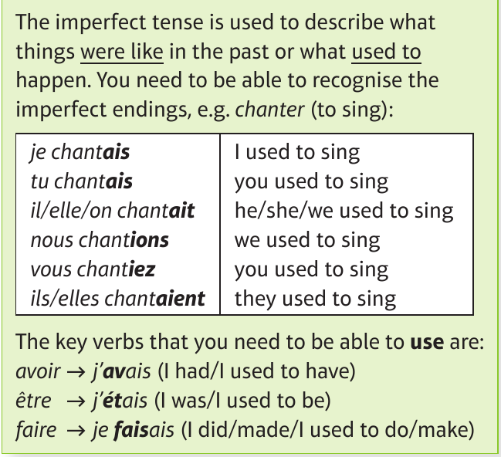

Slide 9
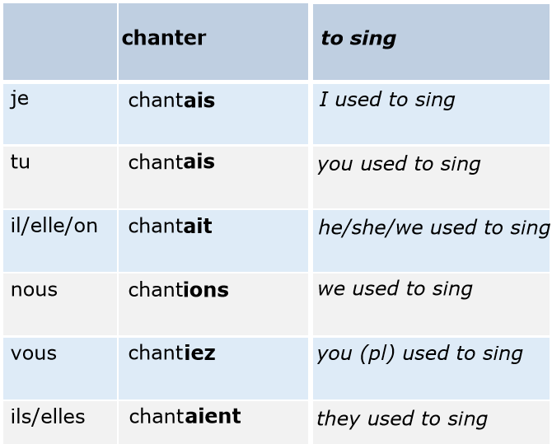

Slide 10
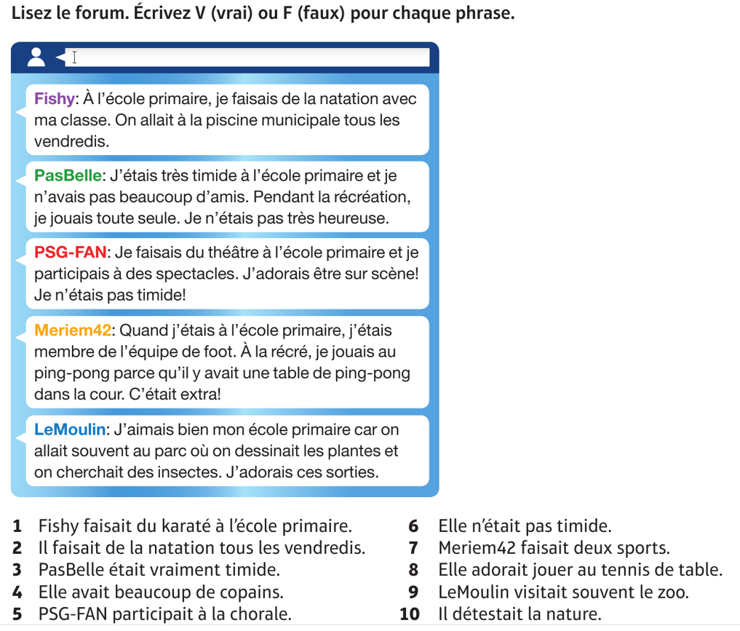

Slide 11
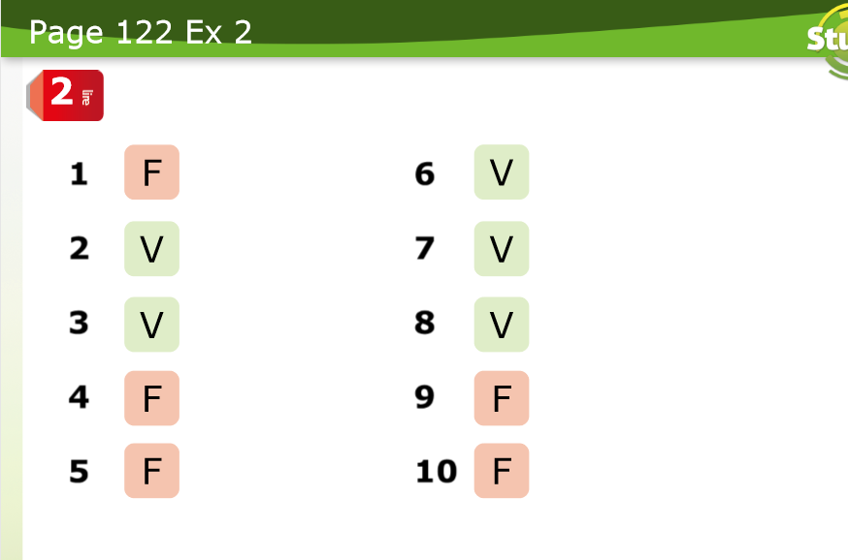

Slide 12
I
SENTENCE OPENER/ TP
VERB PART (imperfect)
connective
Opinion (imperfect)
When I was younger
I used to do judo
as
I found it really useful.
Quand j’étais plus jeune
Je faisais du judo
comme
je trouvais ça vraiment utile.

Slide 13
WE
SENTENCE OPENER/ TP
VERB PART (imperfect)
connective
Opinion (imperfect)
When I was four
I used to go to the park
since
I liked nature.
Quand j’avais quatre ans
j’allais au parc
puisque
j’aimais la nature.

Slide 14
YOU
SENTENCE OPENER/ TP
VERB PART (imperfect)
connective
Opinion (imperfect)
When I was ten
I used to play tennis
however
I found it really frustrating.

Slide 15
Devoirs – homework
Write 5 sentences describing what you used to do when you were younger. State your opinion.
Check the I WE YOU section to check the success criteria.

Slide 16
Classwork
Avant…mais maintenant…
L.O. | To compare past and present To use the IMPERFECT and PRESENT tenses

Slide 17
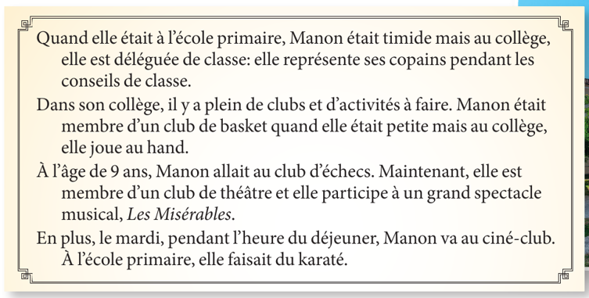
Which verbs are in the IMPERFECT TENSE?
Which verbs are in the PRESENT TENSE?

Slide 18
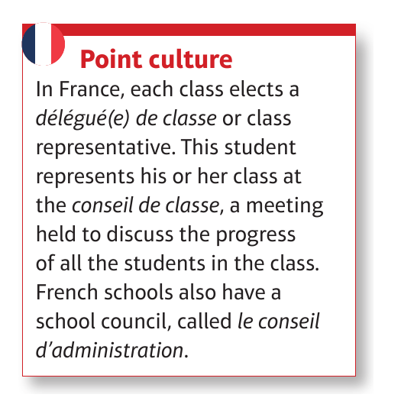

Slide 19
I
In primary school I used to have a lot of free time but now I have a lot of homework to do.
A l’ecole primaire j’avais beaucoup de temps libre mais maintenant j’ai beaucoup de devoirs à faire.

Slide 20
WE
In primary school I used to go to the swimming-pool but now I go to the park.
A l’ecole primaire j’allais à la piscine mais maintenant je vais au parc.

Slide 21
YOU
Write 5 sentences where you mix imperfect and present tenses.

