Slide 1
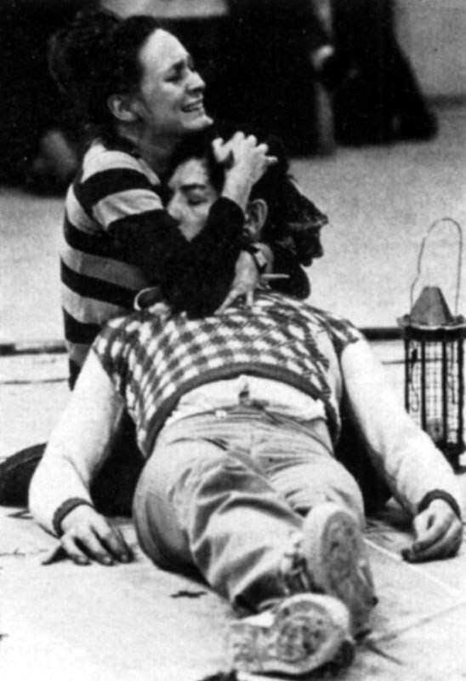
Act 5
Romeo and Juliet

Slide 2
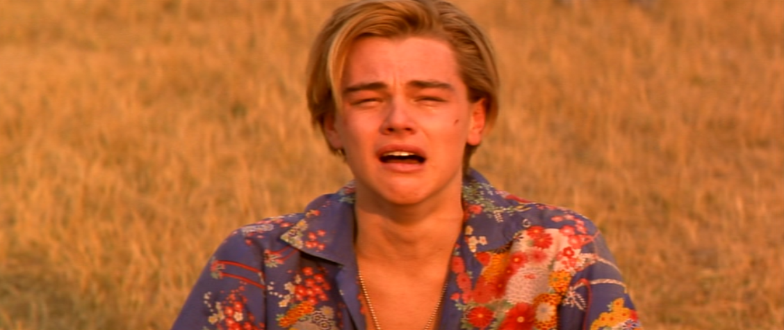
Act 5 Scene 1 Summary
Balthasar brings news to Romeo in Mantua that Juliet is dead.
In desperation, Romeo vows to be with Juliet that night.
He buys poison from an Apothecary and leaves for Verona.

Slide 3
This scene reveals a fatal weakness in Friar Lawrence’s plan.
What is this?

Slide 4
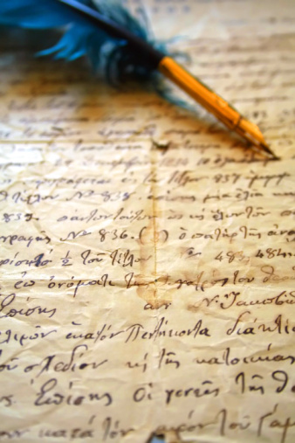
Dear Friar…. Letter writing
Write a letter that Romeo wrote to Fr. Lawrence after hearing of Juliet’s death and deciding to end his own life to be with her.
Try capture Romeo’s feelings and emotions in this letter.
IDEAS:
Thank the Friar?
Explain his decision?
A message to his family?
A message to Juliet’s family?
Lets recap letter writing rules!

Slide 5
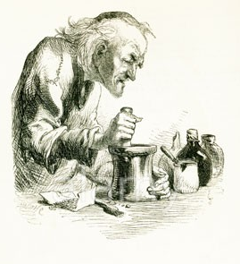
Points to Consider
What is importance of the fact that the Apothecary is poor?
If he refused to give Romeo the vial perhaps Romeo and Juliet may not have died….
Discuss:
What other small details and decisions contribute to the inevitable ending?

Slide 6
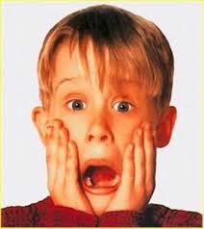
Act 5 Scene 2 Summary
Friar Lawrence is shocked to hear that Friar John has been unable to deliver his letter to Romeo.
He rushes off to collect Juliet from the tomb, knowing that she will soon be awake.

Slide 7
Is the use of
unfortunate coincidence
as a plot device a strength or weakness of the play?

Slide 8
Act 5 Scene 3 Summary
Romeo kills Paris when he tries to stop him entering the tomb.
To be with Juliet again, Romeo drinks the potion and dies.
When the Friar arrives, Juliet wakes up. He tries to hustle her away, but she is determined to stay by Romeo and the Friar flees. Taking Romeo’s dagger, Juliet kills herself.
The Prince, the Capulets and the Montagues find their children and Paris dead.
The Friar explains what has happened and the two fathers make peace.

Slide 9
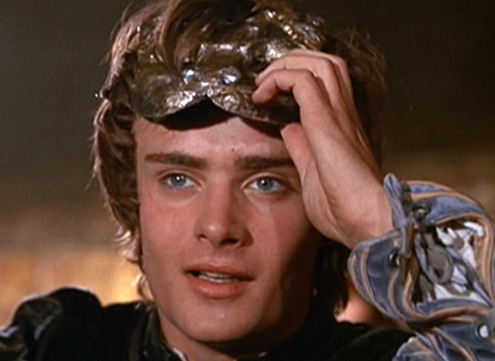
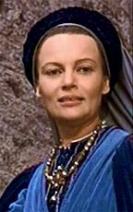
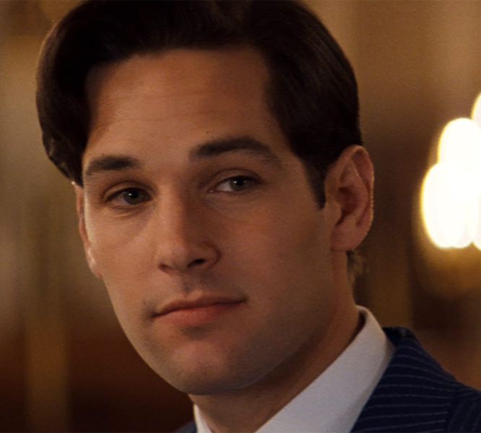
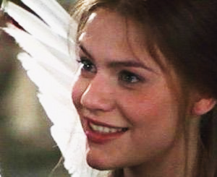
Four people die in this scene!

Slide 10
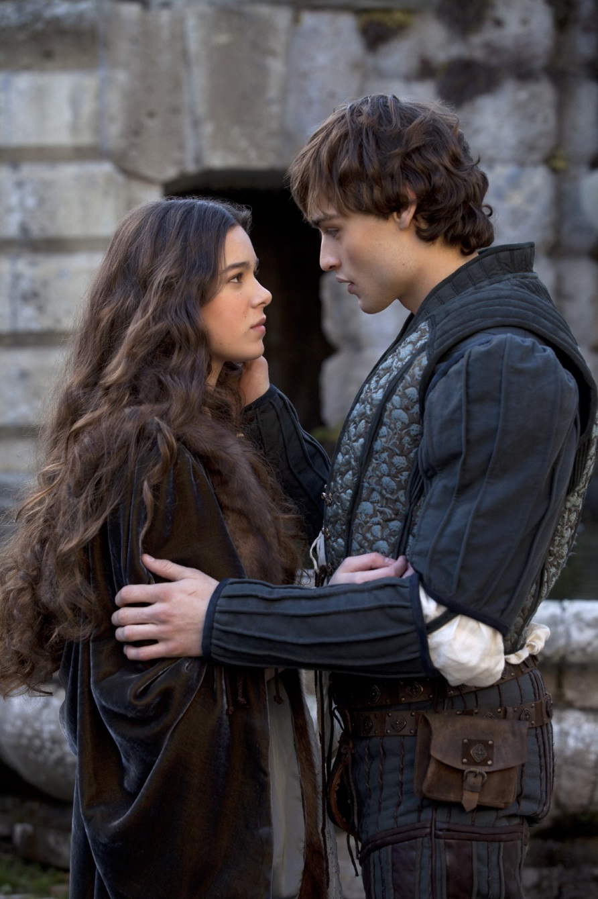
Alternative ending…
Not happy with Shakespeare's ending?
Bullet point ideas for an alternative ending and give reasons for your choices.
Who lives? Who dies?
You decide!

Slide 11
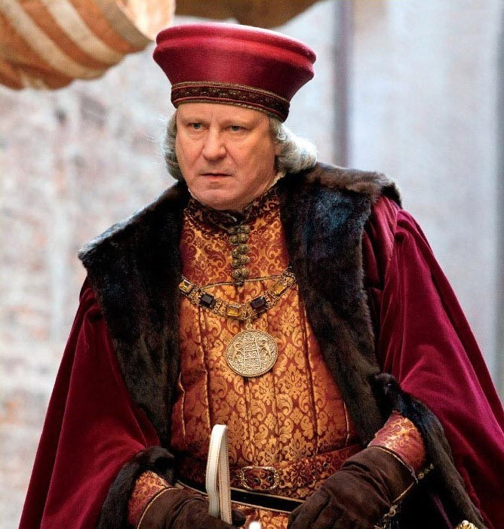
‘Some shall be pardoned, and some punished’
Who, in your opinion, deserve to be pardoned, and who should be punished?
Give reasons for your choices.

Slide 12
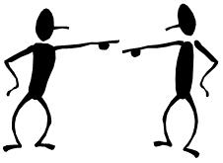
the
blame
game
Who is most to blame for the sequence of tragic events?

Slide 13
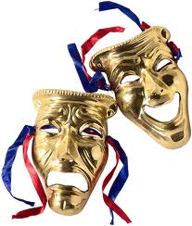
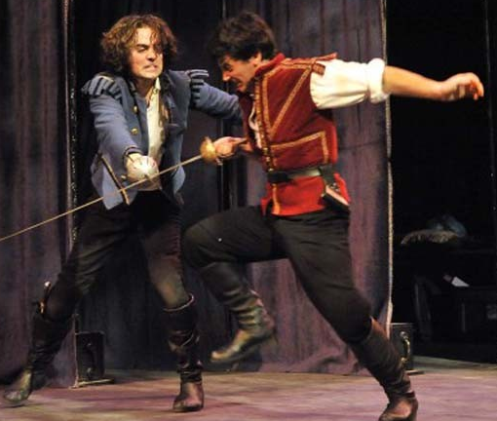
Performance Question
Romeo
Stay not, be gone! Live – and hereafter say
A madman’s mercy bid thee run away.
Paris
I do defy thy conjurations
And apprehend thee for a felon here!
Romeo
Wilt thou provoke me? Then have at thee, boy!
(They fight.)

Slide 14
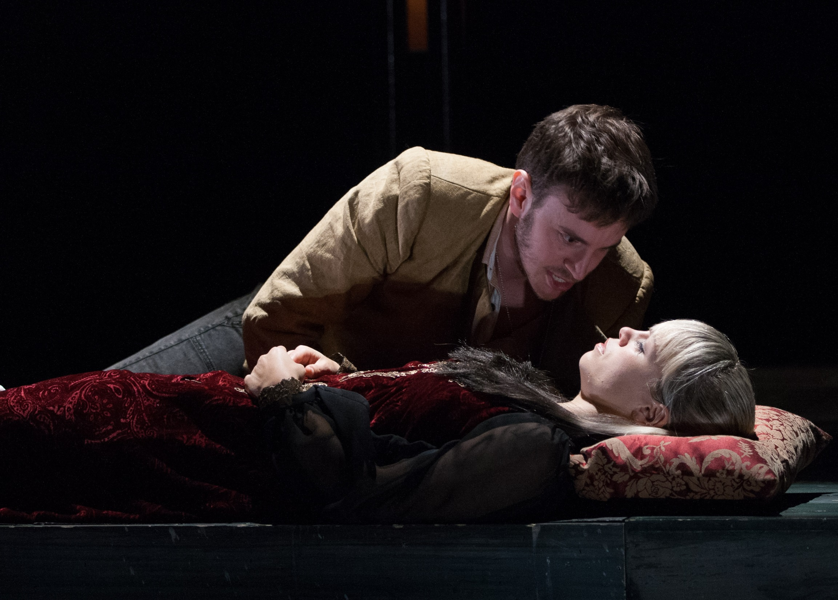
O my love, my wife!
Death, that hath sucked the honey of thy breath,
Hath had no power yet upon thy beauty.
Thou art not conquered. Beauty's ensign yet
Is crimson in thy lips and in thy cheeks,
And death's pale flag is not advanced there.
Quote Finder: Find five key quotes from Act 5 Scene 3
Try find what you believe are the five most significant quotes

Slide 15
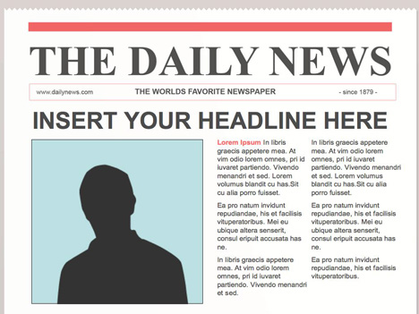
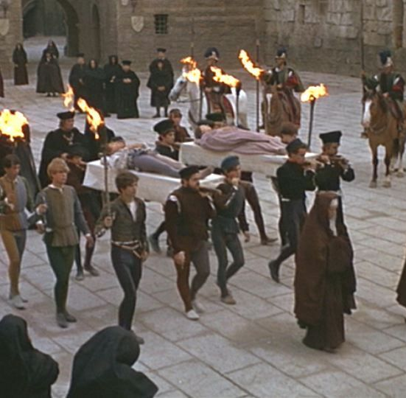
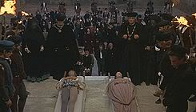
Task: Write a formal newspaper report about the events of Act 5, Scene 3
25 August 1528
Since 1412
Deafening silence in Verona’s streets as tragedy strikes
Residents living in Verona were shocked and deeply saddened following four deaths on Thursday evening. It is believed the deaths are all linked to the on-going Capulet and Montague feud. Authorities say that they are following a number of definite lines of inquiry.
It is believed that Romeo Montague and Juliet Capulet were secretly married earlier this week, unknown to
their families, and both committed suicide in the Capulet vault according to reliable sources.
Juliet Capulet was believed to have died tragically earlier this week. However, this was apparently part of a plan to allow the young lovers be together away from their feuding families.
Prince Escalus has asked for calm while this bizarre series of events is fully investigated.
Read more on page 2,3,4,5.

Slide 16
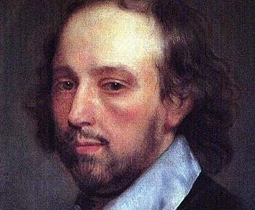
Plot Structure
How has Shakespeare utilised the plot structure in Act 3 Scene 5 to create tension and excitement for the Elizabethan audience?

