Slide 2
?
?

Slide 3
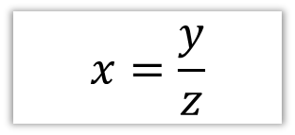
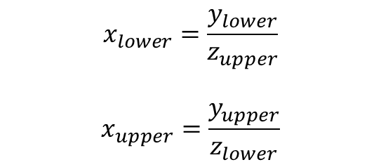
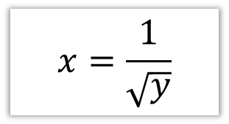
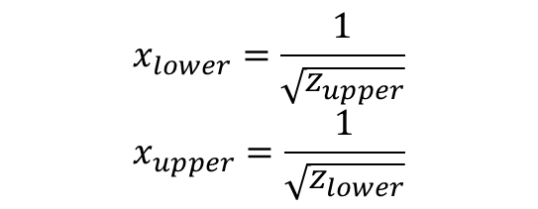
For each of these formulae, what would we use to calculate the lower and upper bounds?
?
?
?
?

Slide 4
?
?
?
?

Slide 5
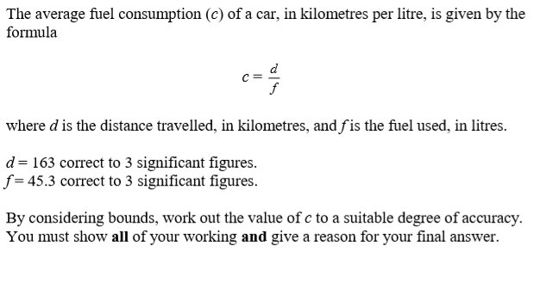

Slide 8
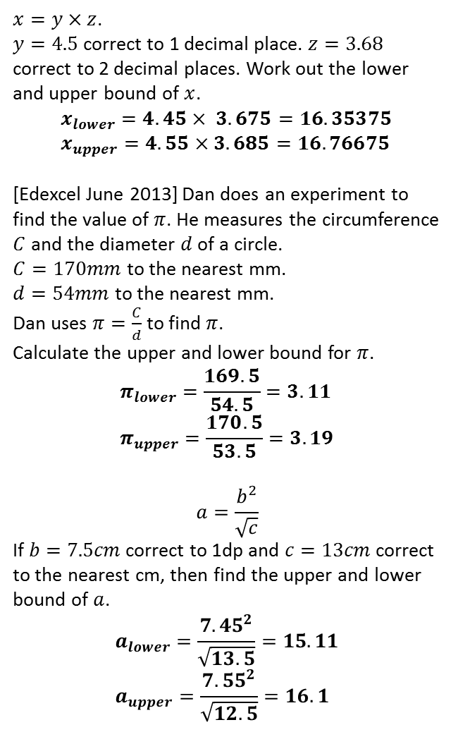
1
4
?
2
?
5
?
?
3
6
?
?

