Slide 1
“Do Now”
SA
What is secreted by the pancreas when blood glucose rise?
What hormone causes an egg to mature?:
The neurones found in the brain and spinal cord are called…?
4. What is a genome?
5. Name 2 types of variation.
Insulin
FSH
Relay neurones
The entire DNA within an organism
Environmental and genetic

Slide 2
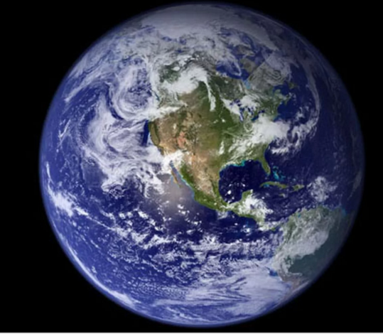
Starting point..
How long ago do scientists think living things first appear on me?
Write down your estimate in years.
Scientists estimate that life on Earth first appeared between 3 - 4.5 billion years ago

Slide 3
Starting point..
Why can’t we be absolutely certain EXACTLY WHEN life first appeared on Earth?
Because early life forms left NO FOSSILS as they were soft bodied. So we have a lack of EVIDENCE.

Slide 4
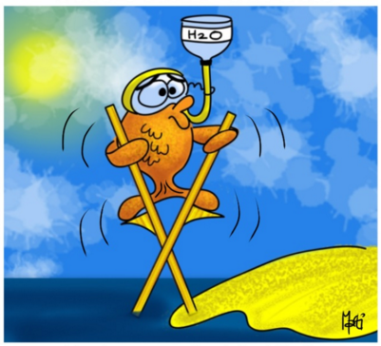
WALT: Describe what evolution is
WILF:
GW: You can state what is meant by the word EVOLUTION
BI: You can describe theories put forward to explain evolution and name scientists involved.
EW: You can consider evidence for or against the theories and describe them in greater detail.

Slide 5
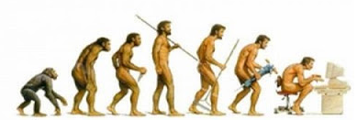
What is evolution?
Evolution is simply the process of change over a period of time.
Evolution is the change in INHERITED CHARACTERISTICS of a population, over time.

Slide 6
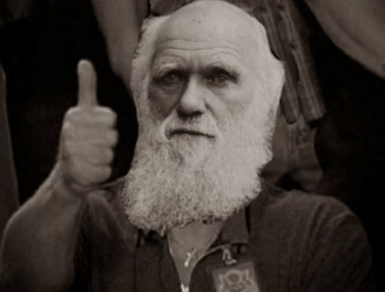
Theory of Evolution
All species of living things have evolved from simple life forms that first developed more than three billion years ago.
This is the theory of evolution by Natural selection and was suggested by me....
Charles Darwin
Most scientists believe my theory, but not everyone does.

Slide 7
The process of natural selection
Organisms in a species show a large amount of variation –
because of differences in their genes.
These differences can be caused by mutations

Slide 8
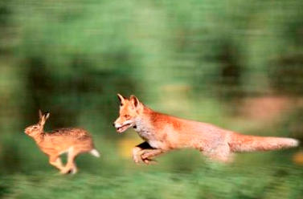
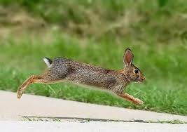
Only the organisms with the best features most suited to the
environment will go on to survive – others will die.

Slide 9
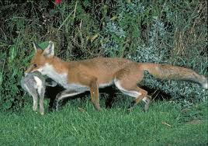
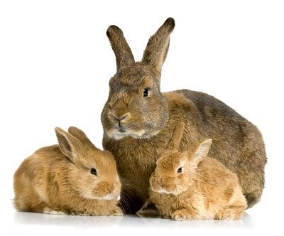
The organisms that survive will then breed and pass these
useful genes onto the next generation of offspring.

Slide 10
The offspring will be more likely to survive so their
population will increase and become more common
over time.
They will have phenotypes (physical characteristics)
best suited to the environment
Eventually, the characteristics of the group of living things
might be so different, that they can no longer interbreed
and they have formed a new species

Slide 11
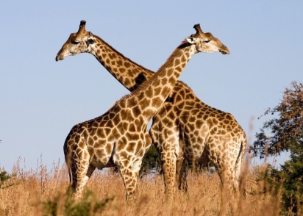
Apply your knowledge…
Using the steps you have just learnt, can you now explain HOW the giraffe evolved to have a LONG neck??

Slide 12
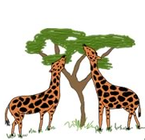
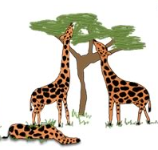
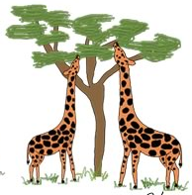
There is variation in the population – some animals have longer necks than others.
The giraffes with the shorter necks are unable to reach trees to feed, so will die of lack of food.
The giraffes that survive will breed and pass on the gene for longer necks to their offspring. More long -necked giraffes are born.

Slide 13
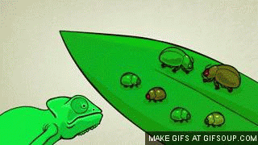
Another example of Natural selection
Notice that there is slight variation within the starting population of beetles

Slide 14
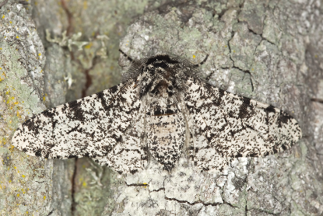
Natural selection in action
This is called the peppered moth and is common throughout the UK.
They rest against the bark of a tree to camouflage themselves from predators.

Slide 15
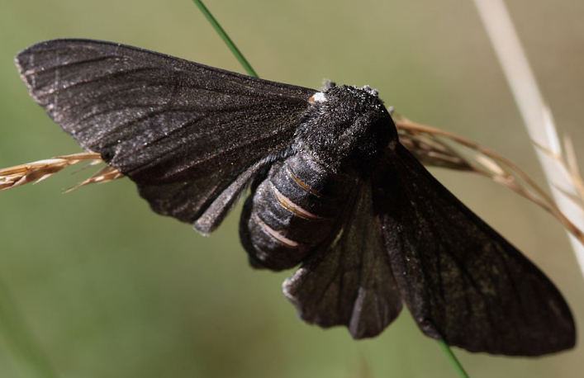
Natural selection in action
In 1811, a completely dark version of the moth was spotted.
It had never been seen before and was a mutant
In 1848 people began to go out and count the population of the peppered moths and they noticed a trend……

Slide 16
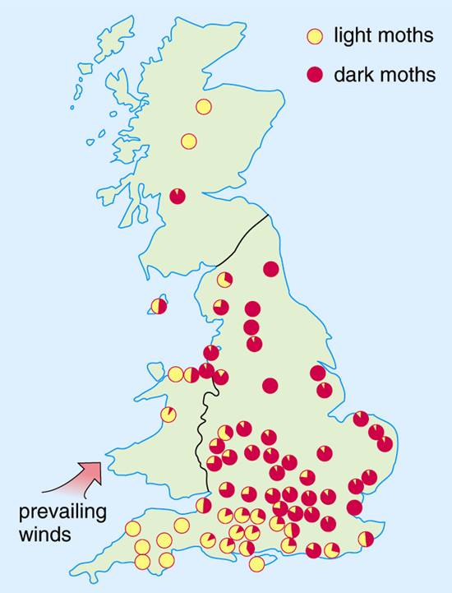
What do you notice about the distribution of each colour of moth?
Can you think of any reasons for the differences?

Slide 17
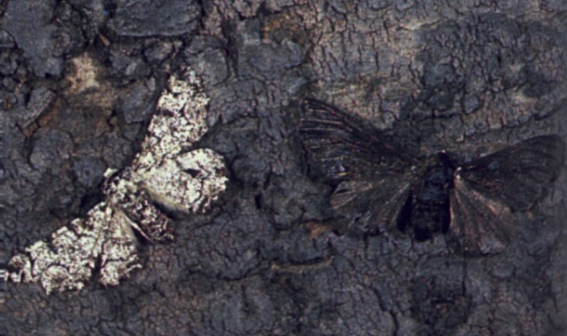
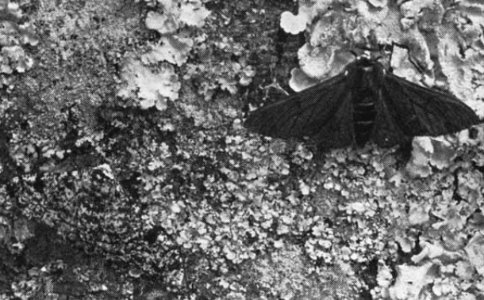

Slide 18
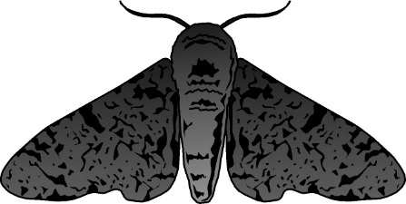
Why are there more dark moths
in industrial areas?
There is variation in colouration in a group of moths –
some are pale and some are dark
Tree surfaces are dark in the city because of air pollution
– soot blackens the tree bark
Dark moth less likely to be seen and eaten by bird predators
Dark moths more likely to survive to breed
Dark moths passed on the genes for the dark colouration to
their offspring – the population of dark moths increases.

Slide 19
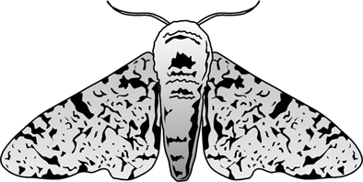
Why are there more light moths
in countryside areas?
There is variation in colouration in a group of moths –
some are pale and some are dark
Tree surfaces in the countryside are pale.
Pale lichens grow on the tree bark and there is no soot.
Light moth less likely to be seen and eaten by bird predators
Light moths more likely to survive to breed
Light moths passed on the genes for the light colouration to
their offspring – the population of light moths increases.

Slide 20
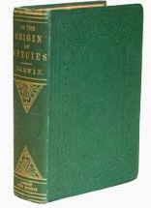
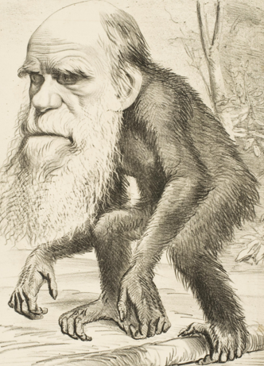
Evidence for Evolution
When Charles Darwin published his ideas about Evolution and Natural Selection, people did not readily accept them.
This is because:
At the time, people believed that God created all life on Earth – Darwin challenged this.
There was a lack of evidence to support his ideas.
He couldn’t explain how beneficial features were passed on to offspring.
Darwin was ridiculed in the newspapers at the time

Slide 21
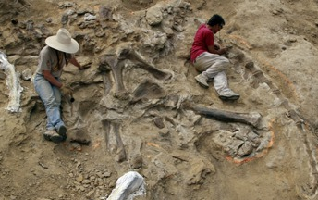
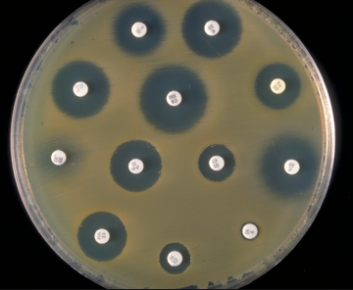
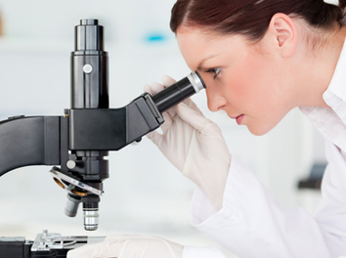
Why has Darwin’s theory been more widely accepted?
There is more evidence from the fossil record that show how living things have changed over time.
There is evidence that evolution has occurred in bacteria – they are evolving to become resistant to antibiotics, which we can study
We now know that characteristics are passed to offspring in genes – we can see genes and chromosomes.

Slide 22
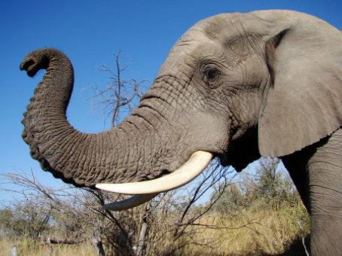
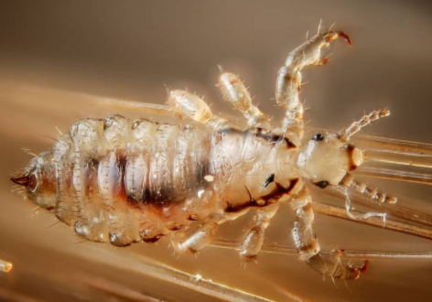
Apply your knowledge – higher level tasks
Describe how the elephant’s long trunk has evolved by natural selection
Describe how head lice have evolved to become resistant to headlice shampoo.

Slide 23
