Slide 1
“Do Now”
SA
Where does respiration occur?
Where in the body would you find the thyroid gland?:
the neck
in the brain.
just above the kidneys
Which food good is needed for growth and repair?
4.How many cell divisions occur during meiosis?
5. What sex chromosomes does someone who is biologically male have?
Mitochondria
Protein
2
XY

Slide 2
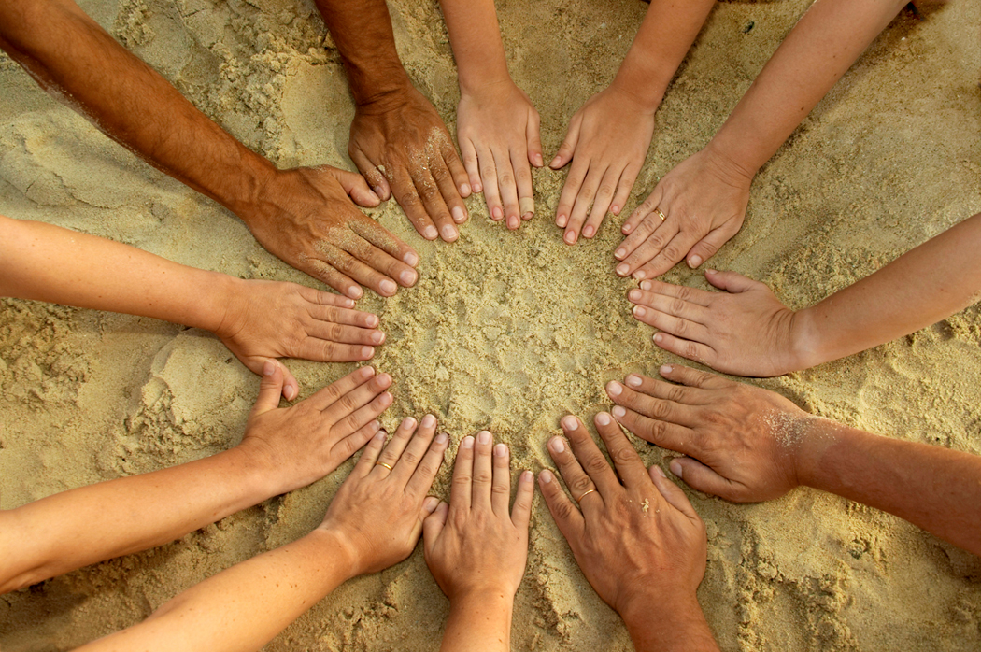
WALT: Understand the causes of variation
WILF:
GW: You can state what the word variation means and describe examples of characteristics that show variation
BI: You can identify two causes of variation between living things.
EW: You can classify characteristics and explain why they might have been caused. You can use key terms correctly.

Slide 3
What is variation?
What do you think the word Variation might mean in Biology?
The presence of differences between living things is called Variation.
Variation between different species is usually greater than the variation within a species.

Slide 4
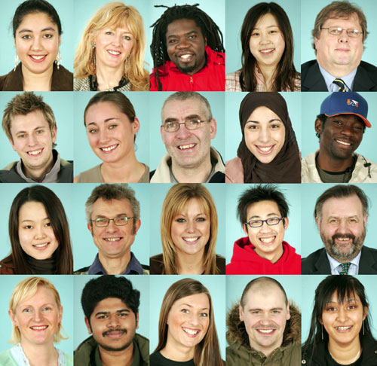

Slide 5
Ways in which humans exhibit variation

Slide 6
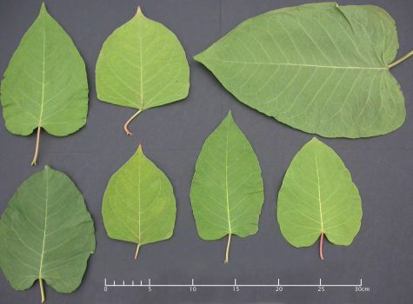
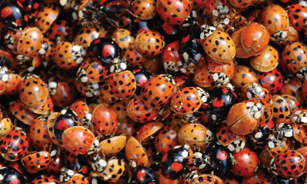
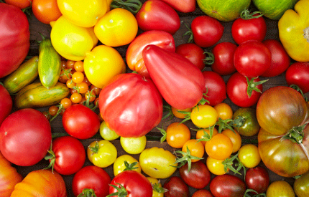
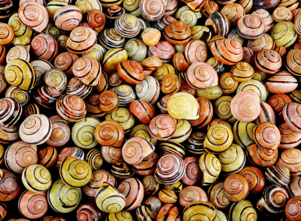
Variation exists in all living things, in all kinds of ways!

Slide 7
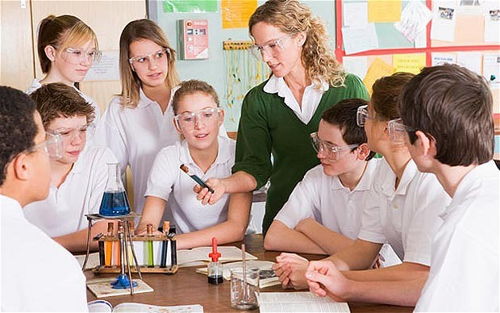
Can you think of some of the reasons WHY you don’t look exactly the same as the other members of your Science class? Write your answers down
I don’t look exactly the same as other members of my class because………

Slide 8
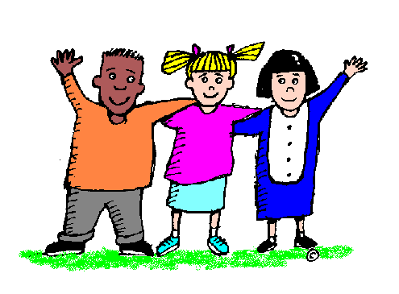
The causes of variation
There are two causes of variation between individuals:
Inherited variation
This type of variation is caused by the genetic information (DNA) passed on by the egg and sperm cells to form our genome.
Environmental variation
This type of variation is caused by differences that have arisen as we have developed. It can be caused by lifestyle choices we have made.

Slide 9
In reality, most of our characteristics are influenced by a combination of Inherited factors and environmental influences

Slide 10
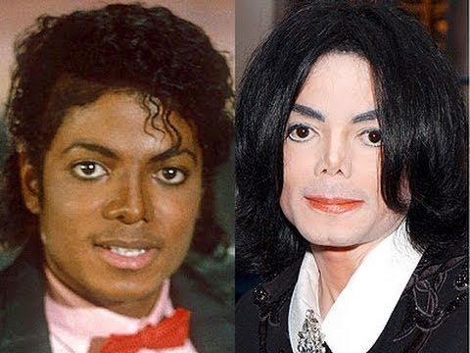
A mixture of inherited and environmental variation give us our characteristics.
Some of our characteristics are easier to alter due to environmental variation.

Slide 11
Task…….
Inherited | Environmental | Mixture of both
Make a copy of the table (at least half a page) Look at the characteristics on the NEXT SLIDE and decide which column you think they go into and write them in.

Slide 12
Blood group
Sun tan
Finger prints
Height
Having green hair
Accent
Very intelligent
Blue eye colour
Skin colour
Small feet
Dolphin Tattoo
Gender
Having blonde hair
Weighing 10 stone
Good at football
Having Asthma
Able to roll tongue

Slide 13
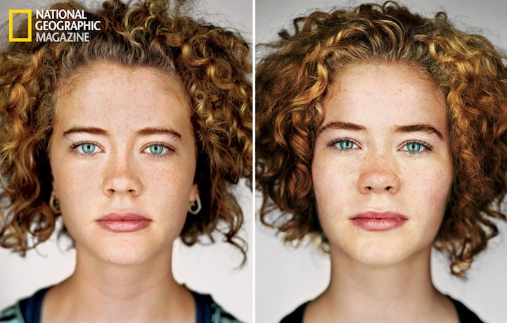
Can you think of a way in which we can study the effects of environmental variation, where there is NO inherited variation? HINT: WHO could we study?
What differences do these twins show?

Slide 14
Characteristic | Caused by genetic variation | Caused by environmental variation | Caused by a combination of both
Scars
Eye colour
Natural hair colour
Height
Weight
Intelligence
Language spoken
Tattoos
Fingerprints
Freckles/birthmarks
Hand you write with
Skin colour
Piercings
Suntan/ Fake tan
Eyesight
Blood group

Slide 15
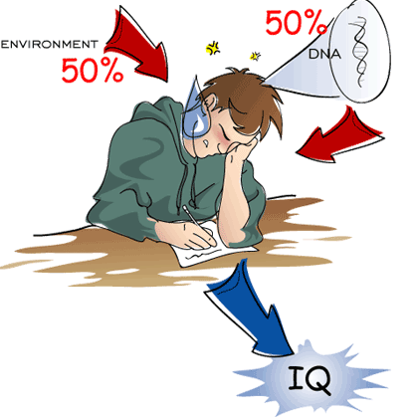
Use your knowledge from today’s lesson to explain why it is important to work as hard as possible in school and at home!

