Slide 1
Do now task
How much can you remember?
What happens at a destructive plate margin? What features are found?
Give three ways climate change will affect a tropical storm?
How can ice sheets melting link to economic impacts?
Describe a country in stage 3 of the DTM
Pencil cases out
Conduct cards in pencil cases
Coats and bags off
Notes:
Collide earthquakes and composite volcanoes)
Intensity/distribution/frequency
Melt/rise in sea levels/flooding/ sea defences breached/land no longer habitable/ economic loss for farers house owners, insurance and government

Slide 2
Human causes of desertification
Date: Monday, 12 October 2020
Learning Objectives:
To be able to explain the cause of desertification in Darfur
To be able to evaluate the role of population growth and human factors in desertification
Notes:
10 mins

Slide 3
Figure 1 shows a mixture of climate change factors, population factors and pressure on resources that all lead to desertification.
For example rising temperatures from global warming, high fertility among the locals and migrants coming from conflict zones, as well as overgrazing by cattle all lead to desertification.

Slide 4
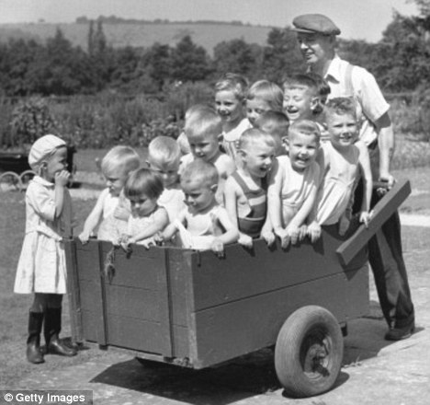
What are the two causes for population growth in areas such as the Sahel?
High birth rate due to lack of education. In 1950 there were 30 million in the Sahel, by 2050 it is expected to be 1 billion.
Migration often occurs if desertification has occurred in one area, making people move to another fragile environment causing desertification here too. These people are called “climate change refugees”.
Learning Objectives:
To be able to explain the cause of desertification in Darfur
To be able to evaluate the role of population growth and human factors in desertification
Notes:
5 mins

Slide 5
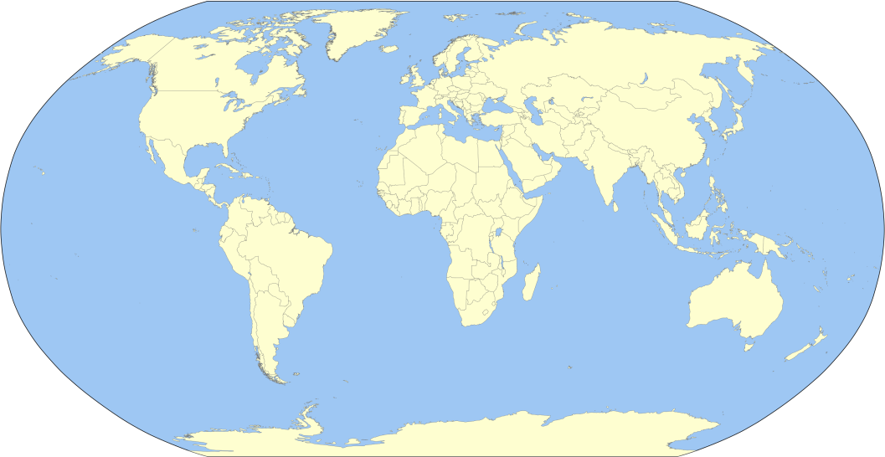
Why has desertification become a problem in Darfur? CASE STUDY
Describe where the Darfur region is (3 marks)
Include:
Continent
Country
Surrounding countries
Learning Objectives:
To be able to explain the cause of desertification in Darfur
To be able to evaluate the role of population growth and human factors in desertification
Notes:
5 mins

Slide 6
What is going on?
Sudan is a country that has been at war since 2003, where 250,000 people have been killed.
Task: Read the news article (on Docs) and answer the question ‘How does desertification cause conflict?’
Learning Objectives:
To be able to explain the cause of desertification in Darfur
To be able to evaluate the role of population growth and human factors in desertification
Notes:
15 mins

Slide 7
What is going on?
Sudan is a country that has been at war since 2003, where 250,000 people have been killed.
Task: Watch the video and list the social and economic problems that the conflict has caused. https://www.youtube.com/watch?v=JIXmz-PeCUs
Learning Objectives:
To be able to explain the cause of desertification in Darfur
To be able to evaluate the role of population growth and human factors in desertification
Notes:
15 mins

Slide 8
Describe the causes of desertification in Darfur (4 marks)

Slide 9
Plenary
Have you answered your learning objectives?
What are the causes of desertification?
What effects does population growth have on desertification?
Learning Objectives:
To be able to explain the cause of desertification in Darfur
To be able to evaluate the role of population growth and human factors in desertification
Notes:
5 mins

