Slide 1
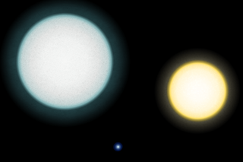
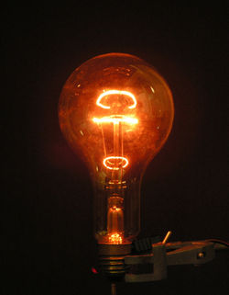
Think!
Which is hotter - red hot or white hot?

Slide 2
Black Body Radiation
Learning Objectives
Know: A perfect ‘black body’ is the best possible absorber and emitter of radiation.
Learning Outcomes
Be able to: Describe how emission and absorption of radiation affect the temperature of an object eg. the Earth.
Key words: Black body Absorb Emit

Slide 3
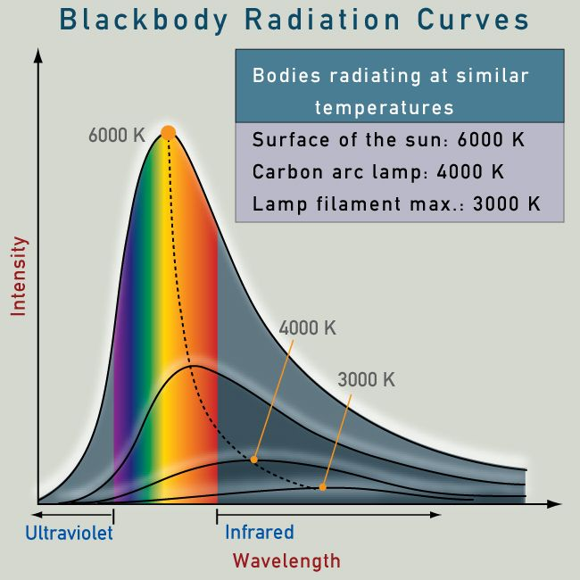
Radiation Intensity Curves
This shows that hotter objects give out more intense radiation at shorter wavelengths (eg. visible and u-v), cooler objects emit most at longer wavelengths (eg. infra-red):

Slide 4
Global Temperature
The Earth’s surface and the atmosphere absorb radiation from the Sun during the day, so warm up. At night, these emit radiation, so cool down.
If emission = absorption, global temperatures will remain constant.
Global warming is due to more radiation being absorbed than emitted. This is thought to be the result of increased C02 levels and decreased ice cover.

