Slide 1
Do now task
How much can you remember?
1. What was the name of the girl in the Brown Vs Topeka case?
2. How many black students tried to enrol at Little Rock?
3. What ideology did the USA follow?
4. What ideology did the Soviet Union follow?
Notes:
1. Linda Brown. 2. Nine. 3. Capitalism. 4. Communism.

Slide 2
Wolsey’s reforms
Recap
1. What were England’s biggest traded?
Wool and cloth.
2. What / who helped Henry rule?
The Royal Council, Privy Chamber and a chief minister.
3. What did Henry need to have to secure his kingdom after he died?
A male heir.
4. Henry aimed to win back lands lost in what country?
France.
5. Who was Henry’s first chief minister?
Wolsey.
Learning Objective
I will be able to describe the different reforms made by Wolsey.
I will be able to evaluate the success of each reform.

Slide 3
Read it:
Infer
Define it:
Deduce or conclude (something) from evidence and reasoning.
Deconstruct it:
Late 15th century (in the sense ‘bring about, inflict’): from Latin inferre ‘bring in, bring about’ (in medieval Latin ‘deduce’).
Example:
What can you infer from the source?
Link it:
Deduce, reason, work out, conclude.

Slide 4
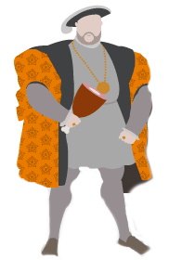
Glossary: Key words and terms
Moveable goods – Possessions that could be moved from one location to another, such as furniture, household items and livestock. Land and buildings were not moveable, and so did not count under the value of moveable goods.
Enclosures – Areas of private land that were fenced off for private use. This was often taken from common lands.

Slide 5
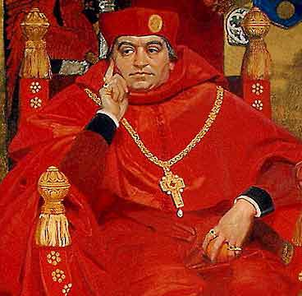
Wolsey’s reforms
Wolsey carried out a series of important reforms, including laws against enclosure and the reform of the finance and justice systems.
He also complied the Eltham Ordinances, which suggested reforms to the Royal Household.
Not all of Wolsey’s reforms were popular. Some created powerful enemies for him and some were not very successful.

Slide 6
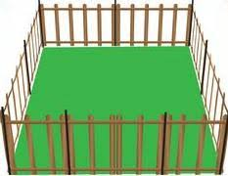
Enclosures
Enclosures - using fences to divide land into fields.
This reduced the land available to the poor who used it to graze their animals.
Wolsey set up an inquiry to investigate the enclosures and to try and reduce its effect on the poor. 260 court cases brought against landowners.
This achieved very little and enclosures continued.
Angered many landowners, creating enemies for Wolsey.

Slide 7
Justice system
Wolsey tried to create a fairer system of justice that made sure the rich were not above the law.
Strengthened the Star Chamber – a royal court set up by Henry to give out justice.
Encouraged the poor to bring cases to court.
Increased the courts work rate (12 a year to 120 a year).
Supported the cases of the poor against the rich and oversaw cases himself.
Limited success – a backlog of cases built up and very few resolved.

Slide 8
The Eltham Ordinances 1526
To tackle the misspending and bad management of the palaces Wolsey created a list of rules 79 chapters long. These included:
Cutting spending on meals and servants, sacking sick and unneeded servants, reducing the amount of money paid to people for expenses and reduced the Privy Chamber from 12 to 6.
Mostly unsuccessful – did save money but he lost interest after he had reduced the size of the Privy Chamber. (his main aim).

Slide 9
Finance
Wolsey needed to raise money for Henry’s battles abroad. He used a combination of old and new taxation that raised a lot of money.
Fifteenths and tenths – were taxes on moveable goods. 1/15 of their value in rural areas and 1/10 of their value in urban areas.
The Subsidy – tax on income. The more you earned the more you paid.
Forced loans – He forced landowners to lend the government money in 1522 and 1523. “Loans” often not paid back.
Clerical taxation – taxed the Church. Supposed to be a gift from the church to the king.
Crown lands – made money through rents and leases. (raised £25,000 in 1515.)

Slide 10
The main sources of revenue (money) raised by Wolsey 1513-29
Tax | Amount raised
Subsidy | £322,000
Forced loans | £260,000
Clerical taxation | £240,000
Fifteenths and tenths | £118,000

Slide 11
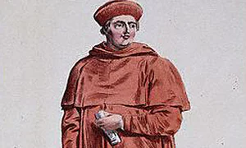
Bringing it together: Wolsey’s reforms
Successes of Wolsey
Failures of Wolsey

Slide 12
Overall, how successful were Wolsey’s reforms?
Enclosures?
Justice?
The Eltham Ordinances?
Finance?

Slide 13
Wolsey’s reform had mixed outcomes.
Some were not successful and led to more enemies for Wolsey, especially the nobles and landowners.
His taxes did raise a lot of money, but could still not keep up with Henry’s spending. Around £1.4 million was spent on fighting wars between 1511 and 1525.
Also, the heavy rate of taxation was very unpopular.

Slide 14
Describe two features of the Eltham Ordinances 1526. (4 marks)
Feature 1
……………………………………………………………………………………………………………………………….
……………………………………………………………………………………………………………………………….
……………………………………………………………………………………………………………………………….
……………………………………………………………………………………………………………………………….
Feature 2
……………………………………………………………………………………………………………………………….
……………………………………………………………………………………………………………………………….
……………………………………………………………………………………………………………………………….
……………………………………………………………………………………………………………………………….

