Slide 1
Do now task
How much can you remember?
Which President sent federal troops to Little Rock?
Who was Emmett Till?
Who were the White Citizens’ Councils (WCC)?
Who were the Dixiecrats?
Notes:
1. President Eisenhower. 2. A 14 year old boy from Chicago who was murdered in Mississippi. 3. Set up to stop desegregation in the south. 4. A group of southern politicians who wanted to keep segregation.

Slide 2
Wolsey’s foreign policy
Recap
1. What was the Amicable Grant?
A tax.
2. Who set up the Amicable Grant?
Wolsey.
3. How many weeks did people have to pay the Amicable Grant?
10 weeks.
4. What was the Amicable Grant supposed to fund?
An invasion / war with France.
5. Who got the blame for the Amicable Grant?
Wolsey.
Learning Objective
I will be able to describe the foreign policy aims of Wolsey.
I will be able to evaluate the successes/failures of Wolsey’s foreign policy.

Slide 3
Read it:
Consequence
Define it:
A result or effect, typically one that is unwelcome or unpleasant.
Deconstruct it:
Late Middle English: via Old French from Latin consequentia, from consequent- ‘following closely’, from the verb consequi .
Example:
Explain two consequences of the bus boycott.
Link it:
Aftermath, aftereffect, fallout, reaction.

Slide 4
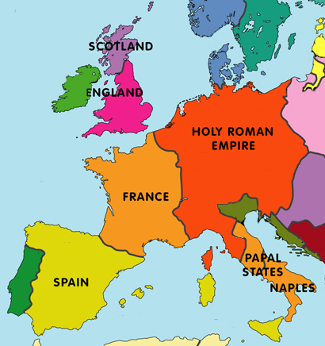
Europe during the reign of Henry
Note! Charles I of Spain was also the Holy Roman Emperor (Charles V). Spain and the H.R.E. became known as the Habsburg Empire.
Spain was an attractive ally for England over France. Henry was married to Catherine of Aragon (Charles I’s aunt) and England’s economy relied on the Netherlands as they had a very strong cloth market which Spain control).

Slide 5
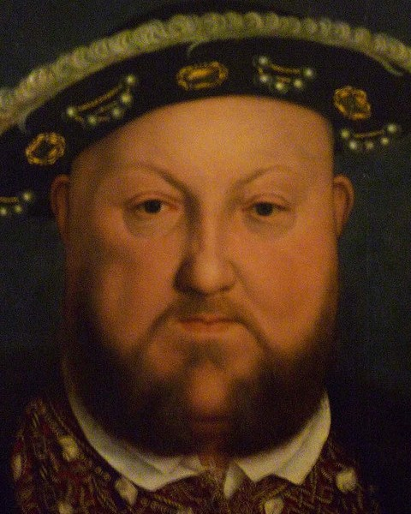
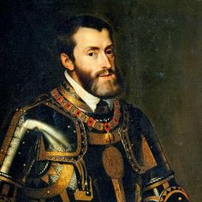
The main players in Europe
Henry VIII of England
Population: 2.75m
Income: £110,000
Allied with Spain
Francis I of France
Population: 15m
Income: £350,000
Allied with Scotland
Charles V of Holy Roman Empire
Population: 23m
Income: £560,000
Also King of Spain
England did not have the population and the resources to compete with the two superpowers – France & the Hapsburg Empire.

Slide 6
Source A: Leonard, Henry VIII and his ministers, 2016.
Like Henry, Charles and Francis were young, bright and ambitious but more powerful.
Rivalries between France and Spain dominated European affairs as they fought over various parts of Europe. Spain was an attractive ally for England.
Henry was married to Charles V’s aunt, Catherine of Aragon. England’s strong cloth trade went through the Netherlands which was under Spanish control. France was England’s traditional enemy.
What does the Source tell you? The source tells me that… Another thing it tells me is… | What can you learn from the Source? This suggests that… This also tells me that…

Slide 7
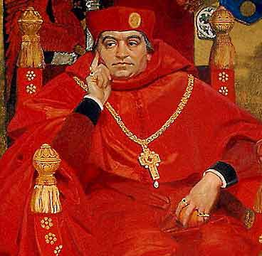
Wolsey had a number of policy aims in a Europe dominated by France and Spain.
His main aim was to carry out the king’s wishes and act as a peacemaker between European states.
He had to balance Henry’s dreams with reality!

Slide 8
Wolsey’s foreign policy aims
-Create better relationships with the two superpowers so England is not isolated and vulnerable.
-Play the two superpowers against each other to England’s advantage.
-Henry to have military glory, more prestige and stopping wars becoming too expensive.
-Make Henry a major peacemaker (more prestige without expensive wars).

Slide 9
Foreign policy successes 1514-1522
The Battle of the Spurs 1514
Final battle in Henry’s first war with France. Gave him a military victory to boast about.

Slide 10
Foreign policy successes 1514-1522
The Treaty of London 1518
Agreed peace in Europe by each state following a non-aggressive policy. If one state attacked another the rest would attack the aggressor. Signed by 20 leaders of Europe and the Pope.
-Brought prestige to Henry. Seen as a great peacemaker.
-Henry and Wolsey at the centre of European politics.
-England seen as a significant power.
-Praised across Europe as a success.

Slide 11
Foreign policy successes 1514-1522
The ‘Field of the Cloth of Gold’ 1520
One of a series of diplomatic meetings set up by Wolsey between Henry and Francis I. No expense spared in a fortnight of feasting and jousting.
Nothing agreed but it put Henry at the centre of European politics.
Displayed England’s power and wealth.
Meeting with a superpower on equal terms.

Slide 12
Foreign policy failures 1522-1529
War with France 1522-25
An alliance with Charles V against France, in the Treaty of Bruges, failed because it was believed that Charles would help Henry take land of France and take the French throne. This did not happen.
After the Battle of Pavia, Charles ignored Henry’s idea of splitting France between them. Instead, Francis I was released by Charles V.
It was unpopular, achieved nothing and cost £430,000.

Slide 13
Foreign policy failures 1522-1529
Alliance with France 1525-29
The Treaty of More and the Treaty of Westminster, brought peace and an alliance between England and France against Spain.
This failed as France were again defeated by Charles V and England did little to help. Damaging England’s reputation as a reliable ally and a serious power.

Slide 14
Foreign policy failures 1522-1529
Wolsey introduced a trade embargo on the Netherlands (Spanish controlled). However, it was called off after protests from English cloth workers.
The Treaty of Cambrai 1529
This was a peace deal between Charles V and Francis I. Wolsey was only told after it was too late. This left England isolated in Europe.

Slide 15
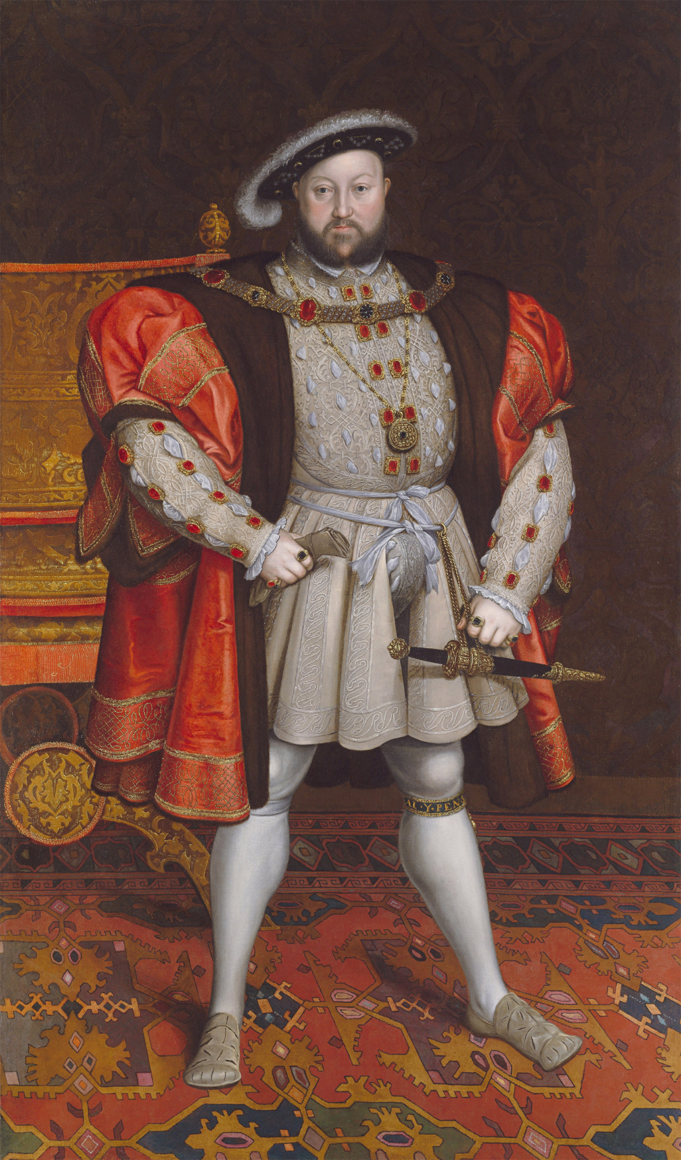
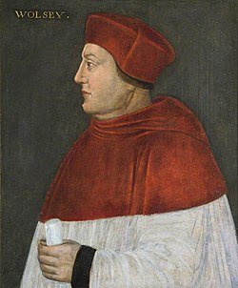
The unreliability of Francis I and Charles V was a key factor in Wolsey’s disastrous foreign policy.
Successes from 1514-1522 but from 1522-1529 it’s mostly failures.

Slide 16
Wolsey’s foreign policy outcomes
Decide if the following or successes or failures
Battle of Spurs
Treaty of Bruges
Treaty of More
Treaty of London
The ‘Field of the Cloth of Gold’
Treaty of Westminster
Treaty of Cambrai
Trade embargo on the Netherlands

Slide 17
‘Wolsey had more successes than failings in relation to foreign policy.’ How far do you agree? (16) You may use the following in your answer: - The Field of Cloth of Gold - The treaty of London
Plan this answer
-Intro – I agree/partly agree/disagree
-On one hand, I agree with the statement (At least 3-4 different points explained)
-On the other hand, I disagree with the statement (At least 3-4 different points explained)
-Conclusion - I agree/partly agree/disagree
Notes:
Students to discuss the successes and failures of – The Field of the Cloth of Gold, The treaty of London, war with France, alliance with Spain, trade embargo with Spain, the failure of the alliance with France, Wolsey’s efforts to achieve military glory against France achieved nothing and Wolsey was powerless to prevent Charles V from ignoring English interests.

