Slide 1
Do now task
How much can you remember?
How are tropical storms measured?
Why are rural areas growing? Give 2 reasons
What does interdependence mean?
What is the brain drain?
Pencil cases out
Conduct cards in pencil cases
Coats and bags off

Slide 2
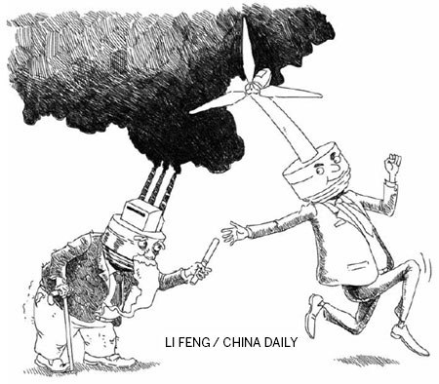
Managing climate change- Mitigation
Starter: By looking at the image, how can we manage climate change?
Lesson Objectives
- To explore a variety of ways that humans can go about managing climate change. - To be able to categorise these management strategies into forms of mitigation and adaptation.

Slide 3
Knowledge Organiser –Climate Change KS4
The global climate has been changing since time began and will continue to change into the future. The Earth's temperature has fluctuated in the last few hundred years. However, since around 1950 there has been a dramatic increase in global temperatures. This increase is known as global warming.
Casestudies
Key Words
Causes of Climate change
Human
Greenhouse effect: Gases that trap solar radiation and warm the Earth.
Burning fossil fuels: Fossil fuels release greenhouse gases in the atmosphere when burnt.
Deforestation: Trees absorb carbon dioxide during photosynthesis. If they are cut down there will be higher levels of carbon dioxide in the atmosphere.
Waste in landfill: Decomposition of waste produces carbon dioxide and methane.
Agriculture: Practices, such as cattle ranching, need large spaces of land, increasing deforestation in the area. Furthermore, cattle release high amounts of greenhouse gases, particularly methane.
Natural
Orbital changes: The Earth has natural warming and cooling periods called Milankovitch cycles.
Volcanic activity: During a volcanic eruption greenhouse gases are emitted into the atmosphere (e.g. carbon dioxide)
Solar output: There can be fluctuations in the amount of radiation from the sun. If there is a high amount emitted then Earth’s temperatures will increase.
1 | Climate change | The change of Earth’s climate, either increasing or decreasing.
2 | Global warming | The rise in the average temperature of the Earth's surface.
3 | Solar radiation | The amount of energy from the sun. The warmer temperatures are, the higher the solar radiation.
4 | Quaternary period | The period of geological time from about 2.6 million years ago to the present.
5 | Greenhouse effect | The retention of heat (solar raditation) in the atmosphere caused by the build-up of greenhouse gases (carbon dioxide, methane, water vapour and methane).
6 | Enhanced green house effects | The warming of the earths atmosphere due to human activity increasing the layer of green house gases.
7 | Milankovitch cycles | The Earth’s variation of movement around the sun which cause an increase or decrease in global temperatures.
8 | Adaptation | Actions taken to adjust to natural events such as climate change, to reduce the potential damage and limit the impacts
9 | Mitigation | Action taken to reduce or eliminate the long-term effects such as making international agreements about carbon reduction targets.
Evidence of Climate change
Thermometer readings: Scientists have collected data and seen an increase in global temperatures.
Glacier retreat: Photographic evidence of glaciers melting, causing them to retreat.
Ice cores: Snow falls and eventually freezes, trapping atmospheric gases. Scientists drill for ice cores and measure the pockets of gas stored.
Change of seasons: On average, in recent years spring has arrived earlier and winters have been less severe.
Rising sea levels: Between 1901 and 2010 average global sea level rose by 0.19m.

Slide 4
Managing Climate Change
Climate change has been in the news a lot recently…
https://www.youtube.com/watch?v=A_lf7_nKXpI

Slide 5
TRUE or FALSE
The greenhouse effect is a natural phenomenon that is being contributed to and made worse by humans.
TRUE
FALSE

Slide 6
TRUE or FALSE
The Earth has warmed by about 3ºF since 1880.
TRUE
FALSE

Slide 7
TRUE or FALSE
There is nothing we can do to try to combat global warming and climate change.
TRUE
FALSE

Slide 8
TRUE or FALSE
Electricity produced from renewable energy resources has increased in recent years.
TRUE
FALSE

Slide 9
TRUE or FALSE
There is no legislation trying to get countries of the world to work together to combat global warming.
TRUE
FALSE

Slide 10
TRUE or FALSE
Changes by businesses and the government will have the greatest effect on combating global warming.
TRUE
FALSE

Slide 11
TRUE or FALSE
There are ways individuals can try to combat climate change on a smaller scale though.
TRUE
FALSE

Slide 12
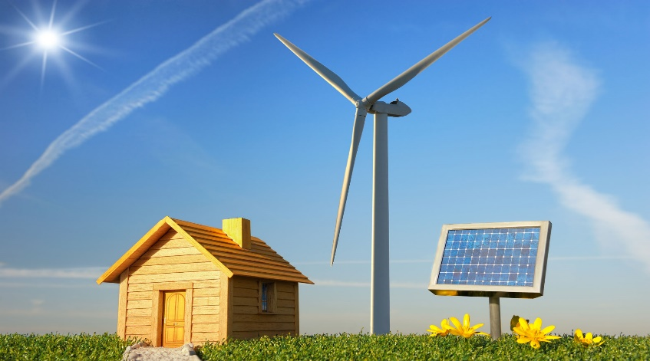
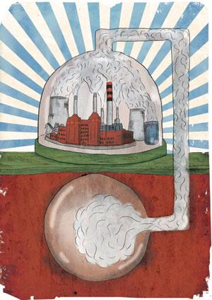
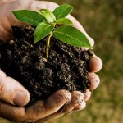
Mitigating Climate Change
Key definition: Mitigation strategies, whether local or global, DEAL with the cause of the problem.
Alternative energy
International Agreements
Replanting Trees
Carbon Capture

Slide 13
Carbon Capture and Storage (CCS)
CCS uses technology to capture CO2, removing it from the atmosphere and storing it elsewhere.
Carbon dioxide is normally pumped via a pipeline deep into the earth. This is then monitored to check that the carbon dioxide doesn’t leak back to the surface or contaminate water.
It IS possible to capture 90% of the CO2 that would otherwise enter the atmosphere.
The United States has enough space to store 1 to 4 trillion tons of carbon dioxide. By comparison, the US emits about 6 billion tons of carbon dioxide every year.

Slide 14
Replanting trees
Trees take in carbon dioxide from the atmosphere through a process called photosynthesis.
They also release moisture, this has a cooling effect because it produces more cloud, reducing incoming radiation.
As long as they are not disturbed, newly planted or regenerating (growing after damaged) forests can continue to absorb carbon for 20-50 years or more.
Task: Use the word document to read about more benefits of replanting trees! Make a list.

Slide 15
Renewable Energy
Using renewable energy means a reduction in CO2 into the atmosphere.
The energy is clean and sustainable
Think: What does sustainable mean?
Task: Read through the information on the worksheet and make notes about each type of renewable energy.
Solar
Wind
Tidal
Geothermal
HEP
Biomass
Nuclear

Slide 16
Paris 2016 International Agreement
In 2016, an assembly of 193 countries discussed the global climate issue. Each country signed a treaty to agree to reduce emissions, with the long-term goal of zero emissions.
The overall aim of this agreement is to keep global temperature rise well below 2c.
Whilst this may be easier for HICs who can afford to invest in clean, green initiatives, LIC and NEE countries struggled. China argued that it should be exempt from this agreement as it develops, after all countries like the UK were allowed to develop through the industrial revolution. However, by signing this agreement, LIC and NEE countries were given finance to adapt (e.g. infrastructure, loss and damage).
To ensure countries understand how they can keep to their agreement, a ”rulebook” was put into place in 2018 at another conference in Katowice, Poland.
Task: Use the word document to read about how international agreements (e.g. the Kyoto Protocol in 1997) help mitigate climate change.
Notes:
https://www.youtube.com/watch?v=I-4F5MJEeqs

Slide 17
Task: Test yourself. Read the boxes and match it up to the correct mitigation strategy.
Technology is used to capture carbon from power stations and then store it underground in abandoned coalmines.
These act as carbon sinks. Carbon Dioxide is absorbed in the process of photosynthesis. They can effectively absorb CO2 for 50 years
Alternative Energy Sources
Carbon Capture
Planting Trees
Climate change affects everyone, so it requires every government to co-operate. The 2015 Paris Agreement was signed by 195 countries and is legally binding. It aims to keep global temperature increase to below 2 degrees C. $100 billion has been promised to support climate change initiatives in developing countries.
International Agreements
Hydro-electricity, nuclear power, wind turbines and solar energy all produce power without adding to Carbon Dioxide to the atmosphere.

Slide 18
Plenary: Put each of the solutions onto the sustainability washing line.
Sustainable
Unsustainable
Alternative Energy
Carbon Capture
International Agreements
Replanting Trees

Slide 19
Homework!
LSQ- Climate Change
Define climate change.
Define global warming.
What is the quaternary period?
How do glaciers provide evidence for climate change?
How do ice cores provide evidence for climate change?
Name the four greenhouse gases.
Give 2 natural causes of climate change.
Give 2 human causes of climate change.

