Slide 1
1)
2)
Translate
1 | école
2 | collège
3 | lycée
4 | université
5 | fac
6 | apprendre
7 | étudier
8 | faire des études
9 | faire ses devoirs
10 | apprentissage
11 | formation
12 | études
13 | avenir
14 | gagner
15 | salaire
16 | diplome
17 | examens
18 | le bac
19 | les contrôles
20 | enseigner
21 | les matières
22 | les cours
23 | aider
24 | réviser
In my school it is forbidden to wear too much make up.
I think that it’s fair because school is for learning.
DO NOW

Slide 2
2)
Translate
1 | école | school
2 | collège | high school
3 | lycée | college
4 | université | university
5 | fac | university
6 | apprendre | to learn
7 | étudier | to study
8 | faire des études | to study
9 | faire ses devoirs | to do homework
10 | apprentissage | apprenticeship
11 | formation | training
12 | études | studies
13 | avenir | future
14 | gagner | to earn money
15 | salaire | salary
16 | diplome | qualification, diploma
17 | examens | exams
18 | le bac | a-level / baccalaureate
19 | les contrôles | tests
20 | enseigner | to teach
21 | les matières | subjects
22 | les cours | lessons
23 | aider | to help
24 | réviser | to revise
Dans mon collège il est interdit de porter trop de maquillage.
Je pense que c’est juste car l’école c’est pour apprendre.
DO NOW

Slide 3
Classwork
Les échanges scolaires
L.O. | To discuss SCHOOL EXCHANGES To use PAST, PRESENT AND FUTURE
DEVOIRS | COLLECT BOOKS

Slide 4
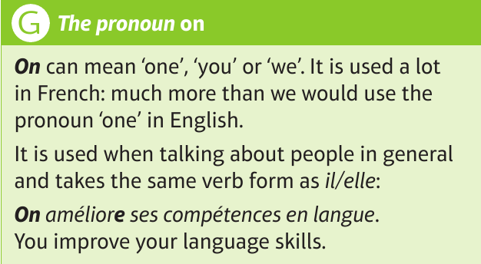
Main structure

Slide 5
Can you work these out?

Slide 6
Try and write them out before checking the answers.

Slide 7
quizlet
https://quizlet.com/_8vmn26?x=1jqt&i=1q80on
If you have difficulties, open this link in Google Chrome

Slide 8
Can you work out the meaning of each statement first?
You will hear a paraphrase of each statement. Can you work them out?
https://www.activeteachonline.com/product/view/id/671/page/132/mode/dps

Slide 9
You can check your answers on the next slide!

Slide 10
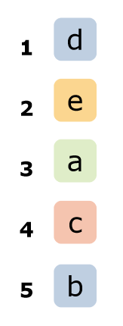

Slide 11
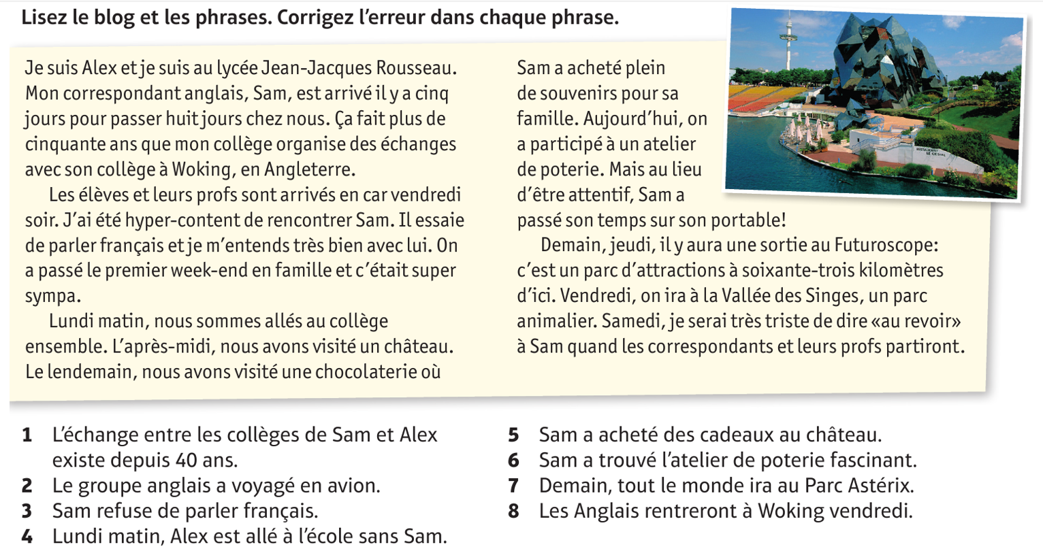
1) Who is Sam?

Slide 12
1) Alex’s exchange student.

Slide 13
2) How long is he staying?

Slide 14
2) 8 days / 1 week

Slide 15
3) How do you say “I get on very well with him”?

Slide 16
3) Je m’entends bien avec lui

Slide 17
4) What did they do Monday afternoon?

Slide 18
4) Visited a castle

Slide 19
5) What did they do the day after?

Slide 20
5) Visited a chocolate factory

Slide 21
6) Where will they go tomorrow?

Slide 22
6) To the Futuroscope, a theme park

Slide 23
Can you try and correct the mistakes in each sentence?

Slide 24
DEVOIRS - homework
Using today’s vocabulary and your debating vocab write a short blog explaining the advantages and disadvantages (if any!) of school exchanges. Aim for 70 words.
Je suis pour | I’m for
Je suis contre | I’m against
C’est une bonne chose | It’s a good thing
C’est une mauvaise chose | It’s a bad thing
Je suis d’accord | I agree
Je ne suis pas d’accord | I disagree
Je suis convaincu(e) que.. | I’m convinced that..
J’ai lu dans un article | I read in an article
Je pense que.. | I think that..
Ils pensent que.. | They think that..
A mon avis | In my opinion
Mes amis disent que.. | My friends say that..

