Slide 1
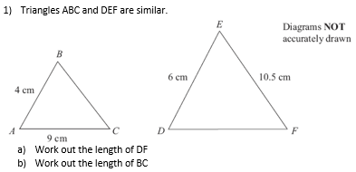
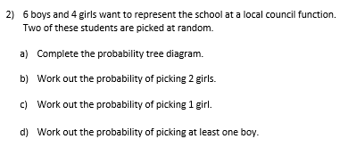

Slide 2
Sketching Graphs
Sketching graphs is a different skill in maths to drawing a graph.
It requires you to plot a graph roughly.
Key Steps
Plot the points where the graph will cut the axes.
Plot the maximum and minimum points.
Free-hand draw the graph going through these points.

Slide 3
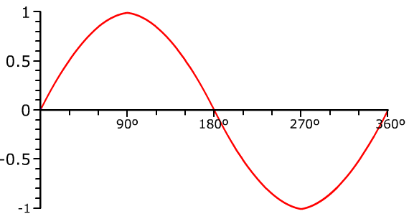
Sine Graph

Slide 4
solve Sin x = 0.5 between 0⁰ & 180⁰.
Sin x = 0.5
So Sin x = 0.5,
When x = 30⁰ & 150⁰
30⁰
150⁰
Notes:
Extension slide to have on WB white students are drawing graphs.

Slide 5
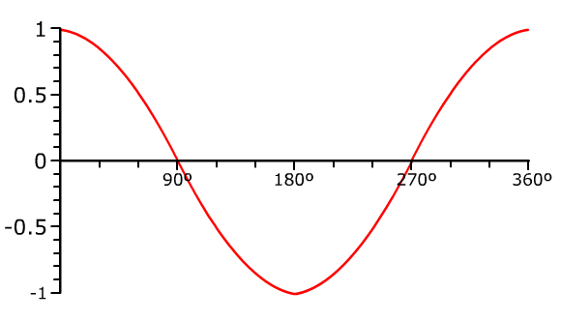
Cosine Graph

Slide 6
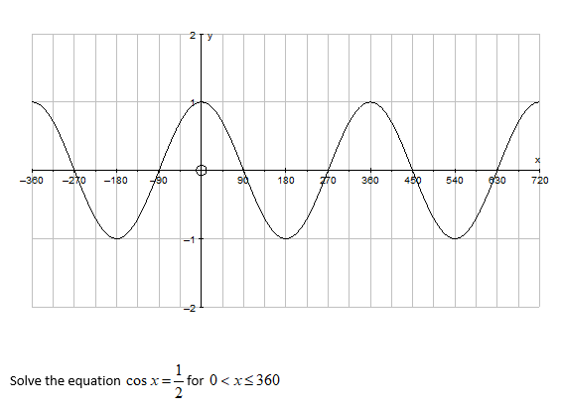

Slide 7
60
300

Slide 8
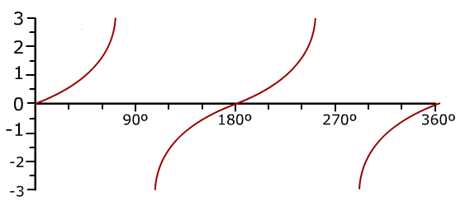
Tangent Graph

Slide 9
Solving Trigonometric Graphs
You need to also be able to solve trigonometric equations.
Example
Solve, Tan(x) = 0.5 between 0⁰ & 360⁰.
Notes:
Extension slide to have on WB white students are drawing graphs.

Slide 10
Example
Solve, Tan(x) = 0.5 between 0⁰ & 360⁰.
26.6⁰
180 ⁰ + 26.6⁰
= 206.6⁰
So Tan x = 0.5,
When x = 26.6⁰ & 206.6⁰
Notes:
Extension slide to have on WB white students are drawing graphs.

Slide 11
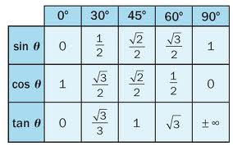
Notes:
Clcik tile to find out the correct value.

Slide 12
8
1
-1
$$y=\sin{x}$$
$$x$$ | 0 | 90 | 180 | 270 | 360
$$y$$ | 0 | 1 | 0 | -1 | 0
?
?
?
?
?
90 180 270 360
Notes:
Get students to sketch axes and tables in their books.

Slide 13
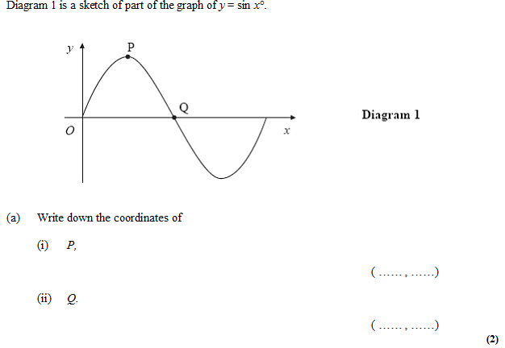
?
90 1
?
180 0

Slide 14
8
1
-1
$$y=\cos{x}$$
$$x$$ | 0 | 90 | 180 | 270 | 360
$$y$$ | 1 | 0 | -1 | 0 | 1
?
?
?
?
?
90 180 270 360
Notes:
Get students to sketch axes and tables in their books.

Slide 15
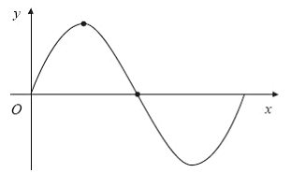
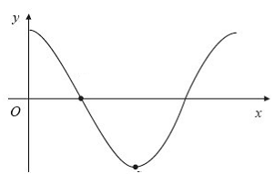
$$y=\sin{x}$$
$$y=\cos{x}$$
$$y=\sin{x}$$
$$y=\cos{x}$$
$$D$$
$$B$$
$$C$$
$$A$$
$$A\left(270, −1\right)$$
?
$$B\left(90, 0\right)$$
?
$$C\left(360, 0\right)$$
?
$$D\left(0, 1\right)$$
?
$$y=\sin{x}$$
$$y=\cos{x}$$
$$y=\sin{x}$$
$$y=\cos{x}$$
$$E$$
$$G$$
$$H$$
$$F$$
$$E\left(180, 0\right)$$
$$F\left(180,−1\right)$$
$$G\left(90,1\right)$$
$$H\left(270, 0\right)$$
?
?
?
?

Slide 16
Q
Suppose that $\sin{45}=\frac{1}{\sqrt{2}}$
Using the graph, find the other solution to $\sin{x}=\frac{1}{\sqrt{2}}$
1
$$\frac{1}{\sqrt{2}}$$
$$x=135°$$
?
90 180 270 360
$$45$$
$$135$$
-1
We can see by symmetry that the difference between 0 and 45 needs to be the same as the difference between $x$ and 180.
Q
Suppose that $\sin{210}=−\frac{1}{2}$
Using the graph, find the other solution to $\sin{x}=−\frac{1}{2}$
$$x=330°$$
?

Slide 17
1
-1
The graph shows the line with equation $y=\cos\left(x\right)$
Given that $\cos\left(60\right)=\frac{1}{2}$, find the other solution to $\cos\left(x\right)=\frac{1}{2}$ $x=300°$
Given that $\cos\left(150°\right)=−\frac{\sqrt{3}}{2}$, find the other solution to $\cos\left(x\right)=−\frac{\sqrt{3}}{2}$ $x=210°$
?
?
90 180 270 360
Notes:
Get students to sketch axes and tables in their books.

Slide 18
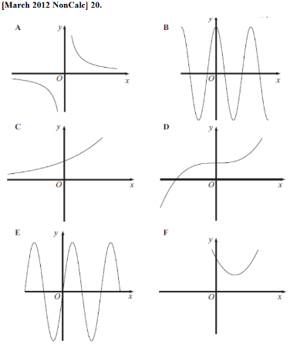
Exercise 1 (on provided sheet)
1
Identify the coordinates of the indicated points.
3
Match the graphs to their equations.
$$A$$
$$y=3×2^{x}$$
$$y=\sin{x}$$
$$C$$
$$B$$
$$x^{2}+y^{2}=9$$
$$y=\frac{4}{x}$$
$$D$$
$$E$$
1
$$A\left(90,1\right) B\left(180,0\right) \\ C\left(0,3\right) D\left(−3,0\right) \\ E\left(1,4\right)$$
?
?
?
?
?
2
Which of these graphs could have the equation $y=x^{3}−2x^{2}+3$?
?
i. $y=4\sin{x}$ E ii. $y=4\cos{x}$ B iii. $y=x^{2}−4x+5$ F iv. $y=4×2^{x}$ C v. $y=x^{3}+4$ D vi. $y=\frac{4}{x}$ A
a
b
c
c, because a is the wrong way up (given $x^{3}$ term has positive coefficient) and b has the wrong y-intercept.
?

Slide 19
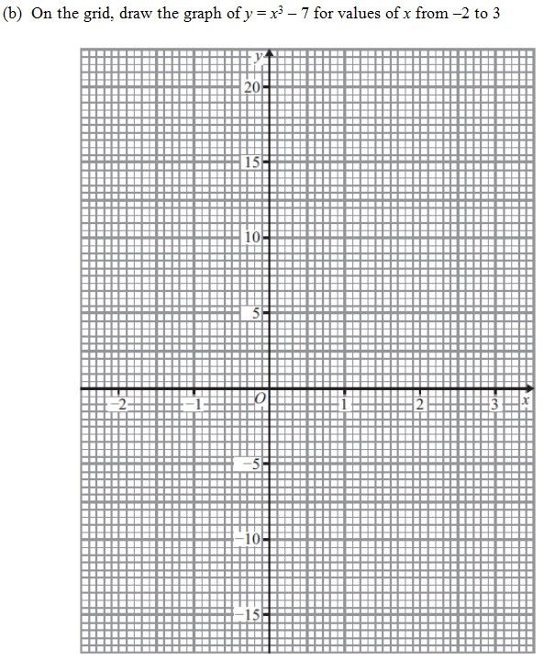
Exercise 1 (on provided sheet)
4
?
-15 -7 -6 1
?
?
?
Reveal

Slide 20
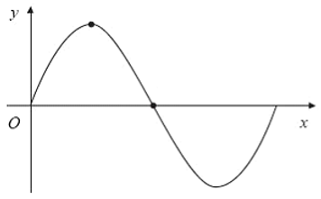
Given $\sin\left(60\right)=\frac{\sqrt{3}}{2}$, determine all solutions to $\sin\left(x\right)=\frac{\sqrt{3}}{2}$ $x=120 (,60)$
Given $\sin\left(30\right)=\frac{1}{2}$, determine all solutions to $\sin\left(x\right)=\frac{1}{2}$ $x=150 (,30)$
[Harder] Given $\sin\left(45\right)=\frac{1}{\sqrt{2}}$, determine the two solutions to $\sin\left(x\right)=−\frac{1}{\sqrt{2}}$ (note the minus) $x=225°, 315°$
?
?
?

Slide 21
