Slide 1
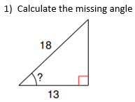


Do now

Slide 2
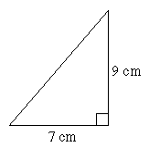
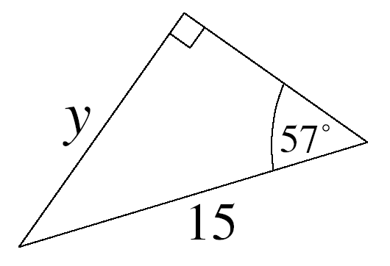
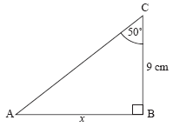
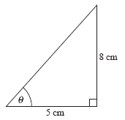
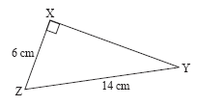
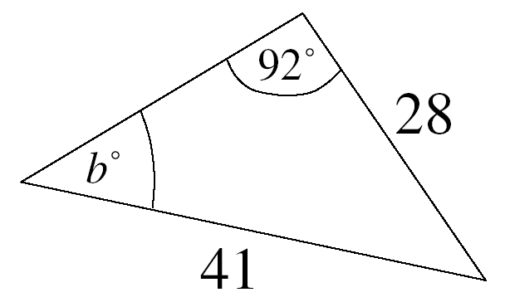
Pythagoras, Sin, Cos or Tan?
1)
2)
3)
x
Pythagoras
Sin – Missing Side
Tan – Missing Side
4)
5)
6)
a
Tan – Missing angle
Pythagoras
Neither...?

Slide 3
B
sin A = sin B = sin C
a b c
a
c
...is the same as...
a = b = c
Sin A sin B sin C
C
A
b
We can use this formula to find missing sides or angles of non-right-angled triangles

Slide 4
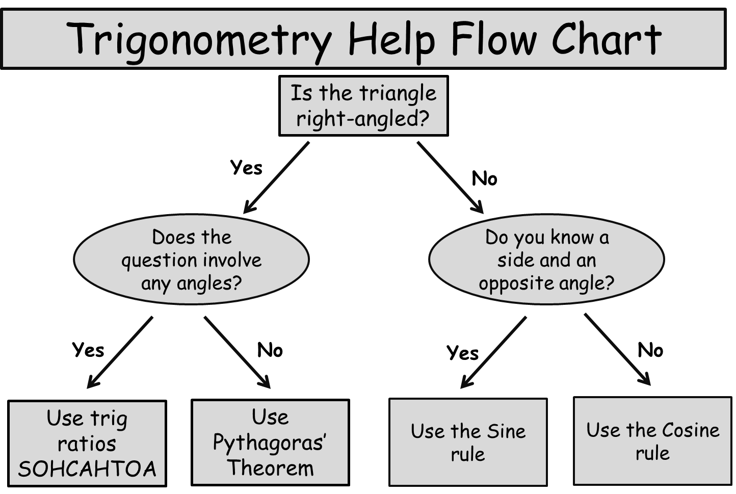

Slide 5
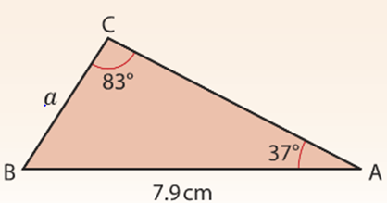
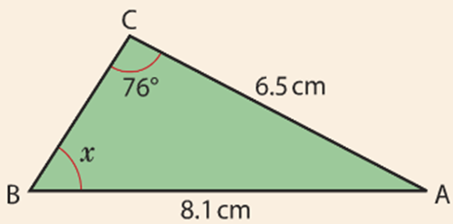
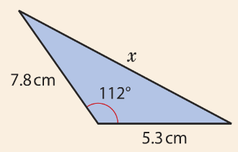
Can we use the Sine rule?

Slide 6
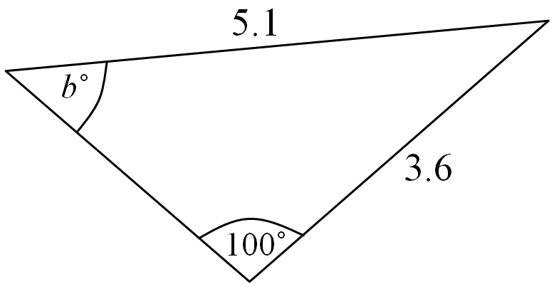
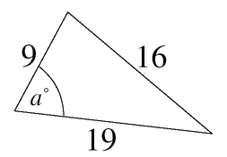
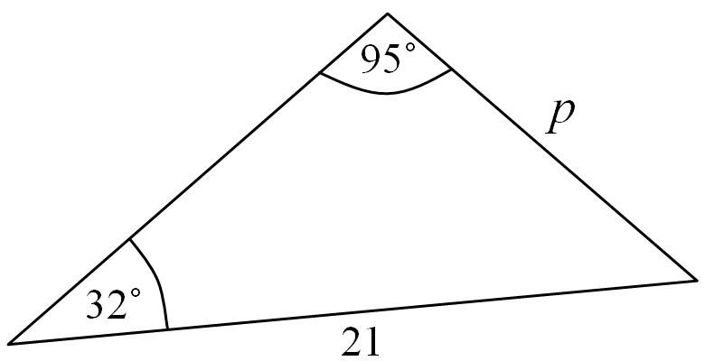
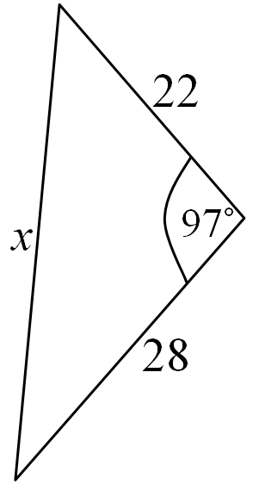
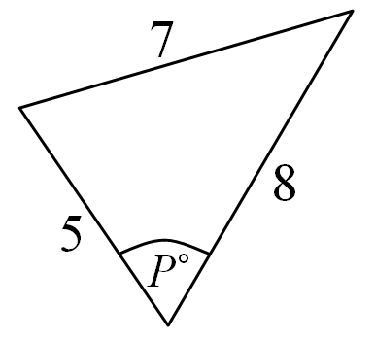
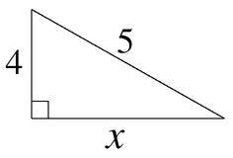

Slide 7
a
b
c
A
=
=
sin A
sin B
sin C
53⁰
Example: Finding a side
12cm
To use the Sine Rule to find a side you have to know two angles and one more side
a
12
=
71⁰
sin 53⁰
sin 71⁰
C
a = ?
B
12 x
sin 53⁰
Rearranging:
a
=
=
10.14 (2 dp)
sin 71⁰

Slide 8
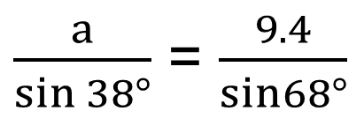
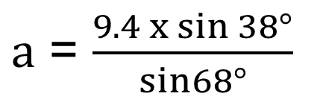
Find the length of the side marked a and give your answer correct to 3 s.f.
68°
a
38°
9.4cm
a = 6.2417…
a = 6.24 cm (3 s.f.)

Slide 9

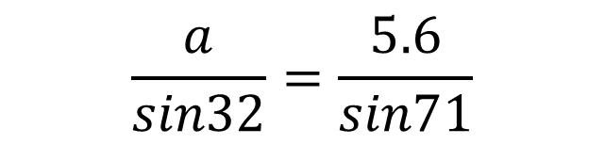
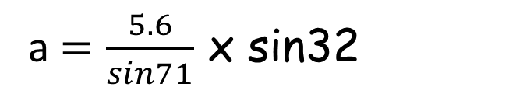
Find the length of the side marked a and give your answer correct to 3 s.f.
71°
a
32°
5.6cm
a = 3.14cm

Slide 10
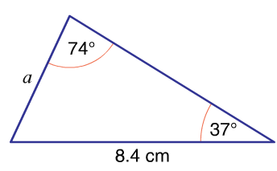
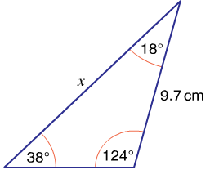
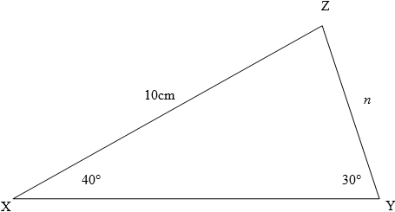

Slide 11
To use the Sine Rule to find an angle you have to know two sides and one angle
A
sin A
sin 43⁰
=
?⁰
24
19
24
sin 43⁰
c = 19
Rearranging:
sin A
=
b
19
sin A
=
0.861 …..
A = sin ^{–1} (0.861 ..)
43⁰
C
A = 59.48⁰
a = 24
B

Slide 12
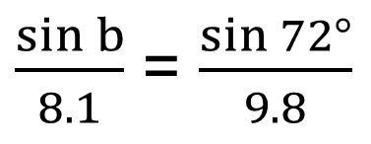
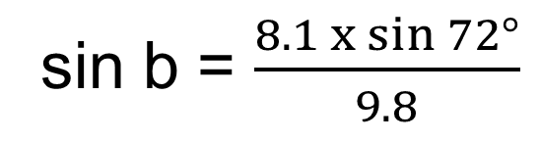
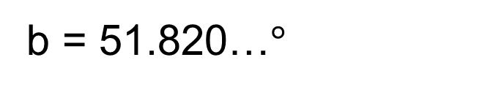
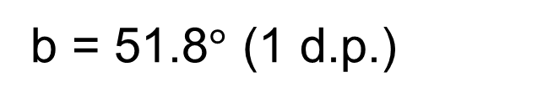
Find the size of the acute angle marked B and give your answer correct to 1 d.p.
72°
8.1cm
B
sin b = 0.7860…
9.8cm

Slide 13
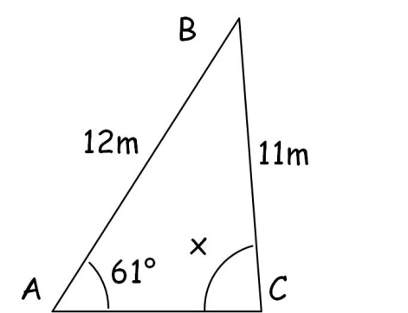
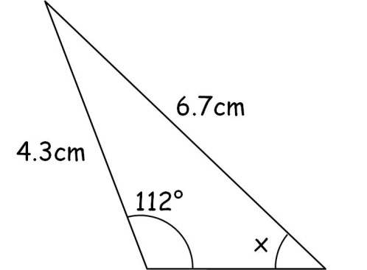

Slide 14
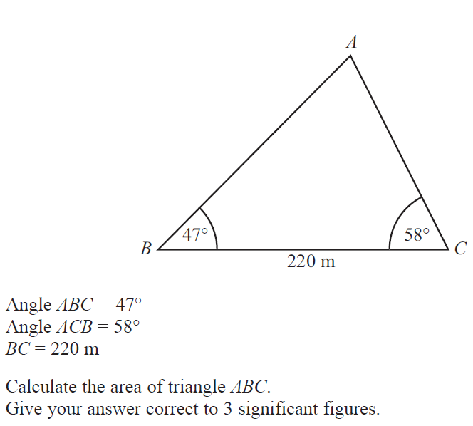

Slide 15
Quadrilateral ABCD is made up of two triangles ABD and BCD.
Use the sine rule to work out the length of x
^{x}
a
8
=
sin 30⁰
sin 45⁰
8 x
sin 30⁰
Rearranging:
a
=
sin 45⁰
=
5.7 (1 dp)

Slide 16





Quadrilateral ABCD is made up of two triangles ABD and BCD.
Use the sine rule to work out the length of x
^{x}
5.7m

Slide 17

The angle of elevation of the top of a building measured from point A is 25º. At point D which is 15m closer to the building, the angle of elevation is 35º Calculate the height of the building.
T
10º
36.5
35º
145º
25º
B
D
15 m
A
Angle TDA =
180 – 35 = 145º
Angle DTA =
180 – 170 = 10º

