Slide 1
Do now task
How much can you remember?
Why is the nutrient cycle so important in the tropical rainforest?
Give 2 natural causes of climate change
Where are tropical storms located (distributed?)
4. Give the 4 factors that will affect the hazard risk
Pencil cases out
Conduct cards in pencil cases
Coats and bags off
Notes:
Udhiu
Lk
G
Type/economic development/ population growth/severity

Slide 2
Do now task
How much can you remember?
Why is the nutrient cycle so important in the tropical rainforest? Provides plenty of nutrients for the plants to absorb.
Give 2 natural causes of climate change. Orbital cycles/ volcanic activity/ solar output.
Where are tropical storms located (distributed?) Between 5 and 30 degrees north and south of the equator.
4. Give the 4 factors that will affect the hazard risk. Type/ economic development/ population growth/ severity.
Pencil cases out
Conduct cards in pencil cases
Coats and bags off
Notes:
Udhiu
Lk
G
Type/economic development/ population growth/severity

Slide 3
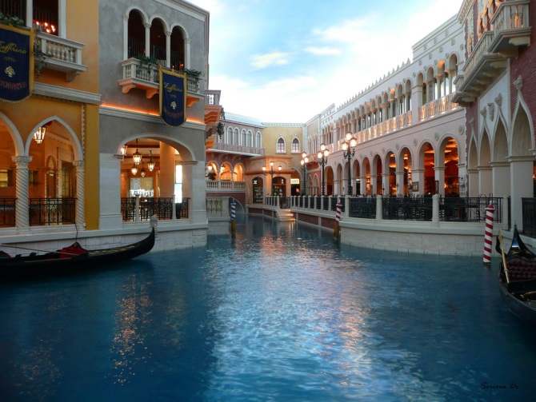
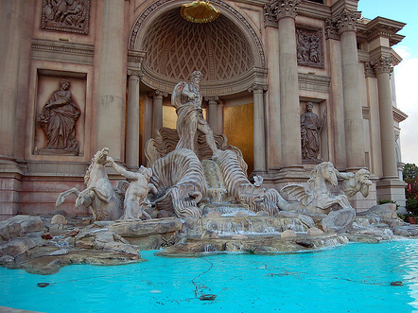
The Western Desert’s water crisis
Tuesday, 06 October 2020
Stretch: What do you think will happen to this place in the future? Is it sustainable?
Learning Objectives:
To be able to explain the costs and benefits of irrigating the Western Desert
To be able to evaluate future water supply and population growth issues in the Western Desert
Notes:
All from Las Vegas- Eiffel tower replica, Little Venice replica, Trevi fountain Rome replica. (10 mins)

Slide 4
1800-1900s

Slide 5
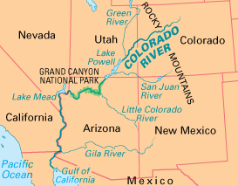
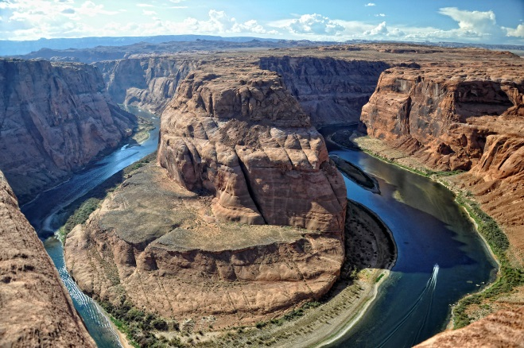
1800s- 1900s
Twentieth century migrants could see plenty of opportunities in the Western Desert’s sunny skies. Farming and tourism would flourish if they could tackle the issue of water shortages.

Slide 6
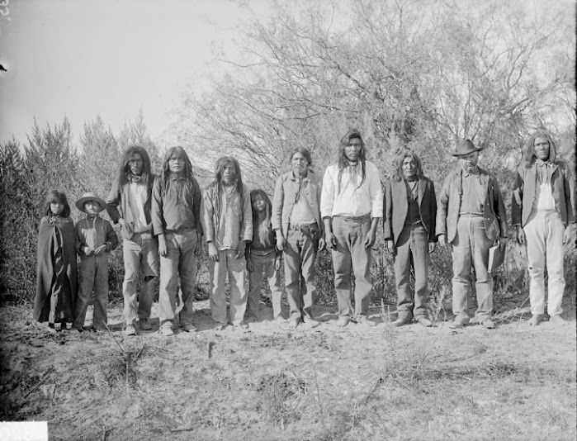
Solution: Colorado River
What: 2300km river which brings meltwater from the Rocky Mountains and Wind River mountains across the USA and down to Mexico.
1800 and 1900s: Cocopah people relied on the Colorado water for irrigation. This was sustainable until the expansion of people after the discovery for gold in 1849.

Slide 7
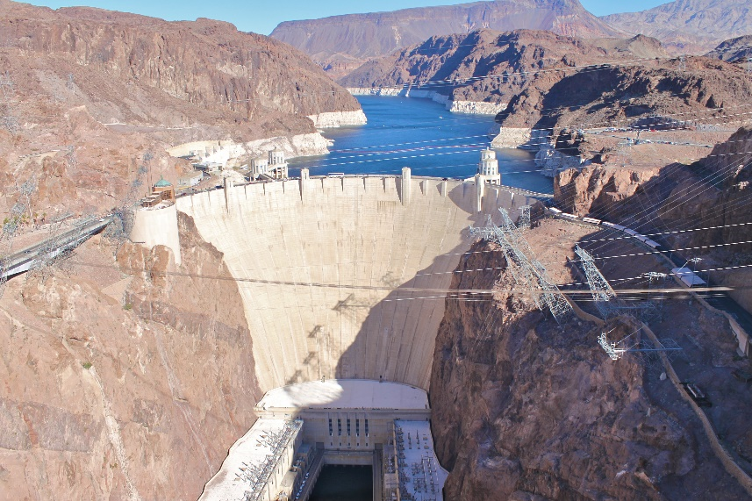
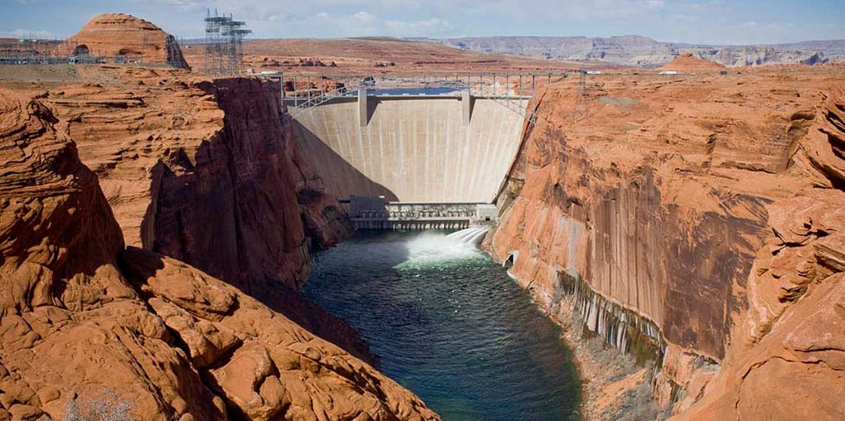
Solution: Colorado River
Solution: In 1935, work began on the Hoover Dam, which stores the equivalent of two years’ river flow in Lake Mead. This cost $49 billion.
The Glen Canyon Dam followed in 1963.
Together the two dams and their reservoirs smooth out the Colorado’s flow through the year and remove its flood peaks.

Slide 8
Solution: Colorado River
Why was it needed: Temperatures throughout the Colorado basin are high so water is lost through evaporation.
The lower basin was liable to flooding.
Urbanisation and population growth in the SW.
Water needed for farming (cattle & irrigation).

Slide 9
Task: Write down 3 advantages and 3 disadvantages of Dams.

Slide 10
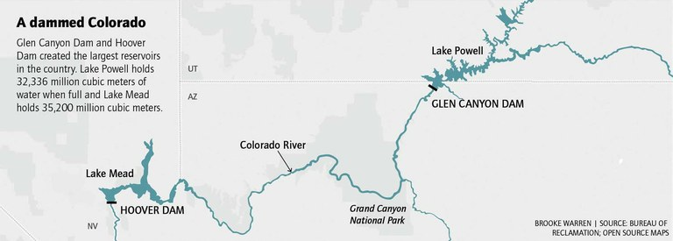

Slide 11
https://www.youtube.com/watch?v=PJrr4-wqIUM
Task: Watch the video for 4 minutes and write down…
3 points about why the Colorado River is so important for development in the Western Desert.
3 points about the problems faced

Slide 12
Today

Slide 13
Solution: Colorado River
Yet while the cities of the Western Desert continue to grow, there is a physical limit to how much water can be taken from Colorado.
There is a political limit too, because of an international agreement which states water must be allowed to flow into Mexico (where the Colorado ends).

Slide 14
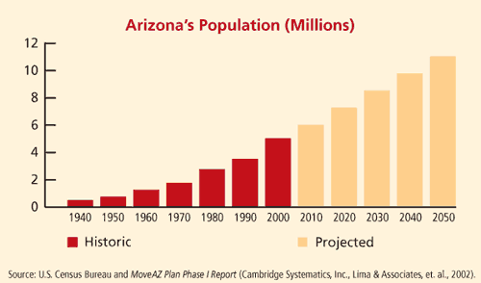
Solution: Colorado River
Between 2000, and 2010, several states experienced rapid population growth, more than double the national average.

Slide 15
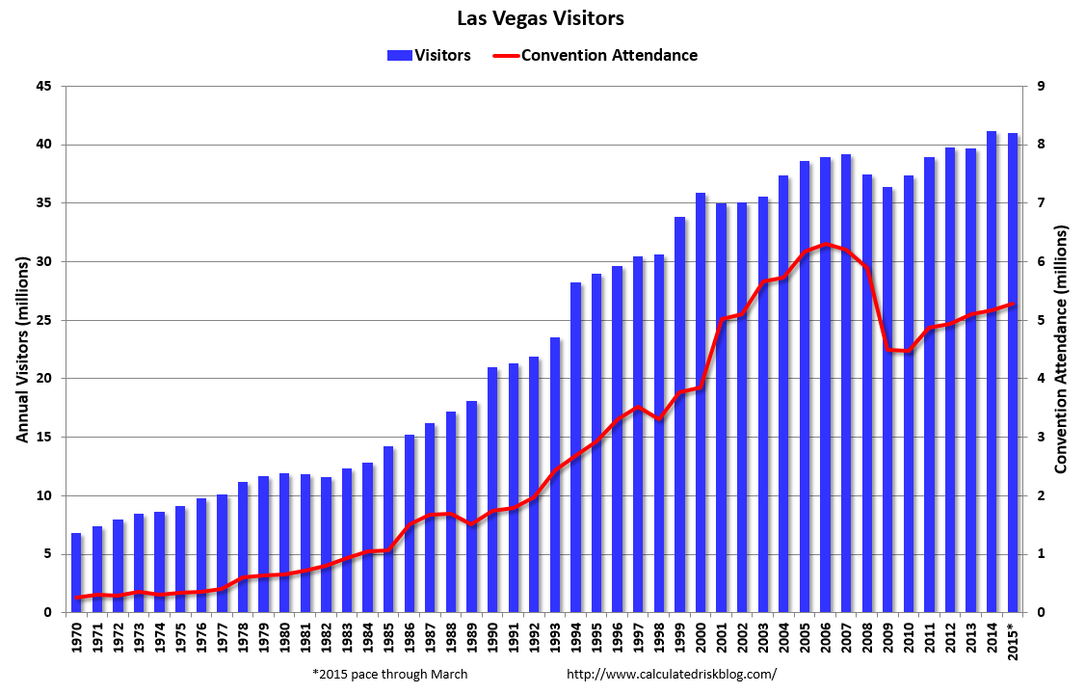

Slide 16
Task: Sort the statements into cost or benefits of the Hoover Dam
Rapid population growth means that even greater water scarcity is expected in the future
Reservoirs bring water to cities throughout the Western Desert area (e.g. Phoenix, Tucson, Albuquerque, San Diego, Las Vegas and Los Angeles).
Colorado’s aqueducts bring life-giving water to farms growing fruits and vegetables
Trapped sediment upstream mean that banks in the lower course have less sediment. This negatively effects the population of Kanab snail.
Water availability allow for 40 million people to visit Las Vegas every year, contributing £100 million to the economy.
More than 1.4 million acres of irrigated land throughout the Colorado River Basin produce about 15% of the USA’s crops and 13% of its livestock.
Climate change has impacted on rainfall patterns. In 2014, Lake Mead reached a record low level.

Slide 17
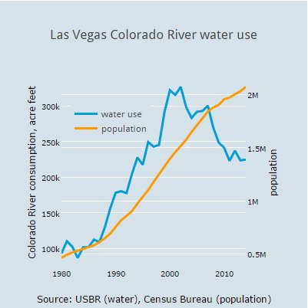
Other solutions are to conserve water by educating the inhabitants of the Western Desert.

Slide 18
Task: Watch the video and answer the questions. This video looks at problems faced by humans in the desert and is based in Las Vegas. https://www.youtube.com/watch?v=Sv1zd23f-E0
What is Las Vegas suffering with?
How much water is used watering their lawn?
How can residents be thoughtful?
What is the solution?

Slide 19
Task: Watch the video and answer the questions. This video looks at problems faced by humans in the desert and is based in Las Vegas. https://www.youtube.com/watch?v=Sv1zd23f-E0
What is Las Vegas suffering with? Water shortages.
How much water is used watering their lawn? 60%
How can residents be thoughtful? Only use grass where it is needed.
What is the solution? Xeriscaping which involves planning gardens carefully (hardy plants, use artificial grass, local rock).

Slide 20
Task: Using your own knowledge and the marks from your feedback test, highlight your KO in green.

Slide 21
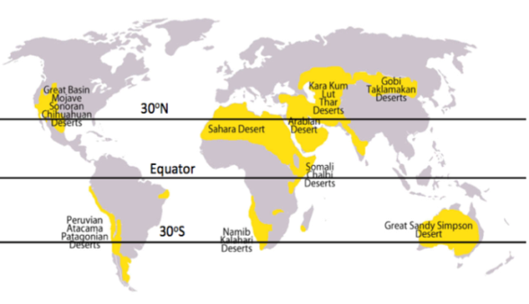
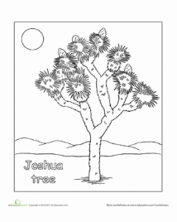
Knowledge Organiser –Deserts
Key Words/ Terms
1. | A desert is: a region so arid because of little rainfall that it supports only sparse and widely spaced vegetation or no vegetation at all
4. | Biome | A large naturally occurring community occupying a major habitat, e.g. desert, forest or tundra.
5. | Evaporation | Water lost from the ground’s surface. Rates of evaporation are high in hot deserts.
6. | Sahara Desert | The largest hot desert in the world. The desert comprises much of North Africa.
8 | Las Vegas | Las Vegas, in Nevada’s Mojave Desert, is a resort city famed for its vibrant nightlife. Citizens have had to adapt their lifestyles to cope with the arid climate.
9. | Desertification | The process by which land becomes drier and degraded, as a result of climate change or human activities, Also known as soil degradation.
10. | Adaptation The camel | The process of change by which an organism or species becomes better suited to its environment. Long eyelashes to keep the sand out Bushy eyebrows to keep the sun out Stores fat in humps to have energy reserves Large feet to walk on the sand Thick lips to be able to eat cacti
11. | Indicator species | Any biological species that defines a trait or characteristic of the environment. It is also an indication of how healthy that ecosystem is. .
Key Facts
The desert biome is an ecosystem that forms due to the low level of rainfall it receives each year. Deserts cover about 20% of the Earth.
There are four major types of desert in this biome - hot and dry, semiarid, coastal, and cold. They are all able to inhabit plant and animal life that are able to survive there.
2. | Hot desert | Parts of the world that have high average temperatures and very low precipitation.
3 | Precipitation | Moisture falling from the atmosphere - as rain, hail, sleet or snow. Rates of precipitation are very low in hot deserts; typically less than 250mm per year.
Spiny upwards turned needle-like leaves coated with a waxy resin. Traps any moisture in the air and reduce water-loss by transpiration.
Thick trunk and limbs. Stores water.
Deep roots and bulbs buried 30 feet below the ground. Reaches groundwater stored deep below.
Shallow roots 2-3 feet below the ground. Quickly catches rainfall before it evaporates.
2 sets of root systems.
Shallow roots & deep roots.

