Slide 1
The theory of evolution
Truth or lie?
Review of what you’ve learnt in genetics.
Groups for starter
Read the scenario on your table
Use your knowledge and understanding to decide if it’s a truth or lie.
Be sure to show your reasons / working out (use white boards)
Be ready to share – anyone in your group may be selected to justify your answer.

Slide 2
The theory of evolution
Learning objectives
Recall that all species of living things have evolved from simple life forms.
Explain how evolution occurs through natural selection
Learning outcomes
Explain the term ‘evolution’.
Describe and apply Lamarck’s theory of evolution.
Consider and explain the evidence for evolution.

Slide 3
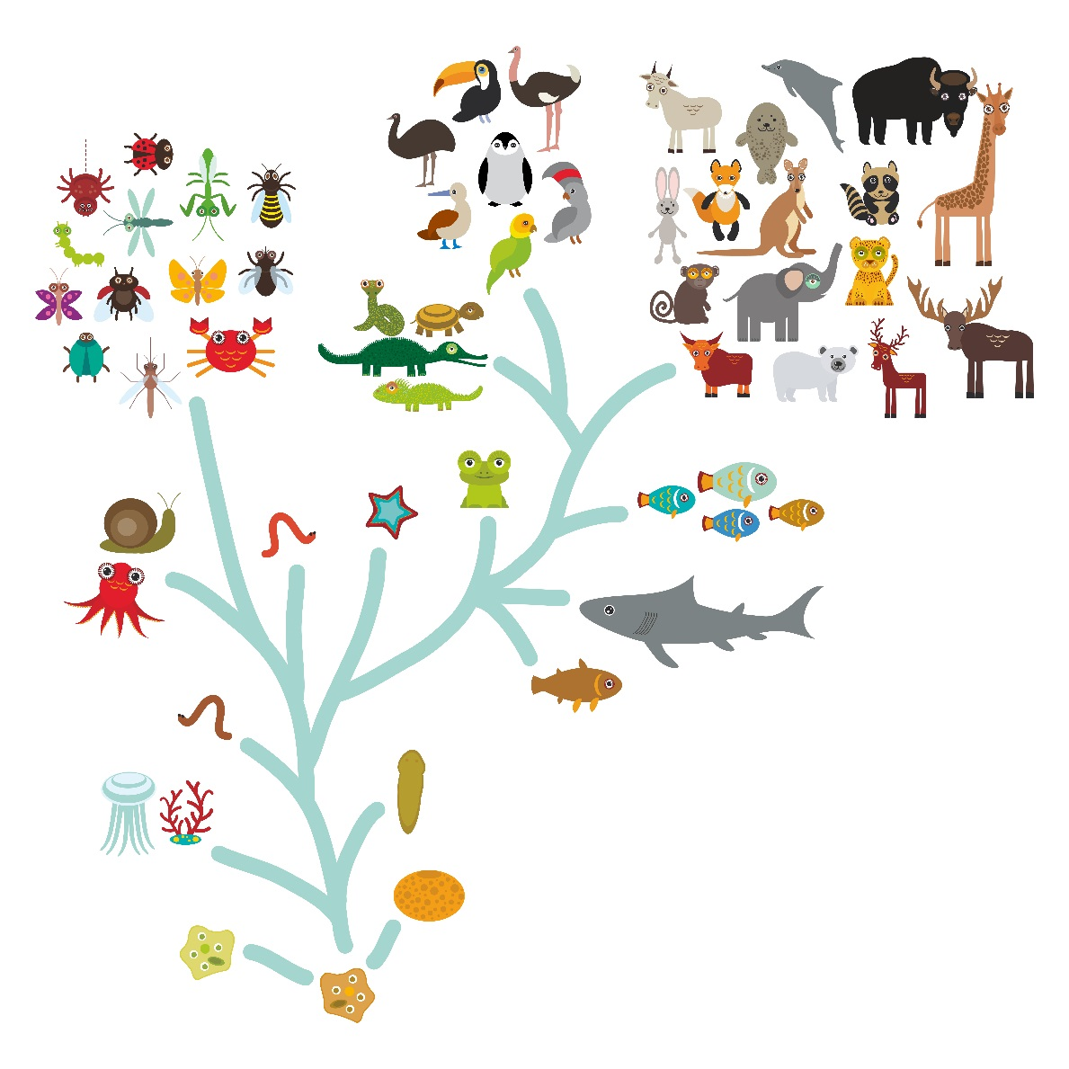
The theory of evolution – evolutionary tree

Slide 4
Lamarck’s theory
Lamarck (1809) believed that characteristics obtained in a parent during their lifetime could be directly passed on to their child. In part this could be true, as shown in the example of the giraffe.
However, Lamarck also believed that by strengthening body parts in a lifetime, e.g. if a parent became a good tennis player, the offspring would inherit stronger muscles. In addition, he believed that organisms did not become extinct, but simply evolved into new species.

Slide 5
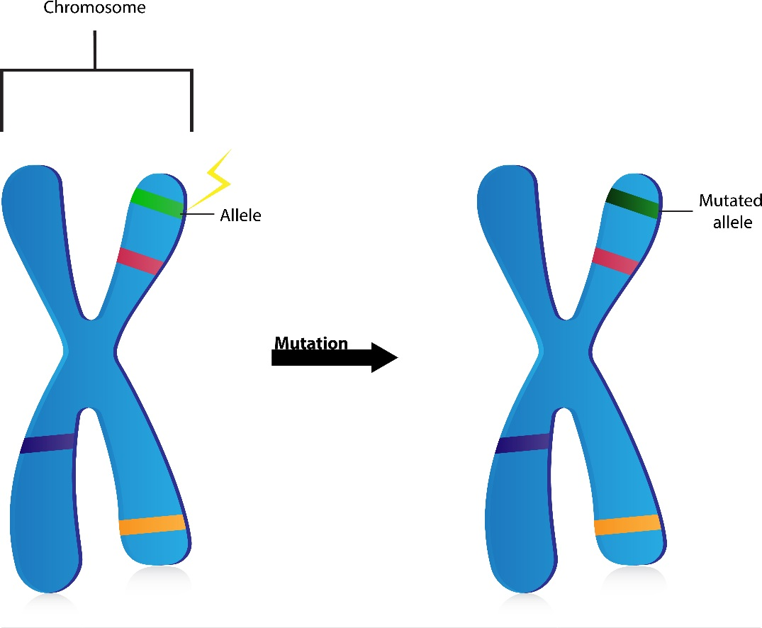
Mutation
A mutation is a change in the genetic code.
Mutations can arise from perfectly natural alterations in copying DNA when cells divide.
Mutations lead to variations within species.
Some mutations are harmful, some beneficial and some are both.
Mutations which are beneficial tend to make an organism more successful and more likely to reproduce.

Slide 6
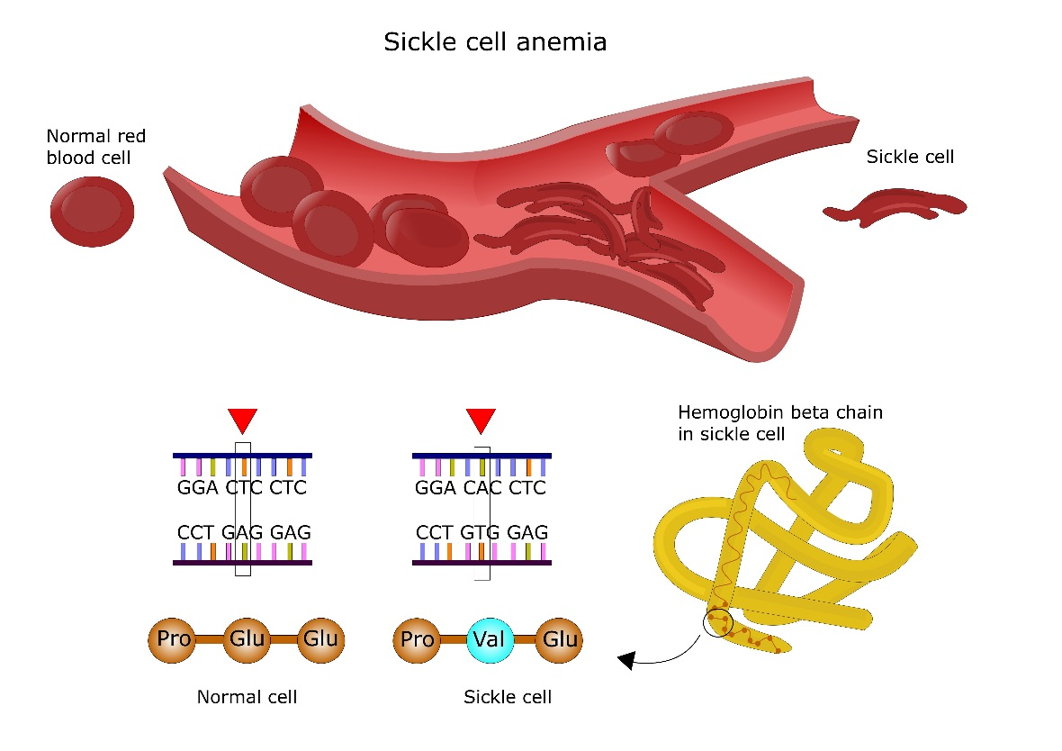
Beneficial mutations?
A particular mutation is common in people of African and Asian origin. There is a change in one section of DNA, which results in people developing deformed haemoglobin and a condition known as sickle cell anaemia.
Individuals are only likely to live to about 20 years old; however, they have a distinct advantage in that they are completely resistant to malaria – the world’s greatest killer. Although they die young, they do live long enough to reproduce.
haemoglobin

Slide 7
Green
Jessica was born with 6 toes (Polydactyl), which she inherited from her dad. The doctor if she has children with a ‘normal’ (non-polydactyl) person she has a 50% chance of having a normal child with 5 digits. Is this correct?

Slide 8
Red
Carl and Susan have had a baby with cystic fibrosis. Carl and Susan don’t suffer with CF. Carl’s friend said it was impossible for him to have a child with Susan that was a CF sufferer, questioning if he was the real biological father.

Slide 9
Purple
Haemophilia is a recessive disease carried on the x chromosome. People who suffer from haemophilia have problems with their blood not clotting very well. This can result in bleeding longer after injury, easily bruising and bleeding on the brain after knocks to the head. Men ae more likely to suffer with the condition than women, is this true?

Slide 10
Orange
Pedro’s 2 black Labradors had 8 puppies. 6 of them were black and 2 of them are golden coloured. His vet told him the chance of that happening are 100:1, was he telling the truth?

Slide 11
Blue
Doris sadly developed symptoms of Huntington’s disease aged 57. Her mum died at the age of 75 but not of Huntington’s and she never knew her father. Doris believes all of her 3 children will develop the disease. Is she correct?

