Slide 1
Waves required practical

Slide 2
Do Now
1. Which equation links wave speed, wavelength and frequency?
2. What do we call the height, or depth, of a wave?
3. What is an example of a longitudinal wave?
4. What is an example of a transverse wave?
5. How many metres in 12.5km?

Slide 3
WALT
Know how to measure the wavelength and frequency of waves in a ripple tank

Slide 4
WILF
GW – Know the equipment needed for one of the practicals
BI – Be able to describe how to measure the wavelength of a wave
EW – Be able to describe how to measure the wavelength and frequency of a wave in both practicals

Slide 5
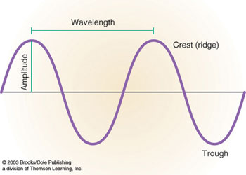
Wavelength and frequency
Wavelength – distance between two identical points on a wave
Frequency – number of full cycles in a second
Amplitude is the distance the wave is from its rest position. (This can be up or down)

Slide 6
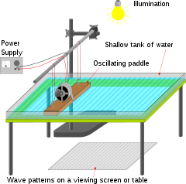
Ripple tank
A moving object creates waves in a tank of water.

Slide 7
Measuring wavelength
Fill the ripple tank with around a few cm of water
Switch on the light and power supply
Adjust the speed of the motor to produce low frequency waves
Using a metre ruler at right angles measure the length of as many waves as possible then divide by the number of waves – this gives wavelength

Slide 8
Simulation
https://www.falstad.com/ripple/

Slide 9
Results - wavelength
Number of waves measured –
Length of waves –
Wavelength = Length of waves / Number of waves

Slide 10
Measuring frequency
Count the number of waves that pass a certain point in 10s
Divide the number of waves by 10 to get the frequency
Speed = wavelength x frequency

Slide 11
Results frequency
Number of waves in 10 s =
Frequency = Number of waves in 10s / 10
Speed = wavelength x frequency

Slide 12
Do now
1. How do you calculate wave speed?
2. How do you calculate speed?
3. What does the speed equation triangle look like?
4. What does the wave speed equation triangle look like?
5. What are the units of frequency?

Slide 13
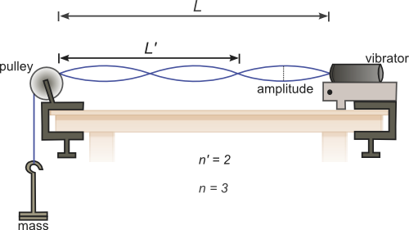
Waves on a string
Need vibration generator, signal generator, cord and masses.

Slide 14
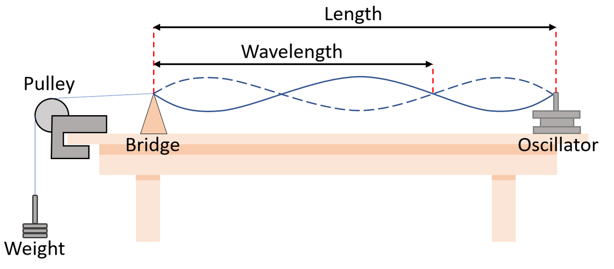
Set up the equipment as shown in the diagram.
Adjust the frequency of the vibration generator until it produces a
clear wave on the string.
For frequency read the number from the signal generator.
3. For wavelength, measure the wavelength of the wave using a ruler.
Use the equation v= f x λ to find the wavespeed of the wave.
Repeat for different 5 frequencies of the wave.

Slide 15
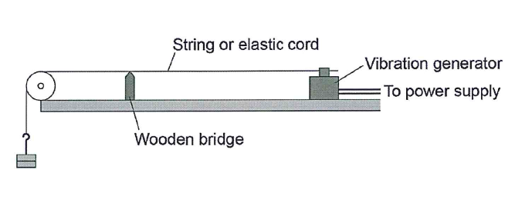
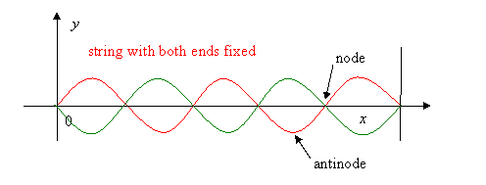
Measuring wavelength on stretched cord
Set up the equipment as shown
Measure the distance between 3 nodes

Slide 16
Measuring frequency
Read the display!
Now write up how to measure the wavelength and frequency on a stretched string.

Slide 17
Results
No.of waves | Frequency (Hz) | Wavelength (m) | Wave speed (m/s)
1.0
2.0
3.0
4.0
5.0

Slide 18
Linking it together
What happens to the wavelength if we increase the frequency?
Increased frequency means more waves per second so that means the wavelength decreases.
We can link all that together in the wave equation
v= f x λ

