Slide 1
Knowledge Organiser – Romeo and Juliet
Historical and social context
1.Staging: The play was first performed around 1595. 16th and 17th century audiences watched Shakespeare's plays being performed at open-air London theatres during the day.
2.Queen Elizabeth: Reigned from 1533-1603. She defied the expectations of a patriarchal society. 3.Setting of the play: 14th-century Verona, Italy. The Montecchi and Capuleti were real families fighting for power in Verona at this time. 4. The bubonic plague: Killed a third of the Italian population in the 14th century and then 17,000 people in an outbreak in London in 1592.
5.Astrology: In both 14th-century Italy and Elizabethan England stars linked to fate and fortune, were believed to predict and influence the course of human events. 6.Gender: Both 14th-century Verona and Elizabethan England were patriarchal societies.
Structure
23.Contrast: Scenes often contrast strongly with the one that follows them, highlighting the theme of conflict 24.Timeframe: The play begins on Sunday morning and ends just before daybreak the following Thursday, creating a rapid, whirlwind pace of action
25.Foreshadowing: R&J’s downfall is hinted at throughout the play, increasing suspense for the audience
26.Dramatic irony: Some things are revealed to the audience before the characters, increasing tension 27.Juxtaposition: The placement of two ideas, statements or events near each other to invite comparison or contrast
Key themes
28.Religion: The impact of religion on the characters’ attitudes and choices. How characters conform to expectations, and how they defy them. 29.Fate and free will: The concept of an inevitable destiny and its relation to the characters’ choices.
30.Honour and loyalty: The importance of kinship, one’s responsibility to their family, views of masculinity and violence.
31.Love: Romantic, sexual, superficial and platonic forms of love are present in the play. This love can be volatile, brutal, and oppressive- or the opposite.
32.The Individual versus society: R&J struggle against their parents, authority, and society’s expectations.
33.Death: How the certainty, fear, acceptance and welcoming of death is portrayed in the play.
34.Youth: The thrills and perils of adolescence. 35.Time: Characters’ awareness of time and how it affects their decisions, the limitations of time, the importance of timing and its effect on the plot.
Shakespearean Tragedy
7. The protagonists are in conflict with an overpowering force (their love against the feud of their families) 8. Both protagonists can be considered to be tragic heroes: high status, sympathetic characters whose fatal flaws contribute to their inevitable downfall (their deaths)
9. Uses a five-part structure: exposition (an initial incident), rising action (a growth in the tension), climax (the high point of the action), falling action (where the plot begins to unravel), denouement (the ending or resolution to the drama)
Characters
10.Romeo Montague: Initially a typical Petrarchan lover, his love for Juliet is incredibly romantic, impulsive and passionate.
11.Juliet Capulet: Young and innocent, not yet 14. Her love for Romeo matures her and makes her bolder in her defiance
12.Lord Capulet: Juliet’s father. Shows concern for Juliet’s welfare, but can be aggressive and tyrannical when he is disobeyed
13.Lady Capulet: Juliet’s mother. Cold and distant for most of the play, she expects Juliet to follow in her own footsteps.
14.Lord Montague: Romeo's father. Can be drawn into conflict, but also has genuine concern for his son and is quietly dignified
15.Lady Montague: Peace-loving and dislikes the violence of the feud. She dies of grief when Romeo is banished
16.Nurse: Juliet's nursemaid, they have a close relationship. She acts as confidante and messenger for Romeo and Juliet 17.Tybalt: Juliet’s ruthless, hot-tempered and vengeful cousin. Has a deep, violent hatred of the Montagues
18.Mercutio: A relative of the Prince and a high-ranking man. Mixes well with both families and is Romeo’s loyal best friend
19.Benvolio: Cares about his cousin Romeo and tries to keep peace between the families 20.Prince Escalus: The symbol of law and order in Verona, yet his threats of punishment are unable to bring an end to the conflict
21.Count Paris: A rich and highly-regarded young man, kinsman to the Prince, who is determined to marry Juliet
22.Friar Lawrence: A caring, trusted, kind man of the Church who is optimistic, perhaps naively, about the possibility of peace
Language
36. Imagery: Language which creates vivid sensory ideas in the reader’s mind, such as a representation of a specific picture or sound 37. Simile: An explicit comparison between two things using ‘like’ or ‘as’ 38. Metaphor: An implicit comparison between two things not using ‘like’ or ‘as’
39. Personification: Attributing human-like qualities to objects, ideas or animals
40. Prose: Lines which use a natural, unstructured rhythm, similar to speech
41. Blank verse: Lines which follow the fixed, more poetic structure of iambic pentameter (10 beats, 5 stressed, 5 unstressed) 42. Rhyming couplet: Two successive rhyming lines, which usually signal that a character has left the stage or is falling in love
43. Sonnet: A poem of 14 lines with a strict rhyme scheme, usually associated with love and romance in conflict 44. Oxymoron: The combination of words or ideas which have opposite or very different meanings
45. Pun: A joke based on the different possible meanings of a word or the fact that there are words which sound alike but have different meanings 46.Soliloquy: When a character, thinking they are alone, speaks their thoughts aloud
Symbolism
47. Light: Juliet’s beauty, the overwhelming power of R&J’s love, hope and optimism
48..Darkness: The secrecy of R&J’s love, loss of hope, R&J’s impending death.
49. Poison: It is in the power of human hands and human will to extract potential evil or fatal harm from an object or thing

Slide 2
Low stakes quiz: Romeo & Juliet
Quiz 2

Slide 3
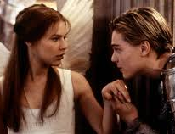
LOW STAKES QUIZ: question one
Q.1. At what time do Romeo and Juliet agree to meet to get married?

Slide 4
LOW STAKES QUIZ: question two
Q.2. Juliet tells her father she won’t marry Paris. How does he react?

Slide 5
LOW STAKES QUIZ: question three
Q.3. Romeo, Tybalt and Mercutio end up in a fight. Who dies from this fight?

Slide 6
LOW STAKES QUIZ: question four
Q.4. Name the place where Romeo is exiled too?

Slide 7
LOW STAKES QUIZ: question five
Q.5. Friar offers Juliet a potion – what does it do to her?

Slide 8
LOW STAKES QUIZ: question six
Q.6. Where does Paris tell Romeo he wants to be buried as he dies?

Slide 9
LOW STAKES QUIZ: question Seven
Q.7. Juliet takes her own life after she awakes from her deep sleep – why?

Slide 10
LOW STAKES QUIZ: question eight
Q.8. What do the Montagues and Capulets decide at the end of the play?

Slide 11
LOW STAKES QUIZ: question nine
Q.9. Who witnesses Romeo and Juliet get married?

Slide 12
LOW STAKES QUIZ: question ten
Q.10. Who was unable to deliver the Romeo the message while he was Mantua?

Slide 13
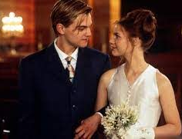
Answers: 1
1. Midday.

Slide 14
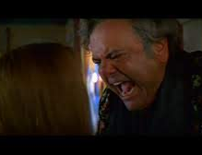
Answers: 2
2. He is furious! Lord tells Juliet she will get married or she will be disowned!

Slide 15
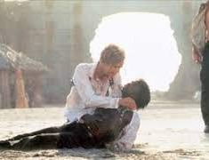
Answers: 3
3. Mercutio dies from the fight.

Slide 16
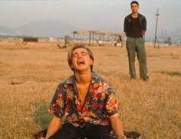
Answers: 4
4. Mantua.

Slide 17
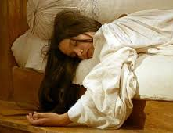
Answers: 5
5. Lure her into a deep sleep state where she will seem dead!

Slide 18
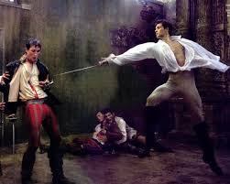
Answers: 6
6. Paris wishes to be laid next to Juliet as he dies.

Slide 19
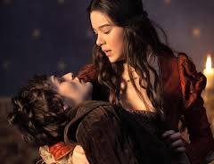
Answers: 7
7. Because she sees Romeo die thinking she is dead!

Slide 20
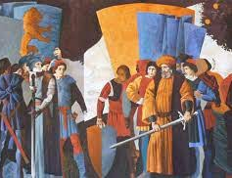
Answers: 8
8. Both families agree to end the feud and move on with their lives.

Slide 21
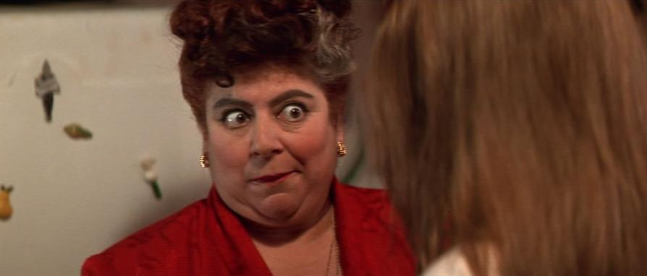
Answers: 9
9. The Nurse

Slide 22
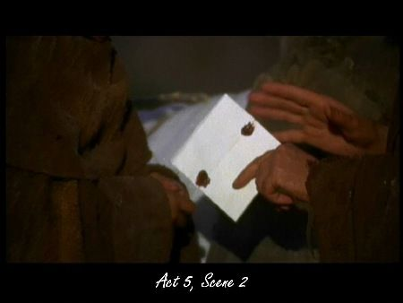
Answers: 10
10. Friar John

Slide 23
Quote Quest:Nature in Romeo and Juliet Test on Friday
1. Verona's summer hath not such a flower. (Nurse 1:3)
2. This bud of love, by summer’s ripening ,
May prove a beauteous flower when next we meet. (Juliet2:2)
3. What’s in a name? That which we call a rose
By any other word would smell as sweet. (Romeo 2:2)
4. Sweet flower, with flowers thy bridal bed I strew (Paris 5:3)
5. As daylight doth a lamp; her eyes in heaven Would through the airy region stream so bright That birds would sing and think it were not night (Romeo 2:2)

Slide 24
Act 3 Lesson 1
Complete the analysis tasks on p15 in your booklet

Slide 25
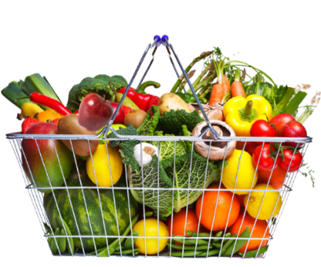
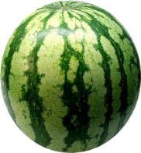
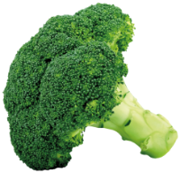
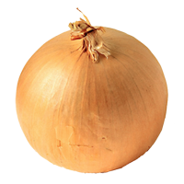
English 5-a-day
Please answer on your post-it note.
1
Romeo and Juliet
Who is Romeo’s cousin? How is he presented in the play?
2
An Inspector Calls
What is capitalism?
3
Poetry
Name two geographical features in ‘Climbing My Grandfather’
4
Poetry
List two animals the wife is compared to in ‘The Farmer’s Bride’
5
English Language
What is emotive language?

Slide 26
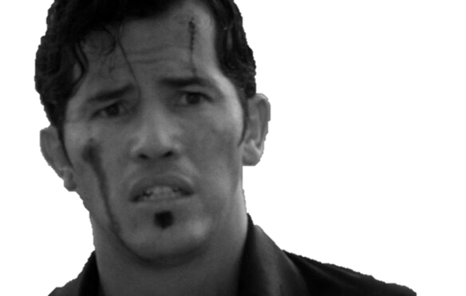
Revise ‘Romeo and Juliet’
“I will withdraw; but this intrusion shall, now seeming sweet, convert to bitterest gall.”
– Tybalt, Act 1, Scene 5.
Five Quick Questions
Why is this such an important quotation in the play?
To whom is Tybalt referring?
Can you link this quotation to any themes in the play?
Can you link this quotation to the context?
Are there any of Shakespeare’s methods here?

Slide 27
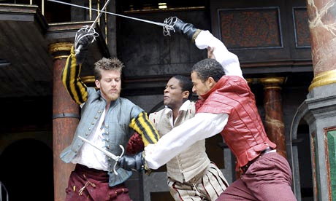
Act 3 Scene 1 Summary
Mercutio and Benvolio meet Tybalt, who is looking for Romeo.
Tybalt insults Romeo. When he does not respond, Mercutio angrily challenges Tybalt himself.
Mercutio and Tybalt fight. Mercutio is fatally wounded.
Feeling ashamed that Mercutio has died on his behalf, Romeo fights with Tybalt and kills him.
As punishment, the prince exiles Romeo from Verona.

Slide 28
3.1 Fight, death, fight, death, exile – part 1.
T
M
T
M
M
M
T
T
T
T

Slide 29
3.1 Fight, death, fight, death, exile part 2
T
M
T
T

Slide 30
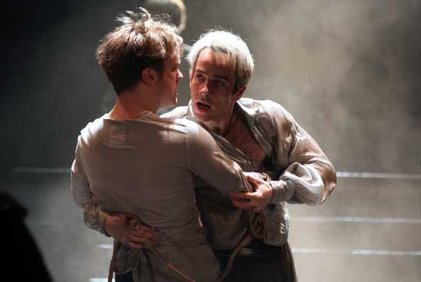
‘Ask for me tomorrow and you shall find me a grave man.’

Slide 32
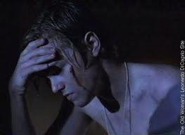

Slide 33
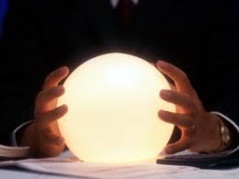
How will Juliet react to this news?

Slide 35
Act 3 Lesson 2
Complete the analysis tasks on p16 in your booklet

Slide 36
English 5-a-day
Please answer on your post-it note.
1
Romeo and Juliet
Why do characters go to Friar Lawrence for help? Think about context.
2
What was Priestley’s key message to his audience?
An Inspector Calls
3
Poetry
How long ago was the football game in ‘Walking Away’?
4
Poetry
What season and month are mentioned in ‘Letters from Yorkshire’?
5
English Language
What is a protagonist?

Slide 37
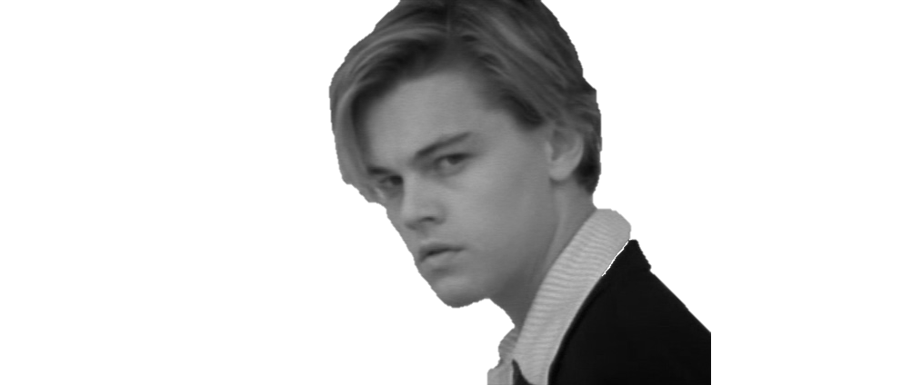
Revise ‘Romeo and Juliet’
"But, soft! what light through yonder window breaks? It is the east, and Juliet is the sun!” – Romeo, Act 2, Scene 2.
Five Quick Questions
Why is this such an important quotation in the play?
Who does Romeo say this to?
Can you link this quotation to any themes in the play?
Can you link this quotation to the context?
Are there any of Shakespeare’s methods here?

Slide 38
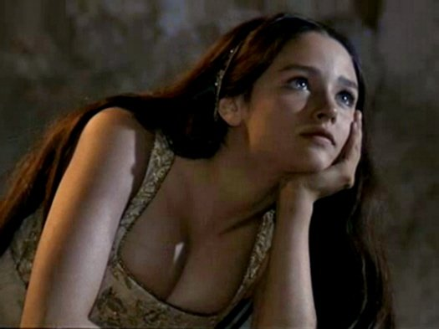
Act 3 Scene 2 Summary
Juliet is longing for night and Romeo’s arrival, when the nurse enters, grieving at Tybalt’s death.
When Juliet realises that Romeo killed Tybalt, her feelings are at first confused. Then it sinks in that Romeo is banished and she becomes desperate.
The nurse offers comfort, promising to bring Romeo to Juliet that night.

Slide 39
3.1 J waits for R to spend the night.
“bring in cloudy night immediately”
“Romeo… Leap to these arms,”
“Come, civil night”
“Come, night. Come, Romeo.”
“Come, gentle night, come, loving, black-browed night,
Give me my Romeo.”
T

Slide 40
3.1 J waits for R to spend the night.
O God, did Romeo’s hand shed Tybalt’s blood?
It did, it did. Alas the day, it did.
O serpent heart hid with a flowering face!
Did ever dragon keep so fair a cave?
Beautiful tyrant! Fiend angelical!
Dove-feathered raven, wolvish-ravening lamb!
Despisèd substance of divinest show,
Just opposite to what thou justly seem’st.
A damnèd saint, an honorable villain!
O nature, what hadst thou to do in hell
When thou didst bower the spirit of a fiend
In moral paradise of such sweet flesh?
Was ever book containing such vile matter
So fairly bound? Oh, that deceit should dwell
In such a gorgeous palace!
Blistered be thy tongue
For such a wish! He was not born to shame.
Upon his brow shame is ashamed to sit,
For ’tis a throne where honor may be crowned.
Sole monarch of the universal earth,
Oh, what a beast was I to chide at him!
Shall I speak ill of him that is my husband?
Ah, poor my lord, what tongue shall smooth thy name,
When I, thy three hours' wife, have mangled it?
But wherefore, villain, didst thou kill my cousin?
That villain cousin would have killed my husband.
Back, foolish tears, back to your native spring.

Slide 41
What is an oxymoron?
‘beautiful tyrant’ + ‘honourable villain’
Oxymoron – two words that contradict each other placed beside each other, for example ‘deafening silence’
Bitter Sweet
Act naturally
Sweet Agony
Awful Nice
Growing smaller
ANTITHESIS is where the ‘opposites’ are not immediately joined e.g. ‘O serpent heart, hid with a flow’ring face!
Antithesis?

Slide 42
Act 3 Lesson 3
Complete the analysis tasks on p17 and p18 in your booklet

Slide 43
English 5-a-day
Please answer on your post-it note.
1
Romeo and Juliet
Who is the first character in the play to die? /Who is the last character in the play to die?
2
In AIC, who says "I don't know - really. Suddenly I felt I just had to laugh“?
An Inspector Calls
3
Poetry
What job does the father have in ‘Follower’?
4
Poetry
Name the two friends in ‘Before You Were Mine’
5
English Language
What is a simple sentence?

Slide 44
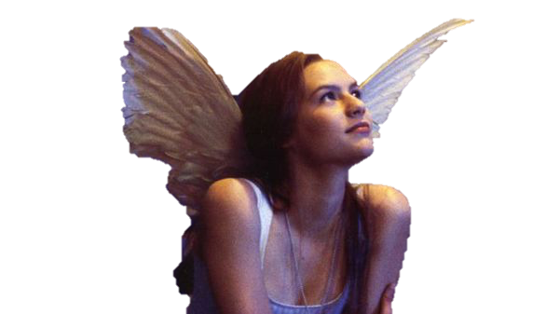
Revise ‘Romeo and Juliet’
“O Romeo, Romeo! wherefore art thou Romeo? Deny thy father and refuse thy name…”– Juliet, Act 2, Scene 2.
Five Quick Questions
Why is this such an important quotation in the play?
To whom is Juliet referring?
Can you link this quotation to any themes in the play?
Can you link this quotation to the context?
Are there any of Shakespeare’s methods here?

Slide 45
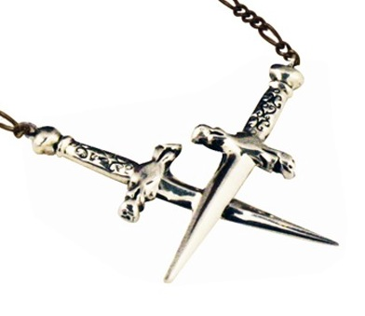
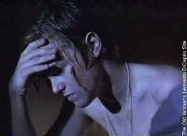
Act 3 Scene 3 Summary
Romeo is desperate when he hears that he has been banished from Verona, and the Friar cannot comfort him.
The Nurse arrives. Fearing that Juliet must now hate him and imagining her grief, Romeo threatens to kill himself, but is prevented by the Friar and the Nurse.
The Friar instructs Romeo to leave for Mantua by dawn at the latest, after he has spent the night with Juliet.

Slide 46
3.3 R learns that he is to be banished
Not body’s death, but body’s banishment.
Ha, banishment! Be merciful, say “death,”
For exile hath more terror in his look,
This is dear mercy, and thou seest it not.
'Tis torture and not mercy. Heaven is here,
Where Juliet lives, (…)
But Romeo may not. He is banishèd. But “banishèd” to kill me?—“Banishèd”!

Slide 47
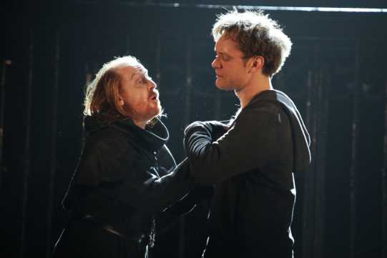
Given that Romeo expected the death sentence (line 9), why does he react so badly to the news that he is to be banished?
How sympathetic are you to his reactions here?

Slide 48
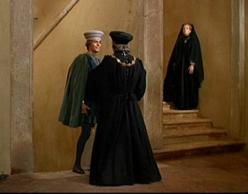
Act 3 Scene 4 Summary
Capulet arranges with Paris that his wedding to Juliet will take place in a few days’ time.
He sends Lady Capulet to inform Juliet.

Slide 49
Act 3 Lesson 4
Complete the analysis tasks on p19 in your booklet

Slide 50
English 5-a-day
Please answer on your post-it note.
1
Romeo and Juliet
When the couple first meet, what form does their dialogue take?
2
At the beginning of AIC, who comes across as being confident and charming?
An Inspector Calls
3
Poetry
Who was Lord Byron writing about in “When We Two Parted”?
4
Poetry
Which artistic movement were Byron and Shelley part of?
5
English Language
How is colour imagery effective?

Slide 51
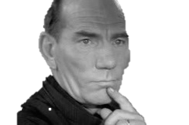
Revise ‘Romeo and Juliet’
“Holy Saint Francis, what a change is here! Is Rosaline, whom thou didst love so dear.”
– Friar Lawrence, Act 2, Scene 3.
Five Quick Questions
Why is this such an important quotation in the play?
To whom is Friar Lawrence speaking?
Can you link this quotation to any themes in the play?
Can you link this quotation to the context?
Are there any of Shakespeare’s methods here?

Slide 52
Act 3 Scene 5 Summary
Having spent the night with Juliet, Romeo leaves for Mantua.
Lady Capulet tells Juliet that she is to marry Paris, but she refuses.
Capulet is furious with Juliet for her disobedience and threatens her.
The Nurse advises Juliet to marry Paris. Juliet pretends to accept her advice, but privately plans to seek help from the Friar.

Slide 53
3.5 (pt. 1) Romeo leaves after spending the night with Juliet.
Wilt thou be gone? It is not yet near day.
I must be gone and live, or stay and die.
Yon light is not daylight, I know it, I.
… Therefore stay yet. Thou need’st not to be gone.
Let me be ta'en. Let me be put to death.
I am content, so thou wilt have it so.
Hie hence! Be gone, away!
… O, now be gone. More light and light it grows.
Your lady mother is coming to your chamber.
Ay, husband, friend,
I must hear from thee every day in the hour,
… Oh, think’st thou we shall ever meet again?
I doubt it not, and all these woes shall serve
For sweet discourses in our time to come.
c
O God, I have an ill-divining soul.
Methinks I see thee now, thou art so low
As one dead in the bottom of a tomb.
Ho, daughter, are you up?

Slide 54
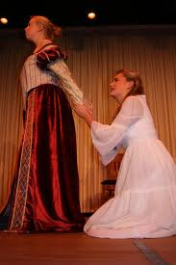
Lady Capulet tells Juliet that she is to marry Paris, but she refuses.

Slide 55
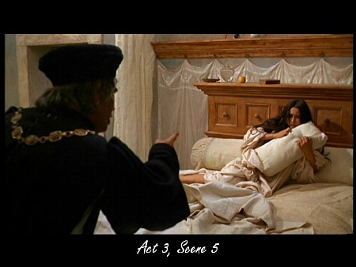

Slide 56
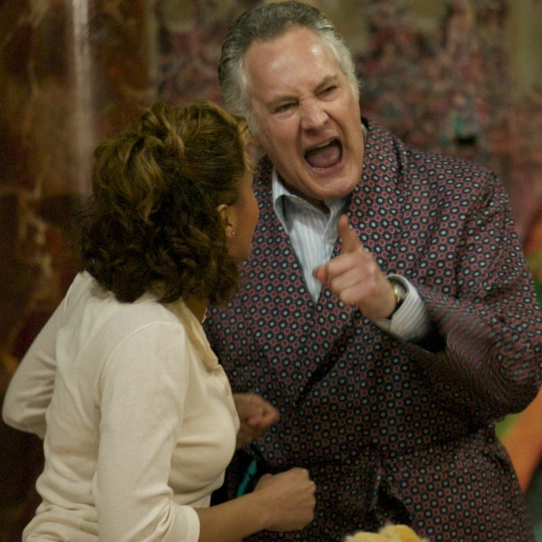
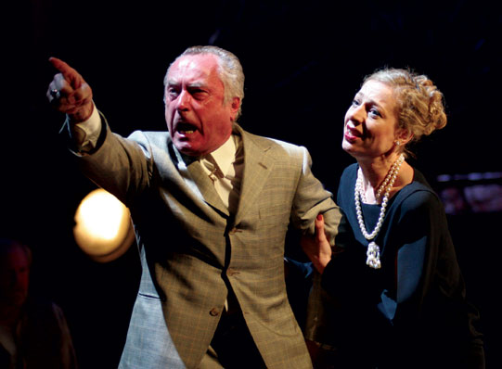
Lord Capulet asserts his control over Juliet.
This is a contrast to his earlier comments!

Slide 57
c
3.5 (pt. 2) Juliet says she will not marry Paris.
I’ll tell thee joyful tidings, girl.
…
The County Paris, at Saint Peter’s Church,
Shall happily make thee there a joyful bride.
C
He shall not make me there a joyful bride.
I wonder at this haste, that I must wed
Ere he, that should be husband, comes to woo.
I pray you, tell my lord and father, madam,
I will not marry yet.
Here comes your father. Tell him so yourself,
And see how he will take it at your hands.

Slide 58
c
3.5 (pt. 2) Juliet says she will not marry Paris.
How, will she none? Doth she not give us thanks?
Is she not proud? Doth she not count her blessed,
Unworthy as she is, that we have wrought
So worthy a gentleman to be her bride?
Not proud you have, but thankful that you have.
Proud can I never be of what I hate,
But thankful even for hate that is meant love.
… Mistress minion you,
Thank me no thankings, nor proud me no prouds,
But fettle your fine joints 'gainst Thursday next
To go with Paris to Saint Peter’s Church,
Or I will drag thee on a hurdle thither.
Out, you green sickness, carrion! Out, you baggage!
You tallow face!
c
Good Father, I beseech you on my knees,
Hear me with patience but to speak a word.
Hang thee, young baggage! Disobedient wretch!
I tell thee what: get thee to church o' Thursday,
Or never after look me in the face.
Speak not. Reply not. Do not answer me.
My fingers itch.—Wife, we scarce thought us blest
165That God had lent us but this only child,
But now I see this one is one too much
And that we have a curse in having her.
Out on her, hilding!

Slide 59
c
3.5 (pt. 2) Juliet says she will not marry Paris.
How, will she none? Doth she not give us thanks?
Is she not proud? Doth she not count her blessed,
Unworthy as she is, that we have wrought
So worthy a gentleman to be her bride?
Not proud you have, but thankful that you have.
Proud can I never be of what I hate,
But thankful even for hate that is meant love.
… Mistress minion you,
Thank me no thankings, nor proud me no prouds,
But fettle your fine joints 'gainst Thursday next
To go with Paris to Saint Peter’s Church,
Or I will drag thee on a hurdle thither.
Out, you green sickness, carrion! Out, you baggage!
You tallow face!
c
Good Father, I beseech you on my knees,
Hear me with patience but to speak a word.
Hang thee, young baggage! Disobedient wretch!
I tell thee what: get thee to church o' Thursday,
Or never after look me in the face.
Speak not. Reply not. Do not answer me.
My fingers itch.—Wife, we scarce thought us blest
165That God had lent us but this only child,
But now I see this one is one too much
And that we have a curse in having her.
Out on her, hilding!

Slide 60
Examine the theme of conflict and how it impacts the Capulet family.
Point/Reasons (technique)
Shakespeare examines the theme of conflict in Act 3, this is evident within the Capulet family when ….
2. Quote
This can be seen in the quote ….
3. Quote analysis in general
This quotation illustrates / portrays / shows…. (Use bullet points and infer)
4. Quote Zoom
The word / phrase / ….
5. Effect on audience
The audience sympathise with Juliet because….
6. Shakespeare’s intention
Shakespeare shows us that conflict exists within families as well as between them.

Slide 61
Example
Point
Capulet is enraged when Juliet refuses to marry Paris.
Language Device
Exclamation marks emphasise anger.
Question marks show that he cannot understand how his daughter is defying him.
Repetition for emphasis.
How! Will she none? Doth she not give us thanks? Is she not proud? Doth she not count her blest,
Audience
We sympathise with Juliet because her father is being so harsh.
Shakespeare shows us that conflict exists within the families as well as between them.

Slide 62
Example
Shakespeare examines the theme of conflict throughout Act 3, this is evident, not only in the fight scene but also, within the Capulet family. Lord Capulet is furious when Juliet refuses to marry Paris. His anger can be seen in the quote ‘How! will she none? Doth she not give us thanks? Is she not proud? Doth she not count her blest,’ The use of Exclamation marks and repetition emphasise his anger. While the Question marks show that he cannot understand the fact that his daughter is defying him. The audience sympathise with Juliet because she is like a possession that is to be given away. Shakespeare shows us that conflict exists within families as well as between them.

Slide 63
Capulet is shocked by Juliet’s behaviour.
Find a quote
Explain why. What kind of a daughter has
Juliet been up until now?
Capulet is angry and insults Juliet.
Fins a quote and explain how the audience would react.
Capulet seems violent.
Does he want to hit her? How do you know?
Explain how the audience would feel

Slide 64
Go through the separate Act 3 recap powerpoint to check you understand the plot

Slide 65
Lesson 5

Slide 66
English 5-a-day
Please answer on your post-it note.
1
Romeo and Juliet
In Greek theatre, who would have said the prologue?
2
In AIC, who says "All right. I knew her. Let’s leave it at that“ ?
An Inspector Calls
3
Poetry
What is Shelley trying to persuade someone to do in ‘Love’s Philosophy’?
4
Poetry
“Sunlight clasps”… “kiss the sea” – what technique?
5
English Language
What does convey mean?

Slide 67
Revise ‘Romeo and Juliet’
“These violent delights have violent ends
And in their triumph die, like fire and powder.”
– Friar Lawrence, Act 2, Scene 6.
Five Quick Questions
Why is this such an important quotation in the play?
To whom is Friar Lawrence speaking?
Can you link this quotation to any themes in the play?
Can you link this quotation to the context?
Are there any of Shakespeare’s methods here?

Slide 68
Quote Quest Coming up!

Slide 69
Nature in Romeo and Juliet
_______ ___________ hath not such a _____________
Who says this quote? What does she mean?
3. This _____ of ______, by _________ ripening ,
May prove a _________ _____ when next we meet.
4. Who says this quote? What does she mean?
5. What’s ____ ___ _________? That which we call
_ _______ by any other name would ______ as sweet.
6. Why does Juliet say this?
7. Sweet ______, with flowers thy ________ _____ I strew
8. Who says this? Explain why it is ironic.
9. As_________ doth a _______; her ______ in __________ Would through the airy region stream so ________ That ________ would sing and think it were not ________
10. Who says this and where are they?
Bonus:
What link can you make with this quote?

Slide 70
Nature in Romeo and Juliet
Verona’s summer hath not such a flower
The Nurse means that Juliet in the most beautiful, and precious child in Verona
3. This bud of love, by summer’s ripening ,
May prove a beauteous flower when next we meet.
4. Juliet means that this new love will quickly develop.
5. What’s in a name? That which we call a rose by any other name would smell as sweet.
6. She says that if Romeo were not a Montague, he would still be Romeo.
7. Sweet flower, with flowers thy bridal bed I strew.
8. Paris. It is ironic because he should have married Juliet the morning she was found “dead”. It is also ironic as she was married to Romeo.
9. As daylight doth a lamp; her eyes in heaven Would through the airy region stream so bright That birds would sing and think it were not night .
10. Romeo on the balcony
Bonus: eyes/ light and dark motif. Link to act 3 sc v lark and nightingale

Slide 71
Friday Writing Challenge and homework Look up the key words and check you understand them Plan and write your response to the following statement Time yourself (45 minutes)

