Slide 1
Read it:
Chemical
Define it:
(noun) a substance produced by or used in a chemical process.
Deconstruct it:
From Greek chemic (“alchemy”) +‎ -al (“related to”)
Example:
The subject Chemistry in school is based around studying chemicals, acids and other liquids.
Digging Deeper:
It can also mean of, used in, produced by, or concerned with chemistry or chemicals: a chemical formula; chemical agents.
Link it:
Synthetic, actinic, Alchemical, enzymatic, synthesized,
synthetical
Notes:
Q. What other words do you know begin with this?
Q. Can it be used in another way?
Q. What antonyms or synonyms do you know for this?
Q. How does it fit into what we have been learning?
Q. What action could we use to help us remember this?
Q. Can you think of a different subject where you
might use this word? Would it have the same
meaning there?

Slide 2
Quote Quest Theme of Fate
Learn the quotes on the next slide and test yourself on Friday

Slide 3
Quote Quest Fate
“A pair of star crossed lovers take their life.” Prologue
“Some consequence yet hanging in the stars,…some vile forfeit of untimely death.”
“But He that hath the steerage of my course Direct my sail!” Romeo 1.4
“O I am fortune’s fool” Romeo 3.1
“I defy you stars!” Romeo 5.1

Slide 4
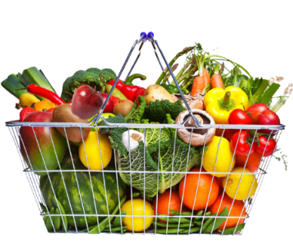
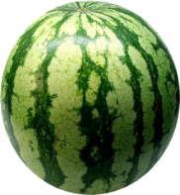
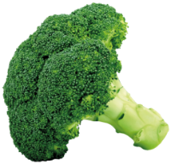
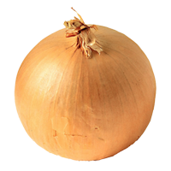
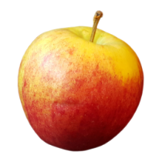
English 5-a-day
Poetry Anthology:
Love and Relationships
When We Two Parted – Byron
Love’s Philosophy – Shelley
Porphyria’s Lover – R Browning
Sonnet 29 – E Browning
Neutral Tones – Hardy
Letters From Yorkshire – Dooley
The Farmer’s Bride – Mew
Walking Away – Day-Lewis
Eden Rock – Causley
Follower – Heaney
Mother, Any Distance – Armitage
Before You Were Mine – Duffy
Winter Swans – Sheers
Singh Song! – Nagra
Please answer in silence.
1
Romeo and Juliet
Explain Friar Lawrence’s plan.
2
5 adjectives to describe Birling
An Inspector Calls
3
“Our souls tap out _____ across the ____ _____” – which poem?
Poetry
4
How is the noun conflict linked with ‘Romeo and Juliet’?
WOTW
5
English Language
Explain what is means to evaluate.

Slide 5
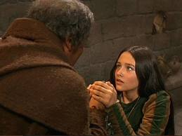
Act 4 Scene 1 Summary
Annotate and answer questions in your extract booklet
Juliet arrives at the Friar’s cell. After a brief conversation with Paris, she asks the Friar for help.
Seeing how desperate Juliet is, the Friar suggests a plan. Juliet is to take a potion which will make it appear as though she is dead. She will be laid in the Capulet tomb, the Friar will write to Romeo, who can then come and collect her secretly. She eagerly agrees.
The Plan!

Slide 6
JULIET O shut the door! and when thou hast done so, Come weep with me; past hope, past cure, past help!
FR. LAWRENCE Ah, Juliet, I already know thy grief; It strains me past the compass of my wits: I hear thou must, and nothing may prorogue it, On Thursday next be married to this county. JULIET Tell me not, friar, that thou hear'st of this, Unless thou tell me how I may prevent it: If, in thy wisdom, thou canst give no help, Do thou but call my resolution wise, And with this knife I'll help it presently. God join'd my heart and Romeo's, thou our hands; And ere this hand, by thee to Romeo seal'd, Shall be the label to another deed, Or my true heart with treacherous revolt Turn to another, this shall slay them both: Therefore, out of thy long-experienced time, Give me some present counsel, or, behold, 'Twixt my extremes and me this bloody knife Shall play the umpire, arbitrating that Which the commission of thy years and art Could to no issue of true honour bring. Be not so long to speak; I long to die, If what thou speak'st speak not of remedy.
What do you learn about the character of Juliet?
Use evidence to support your response

Slide 7
RJ – writer’s purpose
Shakespeare shows us Juliet considering death
to
to
to
challenge/understand/highlight/question
RJ – significant quotes
‘Uneven is the course; I like it not.’
1:
2:
3:
suggests / symbolises / ideas / themes
RJ – choices
Why do you think Shakespeare shows us very little of the character of Paris?
RJ – develop an interpretation
Shakespeare presents the young as having extreme reactions to events.
RJ – precise word analysis
Come weep with me – past hope, past cure, past help.
Means:
Effect:
Why Shakespeare used this word:
RJ – effect
Does the audience empathise with Juliet? Or do they fear what she will do?
22: Act 4 Scene 1

Slide 8
English 5-a-day
Poetry Anthology:
Love and Relationships
When We Two Parted – Byron
Love’s Philosophy – Shelley
Porphyria’s Lover – R Browning
Sonnet 29 – E Browning
Neutral Tones – Hardy
Letters From Yorkshire – Dooley
The Farmer’s Bride – Mew
Walking Away – Day-Lewis
Eden Rock – Causley
Follower – Heaney
Mother, Any Distance – Armitage
Before You Were Mine – Duffy
Winter Swans – Sheers
Singh Song! – Nagra
Please answer in silence.
1
Romeo and Juliet
What is the structure of a sonnet? Any other features you know?
2
5 adjectives to describes Mrs Birling.
An Inspector Calls
3
“Single span” – which poem?
Poetry
4
Define the noun chemical
WOTW
5
English Language
How is the use of flashback effective?

Slide 9
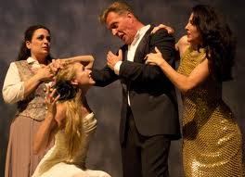
Act 4 Scene 2 Summary
Annotate and answer questions in your extract booklet
Juliet returns home and tells her father that she has seen the Friar and is now sorry for her disobedience.
Capulet excitedly gives instructions that the wedding will now take place the following day and goes to inform Paris.

Slide 10
Capulet
How now, my headstrong! where have you been gadding? Juliet
Where I have learn'd me to repent the sin Of disobedient opposition To you and your behests, and am enjoin'd By holy Laurence to fall prostrate here, And beg your pardon: pardon, I beseech you! Henceforward I am ever ruled by you.
Capulet
Send for the county; go tell him of this: I'll have this knot knit up to-morrow morning.

Slide 11
RJ – writer’s purpose
Shakespeare shows us Juliet agreeing to her father’s instructions
to
to
to
challenge/understand/highlight/question
RJ – significant quotes
‘My heart is wondrous light, since this same wayward girl is so reclaimed.’
1:
2:
3:
suggests / symbolises / ideas / themes
RJ – choices
Why do you think Shakespeare gives Lady Capulet so few lines in the play?
RJ – develop an interpretation
Shakespeare presents the idea that children should be seen and not heard in the play.
RJ – precise word analysis
How now, my headstrong?
Means:
Effect:
Why Shakespeare used this word:
RJ – effect
What are the questions in the audience’s mind at this point?
23: Act 4 Scene 2

Slide 12
English 5-a-day
Poetry Anthology:
Love and Relationships
When We Two Parted – Byron
Love’s Philosophy – Shelley
Porphyria’s Lover – R Browning
Sonnet 29 – E Browning
Neutral Tones – Hardy
Letters From Yorkshire – Dooley
The Farmer’s Bride – Mew
Walking Away – Day-Lewis
Eden Rock – Causley
Follower – Heaney
Mother, Any Distance – Armitage
Before You Were Mine – Duffy
Winter Swans – Sheers
Singh Song! – Nagra
Please answer in silence.
1
Romeo and Juliet
Why does Romeo not receive the letter from Friar Lawrence? Think about context.
2
5 adjectives to describe Sheila.
An Inspector Calls
3
What are the features of a sonnet?
Poetry
4
Use the noun chemical in a sentence.
WOTW
5
English Language
What is the climax of a story?

Slide 13
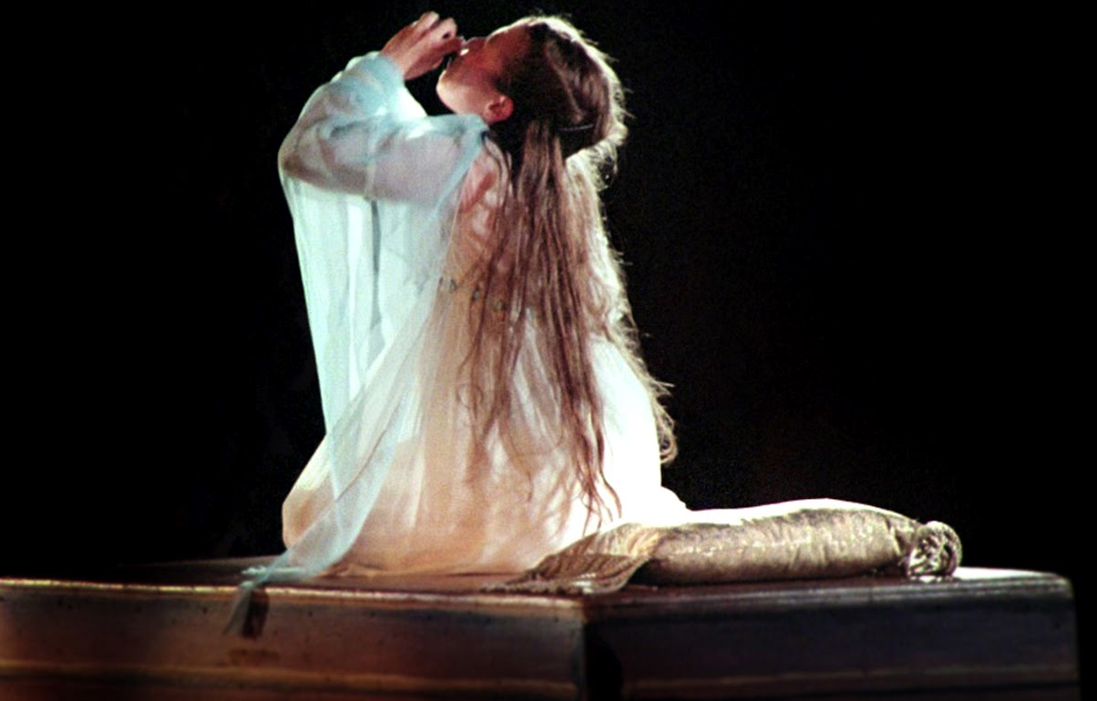
Act 4 Scene 3 Summary
Juliet prepares for bed and says goodnight to her mother and the Nurse.
Juliet overcomes her fears and drinks the potion.
Annotate and answer questions in your extract booklet

Slide 15
RJ – writer’s purpose
Shakespeare shows us Juliet debating what to do
to
to
to
challenge/understand/highlight/question
RJ – significant quotes
‘Methinks I see my cousin’s ghost.’
1:
2:
3:
suggests / symbolises / ideas / themes
RJ – choices
Why do you think Shakespeare chooses to include Juliet’s thought in this scene?
RJ – develop an interpretation
Shakespeare presents Juliet as a confident and determined person
RJ – precise word analysis
I have a faint cold fear thrills through my veins.
Means:
Effect:
Why Shakespeare used this word:
RJ – effect
Do you think the audience is supposed to empathise with Juliet or feel pity for her in this scene?
24: Act 4 Scene 3

Slide 16
English 5-a-day
Poetry Anthology:
Love and Relationships
When We Two Parted – Byron
Love’s Philosophy – Shelley
Porphyria’s Lover – R Browning
Sonnet 29 – E Browning
Neutral Tones – Hardy
Letters From Yorkshire – Dooley
The Farmer’s Bride – Mew
Walking Away – Day-Lewis
Eden Rock – Causley
Follower – Heaney
Mother, Any Distance – Armitage
Before You Were Mine – Duffy
Winter Swans – Sheers
Singh Song! – Nagra
Please answer in silence.
1
Romeo and Juliet
Complete the quote: “Two such ________ kings ______ them still” Who says this, and when?
2
What does this quote tell us about Birling “as if we were all mixed up together like bees in a hive…”
An Inspector Calls
3
“And a pond edged with _______ _____” – which poem?
Poetry
4
What is the etymology of the noun chemical?
WOTW
5
English Language
How many connectives can you think of that mean ‘also’?

Slide 17
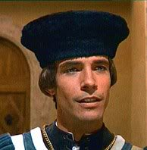
Act 4 Scene 4 Summary
Early next morning the household is busy preparing for the wedding when music is heard outside: Paris has arrived to take Juliet to church.
Annotate and answer questions in your extract booklet

Slide 18
RJ – writer’s purpose
Shakespeare shows us Capulet happy now
to
to
to
challenge/understand/highlight/question
RJ – significant quotes
‘Hie, make haste, make haste!’
1:
2:
3:
suggests / symbolises / ideas / themes
RJ – choices
This scene is small and often missed out. How does it add to the tension in the play?
RJ – develop an interpretation
Shakespeare present Lord Capulet and fathers in a largely sympathetic light.
RJ – precise word analysis
Go waken Juliet: go and trim her up.
Means:
Effect:
Why Shakespeare used this word:
RJ – effect
Do you think Capulet deserves to suffer for what he said to Juliet? Is that what the audience is thinking in this scene?
25: Act 4 Scene 4

Slide 19
English 5-a-day
Poetry Anthology:
Love and Relationships
When We Two Parted – Byron
Love’s Philosophy – Shelley
Porphyria’s Lover – R Browning
Sonnet 29 – E Browning
Neutral Tones – Hardy
Letters From Yorkshire – Dooley
The Farmer’s Bride – Mew
Walking Away – Day-Lewis
Eden Rock – Causley
Follower – Heaney
Mother, Any Distance – Armitage
Before You Were Mine – Duffy
Winter Swans – Sheers
Singh Song! – Nagra
Please answer in silence.
1
Romeo and Juliet
3 conflict quotes?
2
How is lighting used at the start of the play?
An Inspector Calls
3
What is a dramatic monologue?
Poetry
4
Write down a word you associate with the noun chemical, or a synonym.
WOTW
5
English Language
What are the connotations for the black?

Slide 20
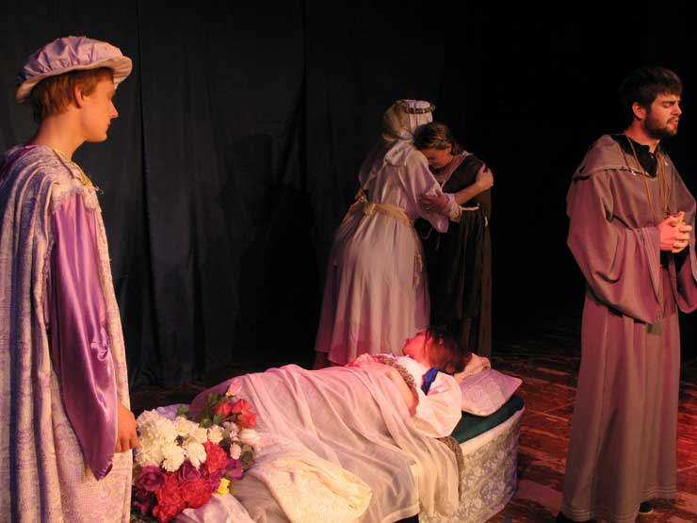
Act 4 Scene 5 Summary
When the Nurse goes to wake Juliet, she finds her apparently dead.
Paris and the Friar enter to find the Capulets grief-stricken over Juliet’s death.
As the family go off to prepare for a funeral, Peter jokes with the musicians.
Annotate and answer questions in your extract booklet

Slide 21
RJ – writer’s purpose
Shakespeare shows us several different reactions to Juliet’s faked death
to
to
to
challenge/understand/highlight/question
RJ – significant quotes
‘Death is my son-in-law, Death is my heir’
1:
2:
3:
suggests / symbolises / ideas / themes
RJ – choices
Why do you think Shakespeare ends the scene with the musicians talking to each other?
RJ – develop an interpretation
Shakespeare presents death as something that unites people.
RJ – precise word analysis
An untimely frost upon the sweetest flower of all the field.
Means:
Effect:
Why Shakespeare used this word:
RJ – effect
How do you think this scene should be played? Do you think it is dramatic? Or is it a comical scene?
26: Act 4 Scene 5

Slide 22
Quote Quest coming up!

Slide 23
Fate
“A pair of _____ _________ ________take their________.”
Which scene?
“Some __________yet h_______ in the s______,… some _____forfeit of _________ death.”
Which scene? What is the device?
“But He that hath the ____________of my course _________ my_________!”
What does Romeo mean here?
“O I am f__________ f______”
Which scene? What does Romeo mean?
“I d_____ you s_______!”
10. Which scene? Why does Romeo say this?

Slide 24
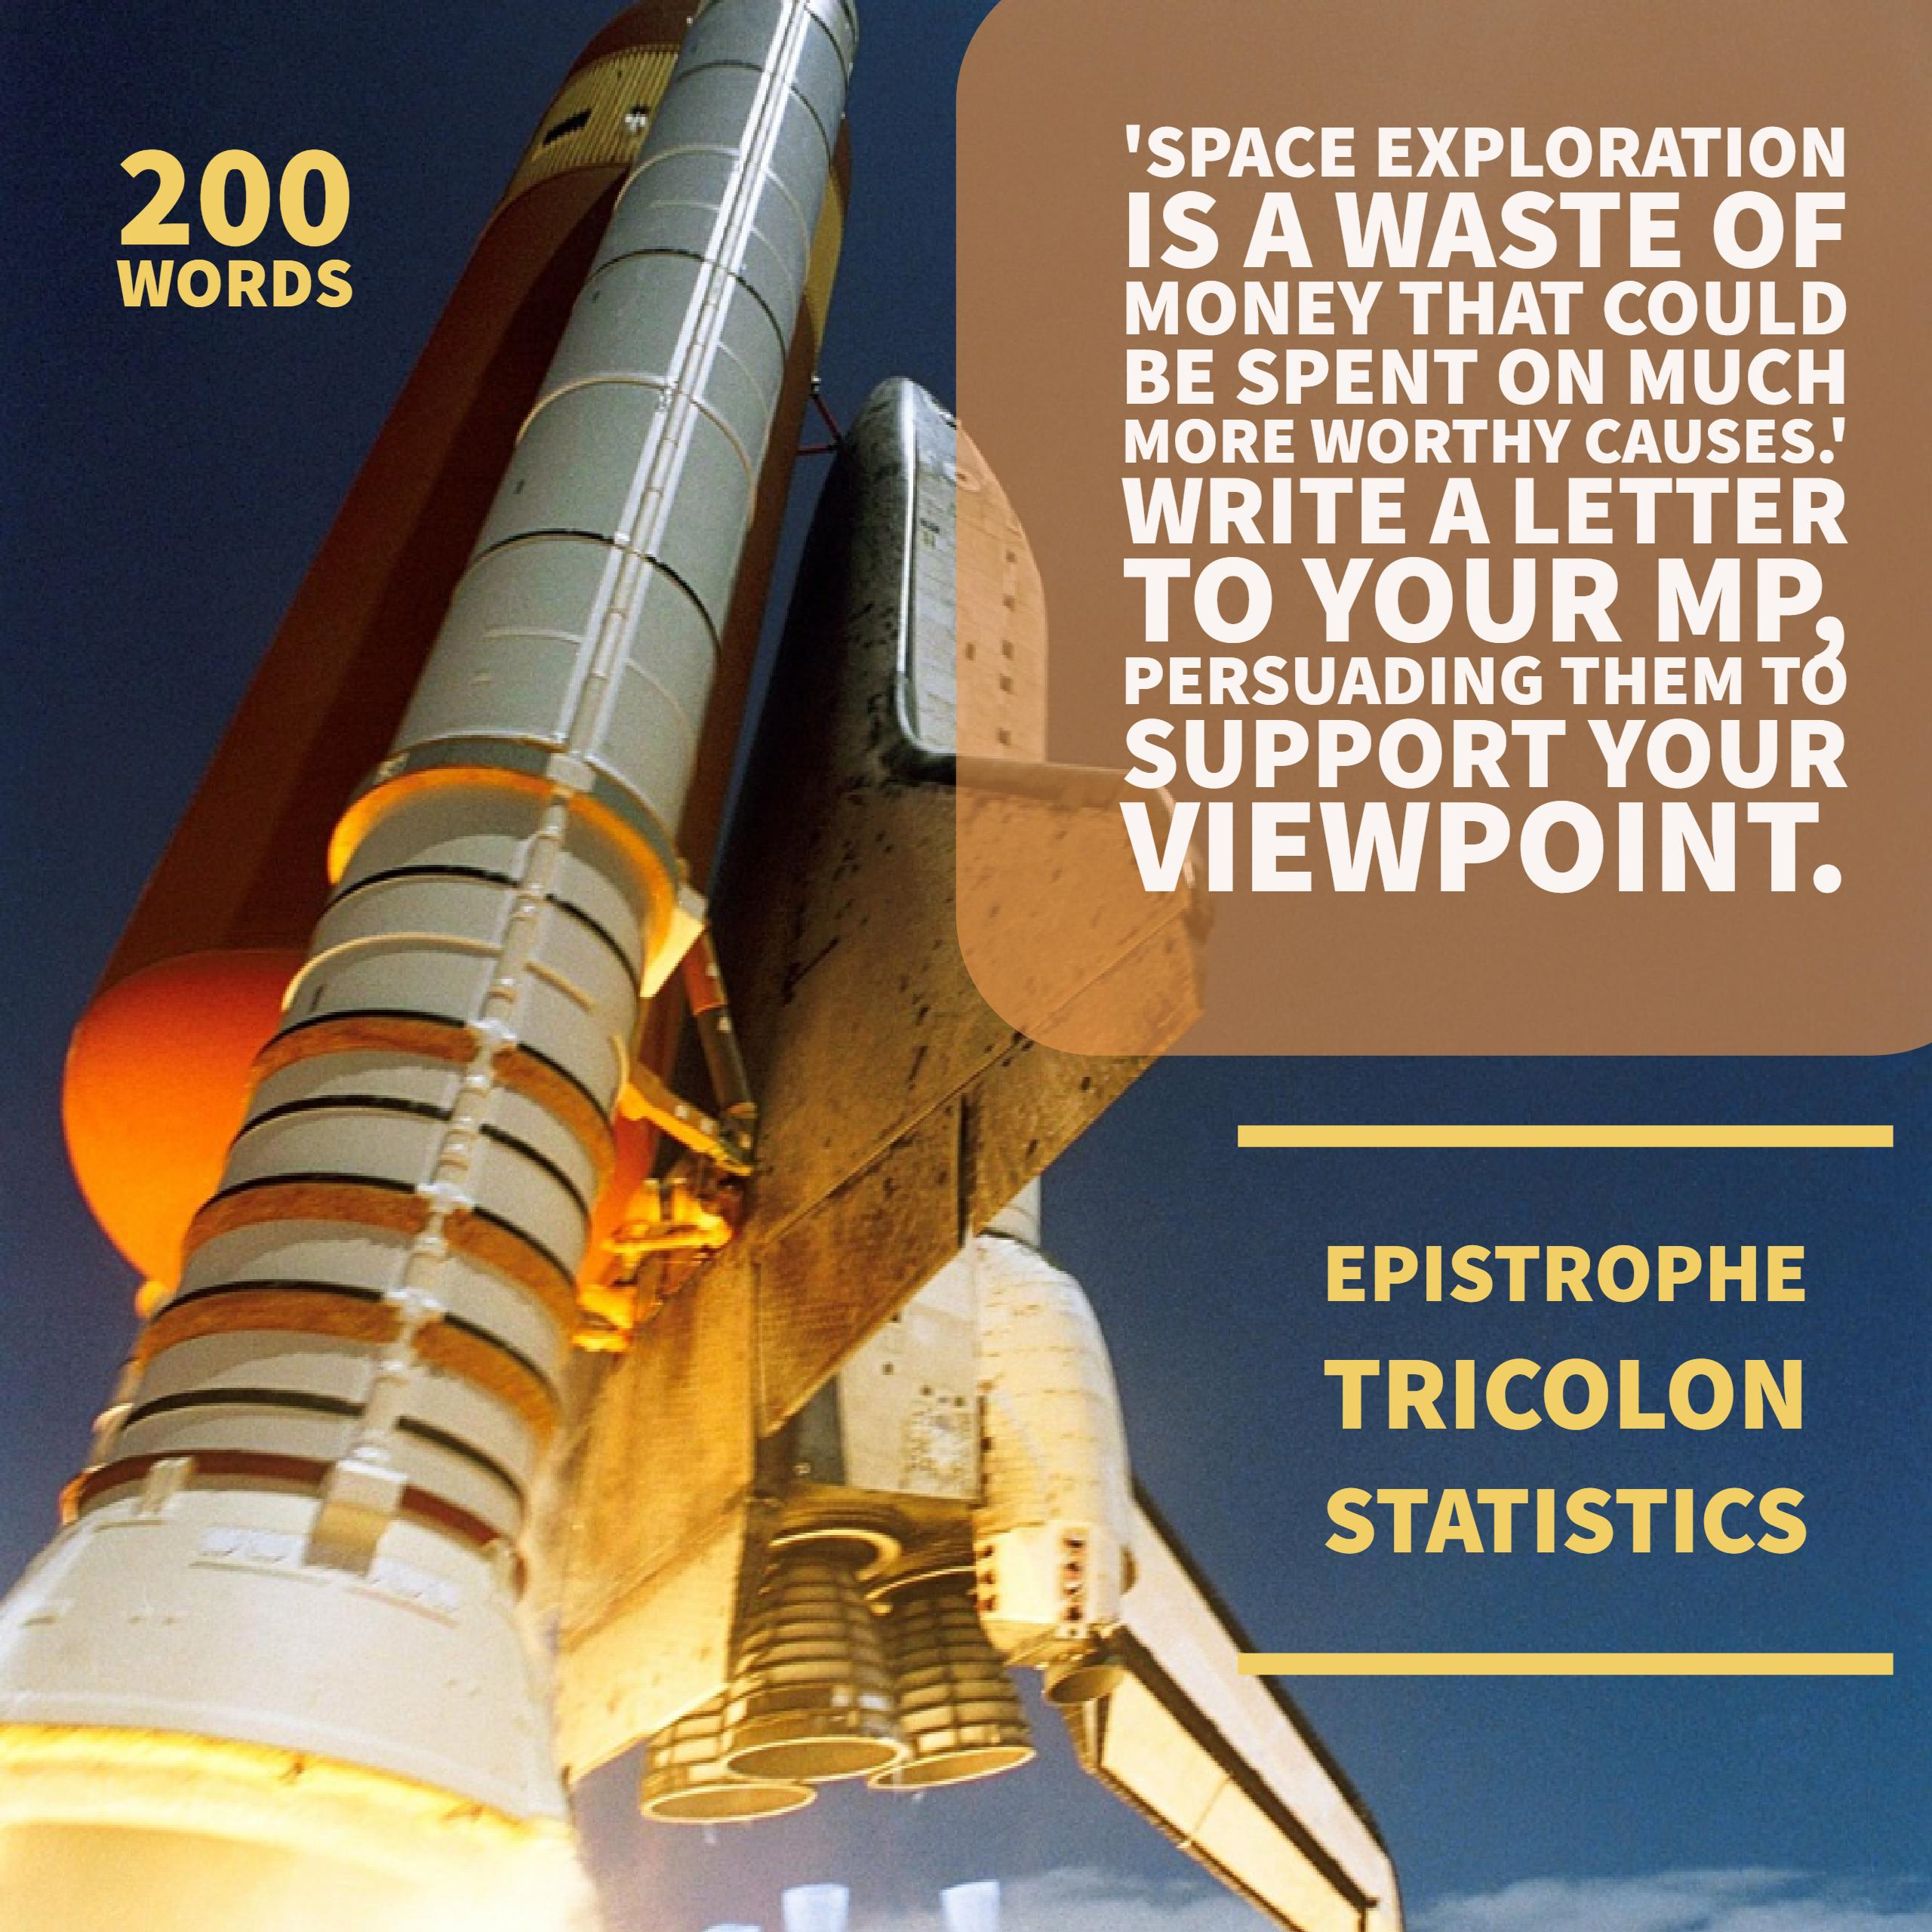
Friday writing challenge

