Slide 1
“Do Now”
SA
1. What is the function of the mitochondria and where can they be found?
Where in the body would you find the thyroid glands?:
the neck
in the brain.
just above the kidneys
Which chemical is used to test for protein?
4. Which is a faster response : endocrine or nervous?
5. What is a section of chromosome called?
Respiration / in cells
Buiret
Nervous
A gene

Slide 2
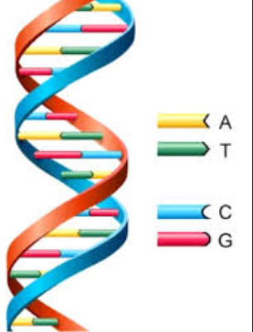
The Human Genome Project
Monday, 12 October 2020
Why is it important that we know about all the human genes?

Slide 3
The big picture: “How has the Human Genome Project impacted on human life?”
Learning outcomes
Explain the aims of the human genome project.
Analyse how the outcomes of the human genome project have been used to develop new drugs.
Evaluate the ethical implications of the human genome project.

Slide 4
Genome
All the DNA of an organism.
It includes all the genes that carry all the genetic information to making all the proteins required by the organism

Slide 5
The Human Genome Project
Started in 1986 (USA and UK) but officially ‘started’ in 1990, Europe and Japan joined in 1992
Completed in 2003 – under budget and 2 years early
The sequence is not that of one person, but is a composite derived from several individuals. Therefore, it is a "representative" or generic sequence. To ensure anonymity of the DNA donors, more blood samples (nearly 100) were collected from volunteers than were used, and no names were attached to the samples that were analysed. Thus, not even the donors knew whether their samples were actually used.
Also sequenced yeast and animals used in medical research e.g. zebra fish and rats.

Slide 6
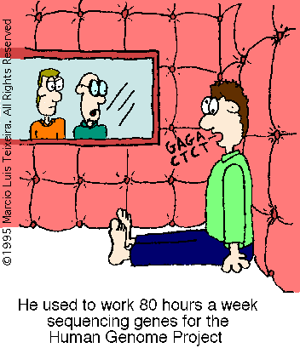
What were the aims of the human genome project?
To identify all the approximately 20,000-25,000 genes in human DNA.
To find where each gene is located
To determine the sequences of the 3 billion chemical base pairs that make up human DNA.
Store this information in databases.
Estimated time 15 years. (started in 1980)
Estimated cost US$3 billion

Slide 7
Exam question:
Explain the aims of the human genome (4 marks)
Extra challenge: Why do you think scientists also sequenced the genomes of animals used for medical research?
LO: Explain the aims of the human genome project.

Slide 8
Self-assessment: Model answer
To identify all the genes in the human genome.
To find the location of all the genes.
To determine the sequences of the base pairs that make up the human DNA.
To find the functions of different genes.
To publish the results on a public database.

Slide 9
Outcomes of the HGP
Using page 137-138 and the human genome website:
http://www.genome.gov/25019879
Fill in your table about the outcomes of the human genome project
LO: Analyse how the outcomes of the human genome project have been used to develop new drugs.

Slide 10
Outcomes of the HGP; Summary
Detailed information about the genome | 30 000 – 40 000 genes average human gene contains 3000 bases non-coding sequences (junk DNA) makes of 50% 1.4 millions locations of single nucleotide polymorphisms
Identification of new genes | breast cancer gene total colour blindness gene genes analysed for mutations causing disease
Identification of new drug targets | a molecule that a drug interacts with identification of genes allows identification of drug targets

Slide 11
Preventative medicine and improved drug treatment | variation in base sequences may account for why some people experience side effects from drug therapies identification of mutations associated with a particular disease allows patient to make lifestyle changes or adopt preventative drug therapy
Understanding basic biology | receptor proteins in the sense of taste post-production processing of proteins
Investigating evolution | repeat sequences replicate and insert themselves into the DNA modifying, reshuffling and creating new genes comparisons with the genome of other organisms establishes evolutionary pathways

Slide 12
Ethical issues
List the key ethical issues raised by the Human genome project.

Slide 13
Potential disadvantages or ethical objections posed by the HGP
People may be put under undue pressure to not have children or terminate pregnancies
Increases pressure for germ line therapy to prevent children inheriting genetic conditions
Embryo has no choice/say in the matter
May lead to discrimination with jobs
May lead to serious issues with insurance (life/medical/car etc.)
May lead to ‘designer babies’ with selection for specific fashionable/on a whim characteristics

Slide 14
Potential disadvantages or ethical objections posed by the HGP
Knowing something might happen may cause psychological stress/ some may not want to know (easier to cope if you don’t know in advance?)
Human rights/personal freedom: intrusion, infringement of civil liberties; who decides who should have genetic tests? Who decides who has access to/should have potentially expensive treatment
Data protection issues: who has access to your genetic information?

Slide 15
Plenary
Past paper questions:
The HGP is making it possible to identify people who may be at risk of developing medical conditions such as heart disease, cancer or diabetes. Reasons why identifying people at risk might be of benefit to the people who are tested. (2 marks)
2) Suggest two reasons why carriers of breast cancer genes should not face discrimination when applying for jobs or insurance. (2 marks

Slide 16
Check your answers
1) To warn people at risk to make life style changes, e.g. quit smoking, eat less saturated fat, do more exercise
Gives people a more informed choice in how to plan their lives
To plan medical provision/monitoring for the individual
To target drug treatment to delay onset/reduce symptoms
To determine healthcare priorities
2) It is not their fault that they have the gene
Most of us would prefer a society where such economic risks were spread across all of us
Such discrimination would reduce the encumber o people going for testing, which could be fatal for them
Having the gene does not mean you will necessarily develop the disease.

Slide 17
Resources

Slide 18
Outcomes | Explanation
Detailed information about the genome
Identification of new genes
Identification of new drug targets
Preventative medicine and improved drug treatment
Understanding basic biology
Investigating evolution

